Slide 1
ALBINISM
Brandon Hall
1st & 2nd
AP Biology

Slide 2
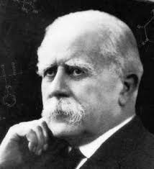
INTRO:
First Discovered in 1908 by Sir Archibald Garrod.
Albinism doesn’t affect one population more than another and is gender neutral.
It is a fairly rare disease and occurs 1 in every 17,000 people.

Slide 3
DESCRIPTION:
Albinism occurs because of a process called hypopigmentation.
The TYR gene provides instructions for making an enzyme called tyrosinase. This enzyme is located in melanocytes, which are specialized cells that produce a pigment called melanin.
There are two types of Albinism:
Oculocutaneous Albinism (OCA)
Ocular Albinism

Slide 4
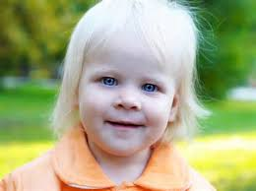
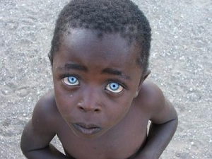
DESCRIPTION:
Some signs that show that somebody has albinism are:
Visual: astigmatism, blurred vision, or sensitivity to light
Eyes: lazy eye, underdeveloped optic nerve, or rapid involuntary movement
Skin: loss of color or freckles

Slide 5
PROGNOSIS:
Albinism does not usually affect a person’s lifespan. It can make it harder to enjoy activities in the sun because of the eye’s and skin’s hypersensitivity towards the UV rays of sunlight.

Slide 6
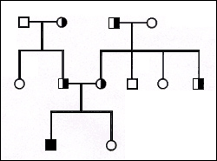
INHERITANCE:
Both parents need to carry the gene for albinism.
They don’t have to show it, but they do have to be carriers.
When both parents carry the gene, neither of them have albinism, there is a 1 in 4 chance at each pregnancy that the baby will be born with albinism.
This is called Autosomal Recessive Inheritance.

Slide 7
TREATMENT:
No real treatment exists. BUT people who have albinism can wear sun protective clothing and wear sunscreen.
For people with albinism that affects their eyes, you can buy glasses or corrective contact lenses.
NO CURE EXISTS. You just use the following above methods to protect you skin.

Slide 8
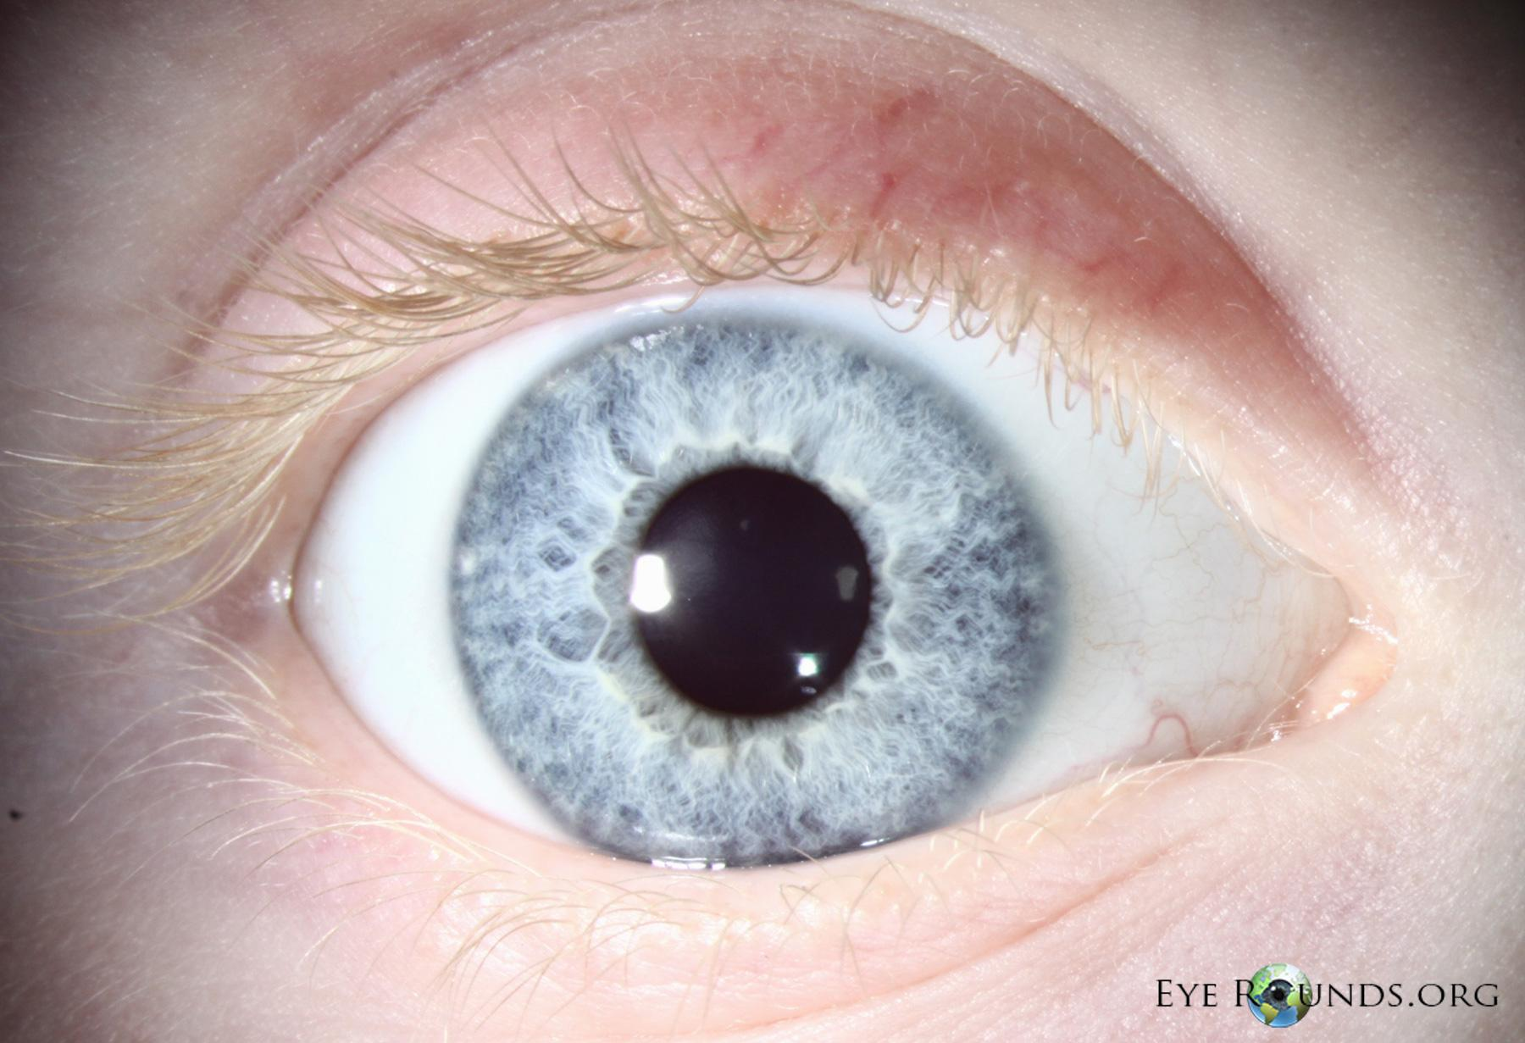
PREVENTION:
There aren’t really any prevention for albinism. The only thing you could do is not fall in love and have children with someone with albinism.

Slide 9
PREVENTION:
There aren’t really screening tests because there is nothing harmful to try to prevent. But there are diagnostic tests to help determine if you have albinism or not.
The diagnostic test includes:
A physical exam
Description of changes in pigmental ion.
Thorough exam of the eyes.
Comparison of pigment to that of other family members.

Slide 10
CITATIONS:
American Association for Pediatric Ophthalmology and Strabismus. (n.d.). Retrieved November 15, 2016, from https://www.aapos.org/terms/conditions/12
Albinism. (n.d.). Retrieved November 15, 2016, from http://umm.edu/health/medical/ency/articles/albinism
Albinism. (n.d.). Retrieved November 15, 2016, from http://www.mayoclinic.org/diseases-conditions/albinism/basics/tests-diagnosis/CON-20029935

