Slide 1
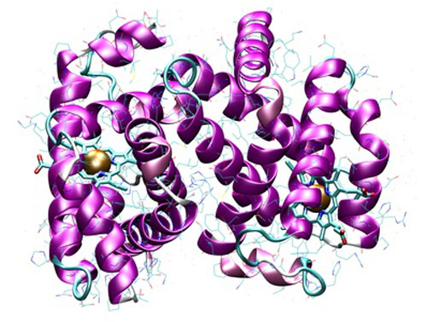
Amino Acids

Slide 2
What are they?
The building blocks of proteins
Amino acids are linked together to create a larger molecule

Slide 3
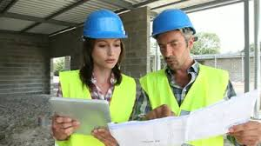
DNA helps make proteins
DNA code = the instructions for amino acid order
Amino acid order = protein structure

Slide 4
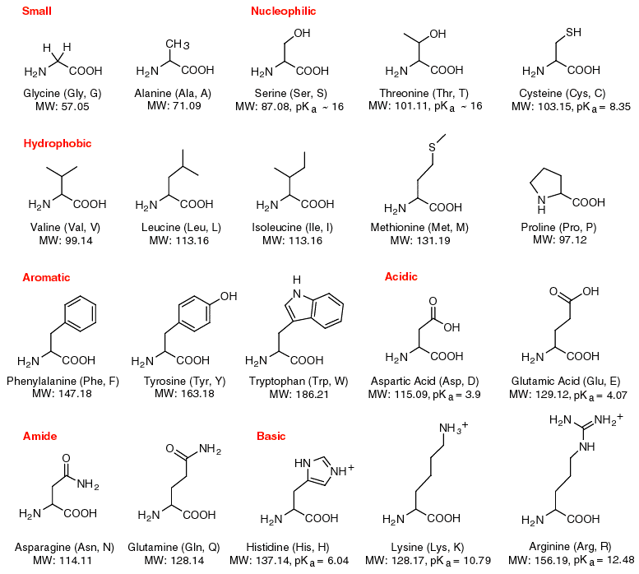
Different types of AA
There are 20 different amino acids (AA)
The human body has 100,000+ proteins!

Slide 5
Different types of AA
There are 20 different amino acids (AA)
The human body has 100,000+ proteins!
*It’s how AA are combined that make the different proteins

Slide 6
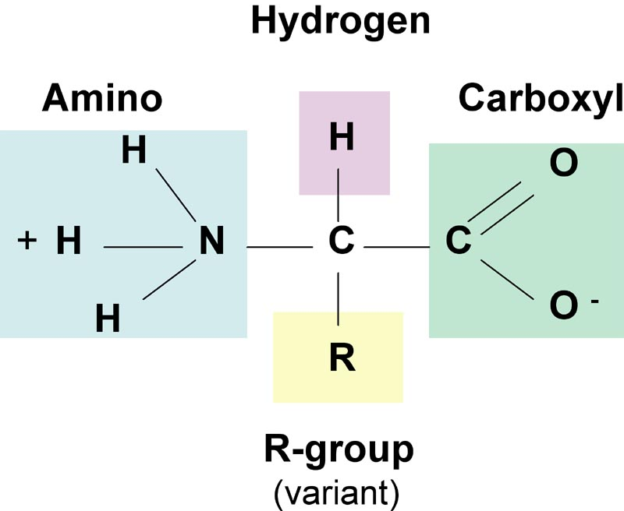
Amino acid structure
4 parts:
1 – Amino group

Slide 7
Amino acid structure
4 parts:
1 – Amino group
2 – Carboxyl group

Slide 8
Amino acid structure
4 parts:
1 – Amino group
2 – Carboxyl group
3 – Hydrogen

Slide 9
Amino acid structure
4 parts:
1 – Amino group
2 – Carboxyl group
3 – Hydrogen
4 – R group (unique to each amino acid)

Slide 10
Peptide Bonds
Amino acids are linked together by peptide bonds.

Slide 11
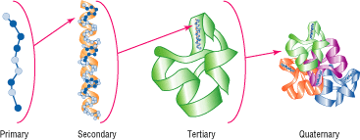
Protein structure
4 types of structure:
1 – Primary = the chain of AA

Slide 12
Protein structure
4 types of structure:
2 – Secondary = folding and twisting within the chain

Slide 13
Protein structure
4 types of structure:
3 – Tertiary = the overall folding of the modified chain

Slide 14
Protein structure
4 types of structure:
4 – Quaternary = multiple tertiary proteins combined to perform a larger function

Slide 15
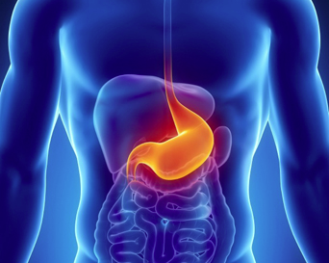
Types of proteins
Enzymes
Carry out chemical reactions (ex: digestion)

Slide 16
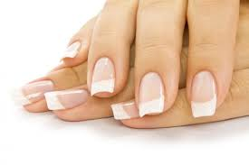
Types of proteins
Structural proteins
Hair, skin, nails

Slide 17
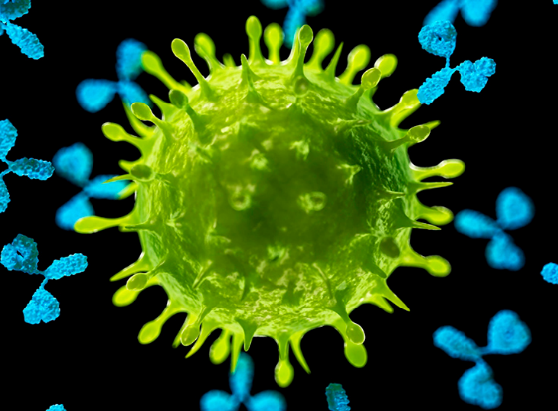
Types of proteins
Immune proteins
Recognize foreign invaders

Slide 18
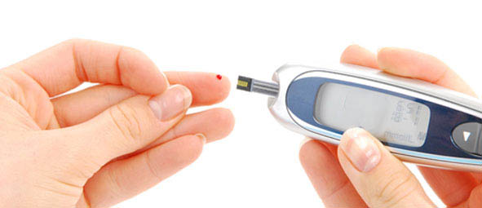
Types of proteins
Hormones
Signal bodily functions (ex: insulin)

Slide 19
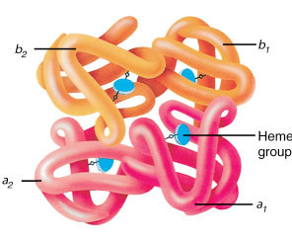
Hemoglobin
Not an enzyme.
Carries oxygen in red blood cells.

