Slide 1
ATOMS

Slide 2
What is an atom?
The smallest unit of matter.
A single atom is almost impossible to see with modern technology.

Slide 3
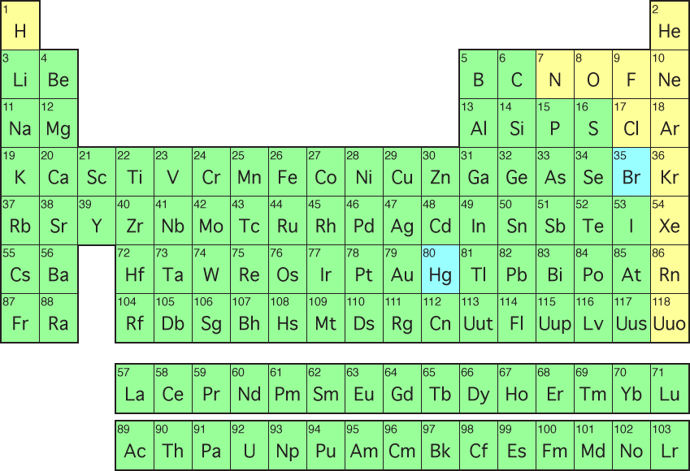
Types of atoms
…are called elements
Example: carbon, oxygen, hydrogen, helium, sodium → these are all elements (types of atoms)
Elements are organized on the Periodic Table of the Elements

Slide 4
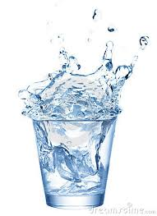
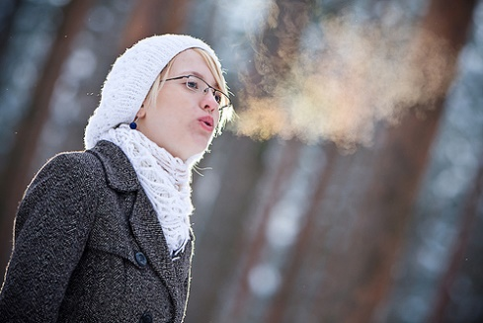
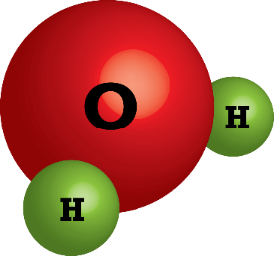
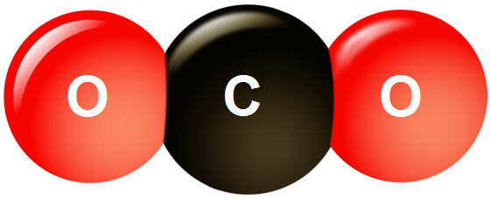
Molecules
If atoms are like words, then molecules are like sentences.
They are atoms bonded together
Different combinations of atoms gives you different molecules

