Slide 1
Companion PowerPoint slide set DNA Methylation & Cadmium Exposure in utero An Epigenetic Analysis Activity for Students
This teacher slide set was created by Dana Haine, MS, of the UNC Superfund Research Program, which is funded by the National Institute of Environmental Health Sciences (P42ES005948).

Slide 2
1) Changes to DNA Methylation leads to gene silencing
Target gene expressed in normal cell
e.g., tumor suppresor gene
Normal State
TF
Promoter
Target gene
expressed
Target gene inactivated by hypermethylation
Disease State arising from Epigenetic Modification
TF
X
Promoter
Target gene
not expressed
Notes:
DNA methylation at promoter regions can impede target gene expression
CpG sites are regions of DNA where a cytosine nucleotide occurs next to a guanine nucleotide in the linear sequence of bases along its length.
*"CpG" stands for cytosine and guanine separated by a phosphate (—C—phosphate—G—), which links the two nucleosides together in DNA.

Slide 3
2) Changes to DNA Methylation leads to gene activation
Target gene silenced by methylation
e.g., oncogene
Normal State
TF
X
Promoter
Target gene
not expressed
Target gene activated by hypomethylation
or demethylation
Disease State arising from Epigenetic Modification
TF
Promoter
Target gene
expressed
Notes:
DNA methylation at promoter regions can impede target gene expression
CpG sites are regions of DNA where a cytosine nucleotide occurs next to a guanine nucleotide in the linear sequence of bases along its length.
*"CpG" stands for cytosine and guanine separated by a phosphate (—C—phosphate—G—), which links the two nucleosides together in DNA.

Slide 4
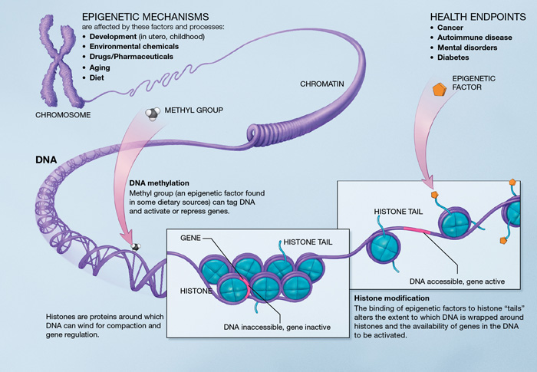
Notes:
http://commonfund.nih.gov/epigenomics/epigeneticmechanisms.aspx

Slide 5
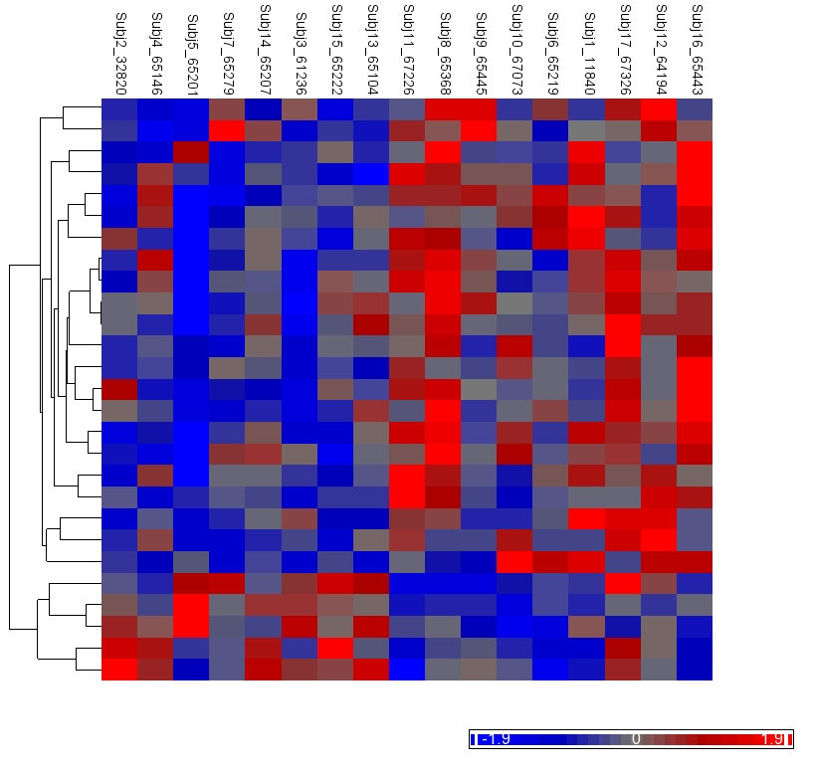
Cadmium Level:
Hypermethylation
Average
Hypomethylation
Cadmium Exposure Group:
Lower
Higher
(Fry, 2011)
Notes:
This heat map shows 27 differentially methylated genes (y axis) in 17 individuals (x axis).

Slide 6
Blood
Cadmium Level:
<0.08 µg/L
1.11 µg/L
Hypermethylation
Rows 6-27
Average
Hypomethylation
Rows 1-5
Cadmium Exposure Group:
Lower
Higher
(Fry, 2011. Unpublished)
Notes:
This heat map shows 27 differentially methylated genes (y axis) in 17 individuals (x axis).

Slide 7
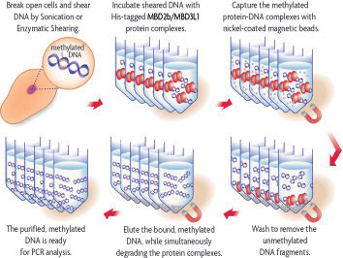
DNA from newborn cord blood was isolated then amplified using methylated CpG island recovery assay (MIRA).
http://www.activemotif.com/catalog/43/methylcollector-methylcollector-ultra.html
Notes:
To look at the marks of babies DNA, we applied a…
DNA from the newborns’ umbilical cord blood to isolate and amplify the methylated DNA using a MIRA
Essentially, what we’ve done is separated the methylated DNA and amplified it. Using microarray technology we can then identify the sites of methylated DNA at over 4.6 million sites throughout the genome.
We then compared the methylation status between exposure groups. And what we found was…

Slide 8
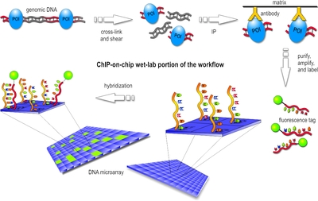
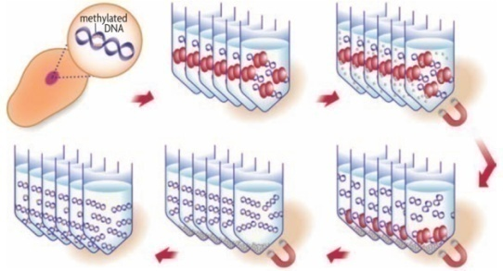
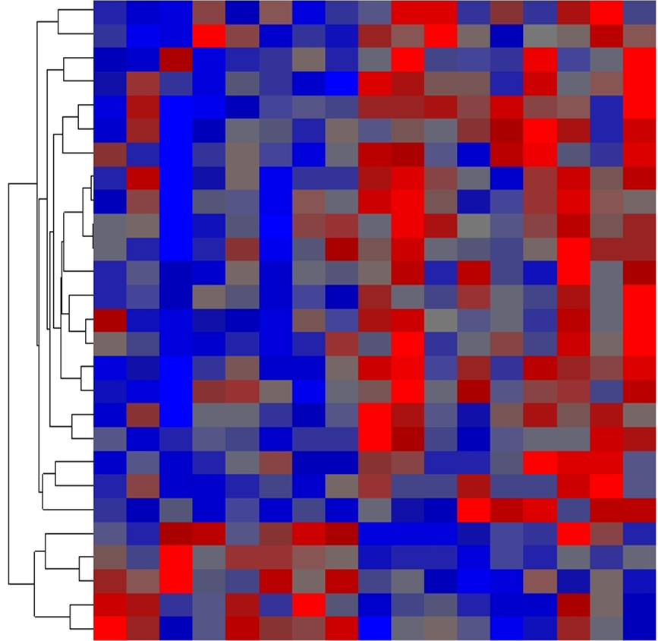
Microarray analysis was used to determine which genes exhibited differential methylation in response to Cadmium exposure
MIRA
Affymetrix Human Promoter 1.0R arrays which represent ~59 percent of known CpG islands (4.6 million sites; 14,362 CpG islands)
Heat map analysis
Adapted from http://www.bcm.edu/garp/?pmid=4660
Notes:
the heat map does not show fluorescence but rather uses shades of red or blue to depict the relative abundance of methylated sites

