Slide 1
Cell Membrane The Most Important Organelle
Brett McCraw
½ period
9/14/16

Slide 2
Major Processes
Surrounds ALL living cells
Boundary between living and non-living
Selective permeability- decides what goes in and out of cell
Controls how substances can move in and out of the cell, protecting the “integrity” of the cell
Strength and flexibility
Process of osmosis- the diffusion of water across a selectively permeable membrane to create balance

Slide 4
Interactions with other Organelles
The cell membrane protects the entire cell from unwanted substances inside and outside
The protein base is attached to the cytoskeleton and ECM which gives the cell a more distinct shape and stabilizes the location of proteins.
Membranes around the nucleus and other organelles are almost identical to the cell membrane

Slide 6
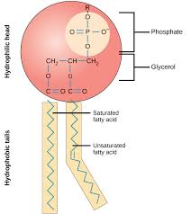
Relation of organelle structure to its functions
Main idea- selective permeability
Structure- Fluid Mosaic Structure
Phospholipids
Proteins
Carbs
Phospholipids- form the lipid bilayer. Polar phosphate heads and non polar fatty acid tails (amphipathetic)

Slide 7
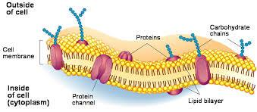
Carbohydrates
Exist on outer surface for cell recognition and protection
Create glycoproteins and glycolipids
Form a cell coat, glycocalyx, which is where cell recognition, protection, and antigens exist

Slide 8
Proteins
Hydrophilic amino acids on outside, hydrophobic amino acids on inside
Integral proteins- transprotein (all the way through membrane)
Peripheral protein- loosely bound to outside surface
Transport proteins- hydrophilic channels that selectively transport substances across the membrane passively(no energy) or actively(ATP). Some change shape or move side to side.
Outer surface proteins have specific binding sites

Slide 9
Role of Proteins
Transportation
Enzymatic Activity
Signal Transduction- the binding site relays with a chemical messenger. Protein is conformed and relays message to the cell.
Cell to cell recognition- “identification tags”
Intercellular joining- hook to certain cells in certain junctions

Slide 12
End Product
Cells are healthy due to the movement of needed substances in and out of the membrane
Messages are relayed to allow the cell to continue to function
Cell strength and flexibility is maintained
Homeostasis- balance in the cell

Slide 13
Citations
Cellmembrane. (2004, June 18). Retrieved September 19, 2016, from biologymad.com, http://www.biologymad.com/cells/cellmembrane.htm
Bailey, R. (2016, April 25). Cell membrane. Retrieved September 19, 2016, from Education, http://biology.about.com/od/cellanatomy/ss/cell-membrane.htm
Campbell, N. A., & Reece, J. B. (2004). Biology AP edition (7th ed.). San Francisco: Pearson, Benjamin Cummings.

