Slide 1
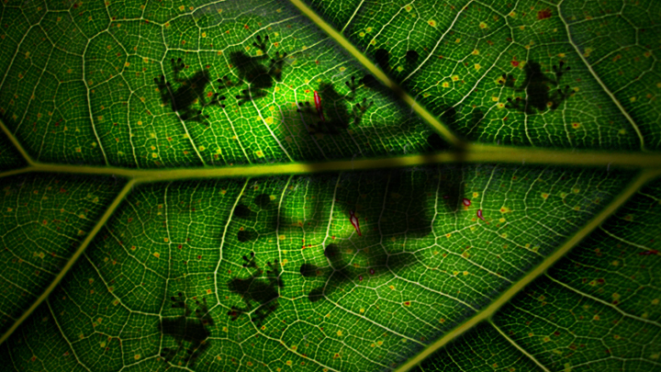
CHARACTERISTICS OF LIVING THINGS

Slide 2
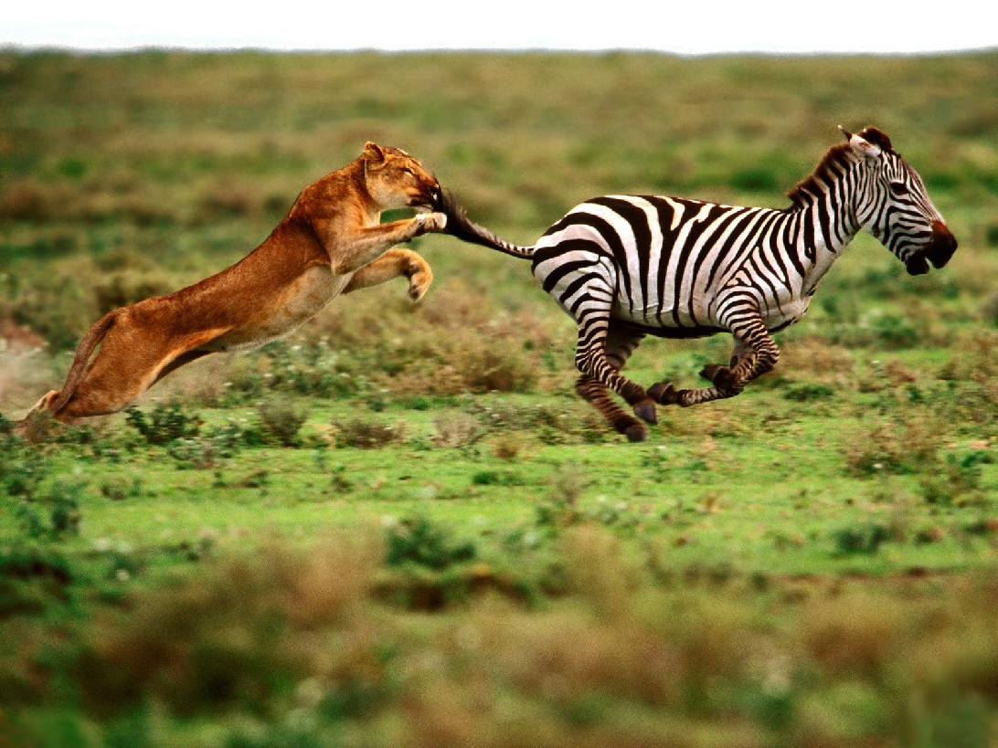
1. All living things MOVE
Can be internally or at the cell level

Slide 3
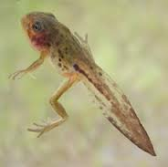
2. All living things GROW
And DEVELOP!

Slide 4
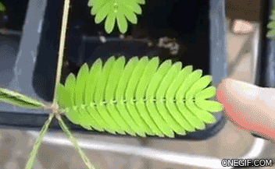
3. All living things RESPOND to their ENVIRONMENT
http://i1146.photobucket.com/albums/o528/arcki1/Mimosa-pudica-una-planta-vergonzosa_zps3604cb7c.gif

Slide 5
4. All living things REPRODUCE

Slide 6
5. All living things USE ENERGY

Slide 7
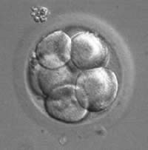
6. All living things are MADE OF CELLS

Slide 8
D.E.A.R.
D All living things have DNA and cells.
E All living things use energy.
A All living things adapt or respond to their environment.
R All living things grow and reproduce.

