Slide 1
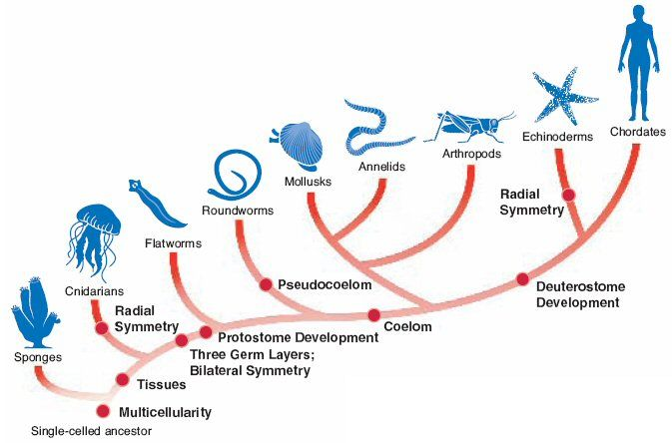
Classification & Cladograms

Slide 2
Review: The Six Kingdoms of Life
Eubacteria
Archaebacteria
Protista
Plantae
Fungi
Animalia

Slide 3
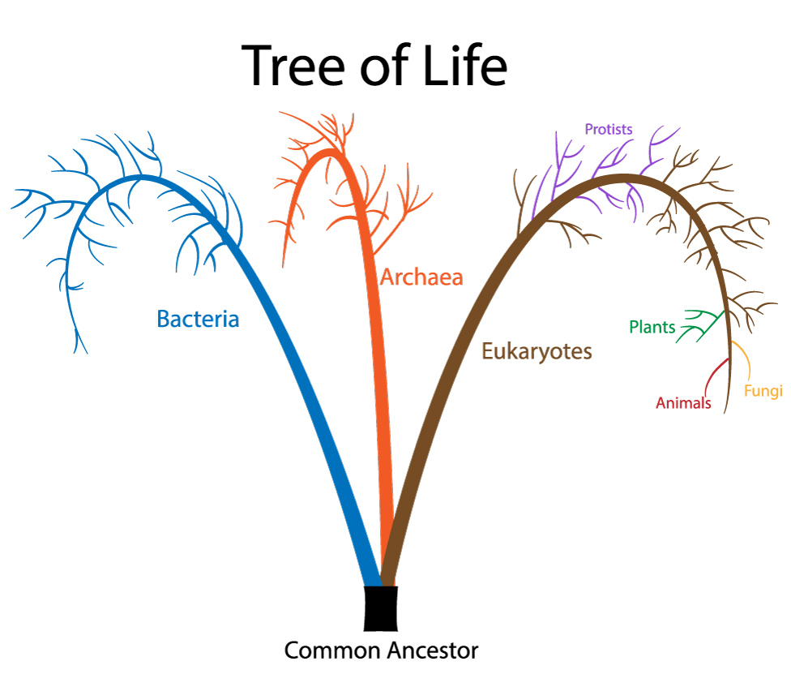
Domains
A recent addition to the classification system.
Organizes the kingdoms into larger groups.

Slide 4
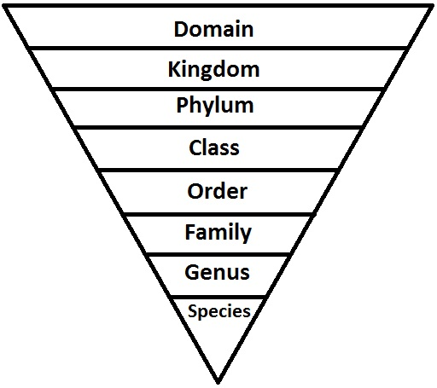
Taxonomic Classification
Further organizes domains and kingdoms by shared characteristics.

Slide 5
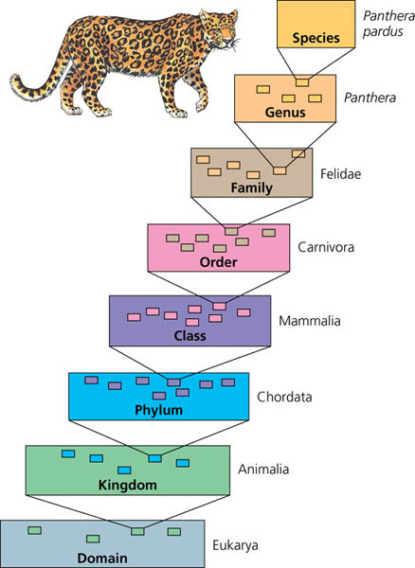

Slide 6
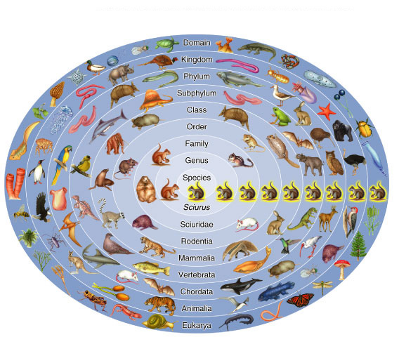
Eastern gray squirrel
Sciurus carolinensis

Slide 7
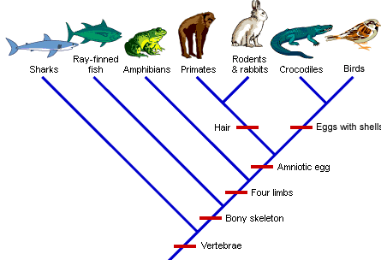
Cladogram
A “family tree” showing shared characteristics between groups of organisms.

Slide 9
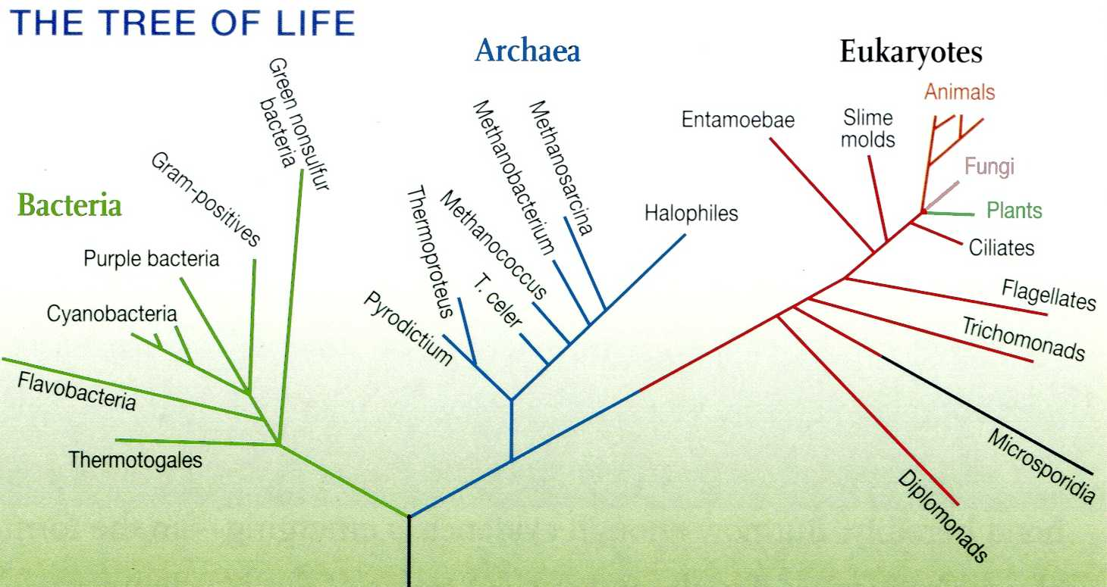
Phylogenetic Tree

Slide 10
Phylogenetic Tree
AKA “cladogram”
Shows evolutionary relationships.

Slide 11
Phylogenetic Tree
This tree compares DNA sequences.
The larger the distance between branches the greater the number of differences between sequences.

Slide 12
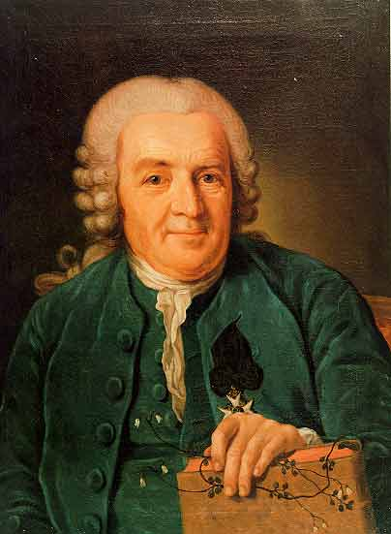
Binomial Nomenclature
Carolus Linnaeus – “Father of Taxonomy”
Swedish scientist who created naming system for classifying organisms
Organisms have two-part (binomial) scientific names
Genus species (Genus is capitalized, species lowercase, all italicized)
Ex: Homo sapiens, Canis lupus, Pan troglodytes

Slide 13
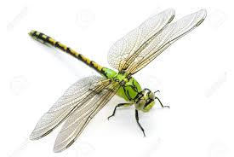
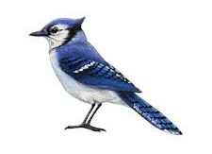
Binomial Nomenclature
Benefits: clearly identifies organisms
Common names can be misleading and confusing
Dragonfly (not a dragon), starfish (not a fish)
Different cultures/languages have different names for the same organism
EX: Blue jay, blue coat, corn thief

