Slide 1
Cytoskeleton
By: Cheyenne walden

Slide 2
What is the cytoskeleton?
Cyto- Cell
“Skeleton of the cell”
Found in the cytoplasm of EUKARYOTIC cells
Attached to the cell membrane

Slide 3
Main functions:
Maintain cell shape- (ex: red blood cells and nerve cells)
Increases surfaces area which helps increase efficiency of oxygen into and out of the cell (Red Blood Cell)
Axons of the nerve cell (Nerve Cell)

Slide 4
Continued…
Cell Movement
Holds chloroplasts in place but is able to manipulate the cells when the sunlight is in a certain angle
Cell Division- chromosomes undergoing mitosis are held in place then separated to carryout cell division
Cytokinesis- membrane enfolds and pinches itself into two

Slide 5
Continued…
Holds organelles in place

Slide 6
Continued…
Strengthens cell
Structural support...speaking of structure…

Slide 7
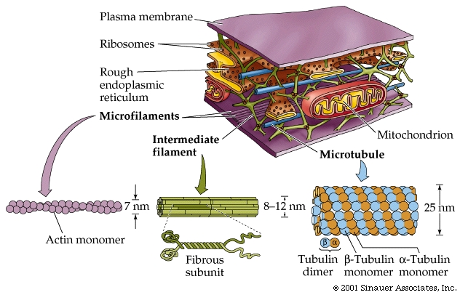
Structure
DYNAMIC- meaning changeable; it is able to increase and decrease
It is made up of subunits that can be rapidly removed or inserted.

Slide 8
Continued:
Microtubules: made of a protein called tubulin
Involved in cell movement; make up flagella and cilia
Microfilaments: made of protein subunits called actin
Involved in the cytoplasmic streaming, chloroplast orientation, cytokinesis, phagocytosis and muscle contraction
Intermediate Filaments: made of strong fibrous protein
Strengthen cells that are more objected to wear and tear (ex: skin cells);

Slide 9
QUICK RECAP OF MAIN FUNCTIONS…

Slide 11
Sources:
Learn.Genetics. (2015). Retrieved September 18, 2016, from http://learn.genetics.Utah.edu/
University of Utah
J. (2015). What is the Cytoskeleton? Retrieved September 18, 2016, from https://www.youtube.com/watch?v=vlbXO3Va5A0
Bachelor of Science (B.Sc.), Genetics
By Deborah Fields, BSc (Hons), PgDip, MCIPR. (2016, June 01). What is a Cytoskeleton? Retrieved September 18, 2016, from http://www.news-medical.net/life-sciences/What-is-a-Cytoskeleton.aspx
Bachelor of Science (B.Sc.), MCIPR

