Slide 1
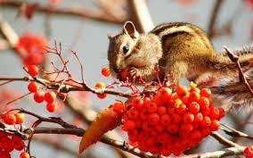
Bell Ringer
What are the different types of energy you see in this photo?

Slide 2
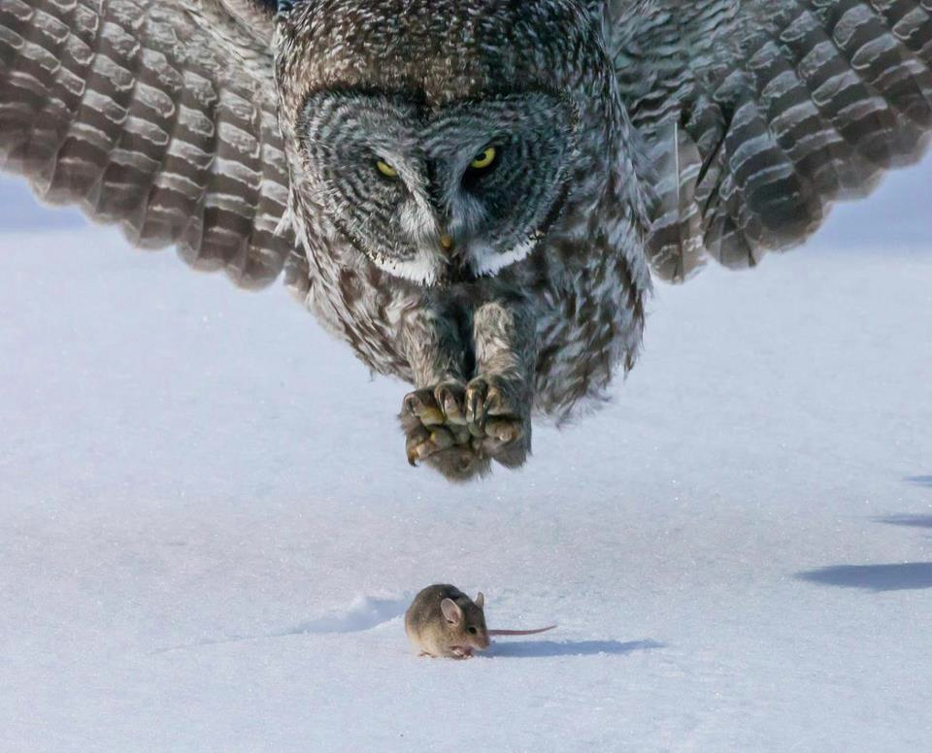
Ecosystem energy Part 2

Slide 3
Review
Where does the energy to keep these organisms alive come from?

Slide 4
Review

Slide 5
Review

Slide 6
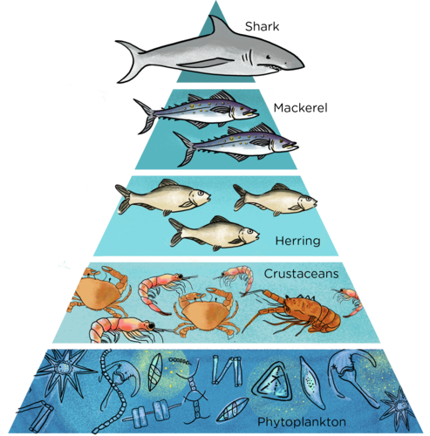
Energy pyramids
They emphasize the amount of each level needed to maintain the level above it.

Slide 7
How much phytoplankton is needed to keep a few sharks alive?

Slide 8
A LOT!

Slide 9
Trophic Level Game!

Slide 10
Each level only receives 10% of the energy from the level below.
0.01%
0.1%
1%
10%
100%

Slide 11
Each level only receives 10% of the energy from the level below.
0.01%
HEAT
0.1%
HEAT
1%
HEAT
10%
HEAT
100%

Slide 12
Where do decomposers fit on this pyramid?

Slide 13
Decomposers (bacteria)
Energy Loss (Heat)
Nutrients

Slide 14
Conservation of Matter & Energy
Matter can neither be created nor destroyed.
Energy can neither be created nor destroyed.
Circle of life! Everything is recycled.

