Slide 1
Enzymes

Slide 2
What are they?
Proteins which help chemical reactions in the body to happen faster.
Digestion

Slide 3
What are they?
Proteins which help chemical reactions in the body to happen faster.
Enzymes act as catalysts.

Slide 4
Catalysts
Enzymes lower the activation energy of a chemical reaction.
Activation energy = energy required for a chemical reaction to take place.

Slide 5
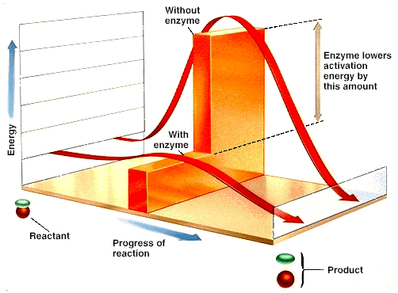

Slide 6
Enzyme Details
They are proteins that help chemical reactions to take place.
They are specific for each reaction.
They are reusable.

Slide 7
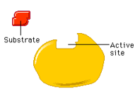
Parts of enzymatic reactions
Substrate = the particle that binds to the enzyme before the reaction.

Slide 8
Parts of enzymatic reactions
Active site = the location on the enzyme where substrates bind during the reaction.

Slide 9
Parts of enzymatic reactions
Enzyme-substrate complex = the compound formed when the enzyme and substrate temporarily bind together.

Slide 10
Parts of enzymatic reactions
Product = the particle(s) that results from the reaction.

Slide 12
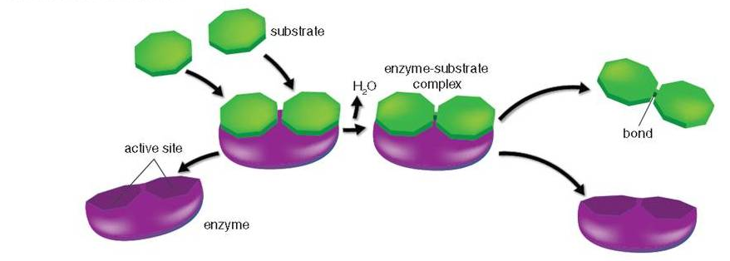
Types of reactions
Enzymes can bond substrates together OR break a substrate apart.

Slide 13
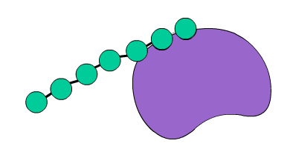
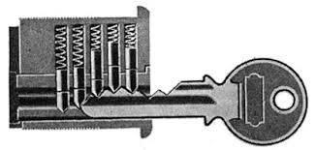
Enzyme specificity
Old model called “lock and key”

Slide 14
Enzyme specificity
New model called “induced fit”

Slide 15
http://www.kscience.co.uk/animations/anim_2.htm

