Slide 1
Evidences for Evolution

Slide 2
Review: What is evolution?
The change in the inherited
characteristics of biological
populations over time.

Slide 3
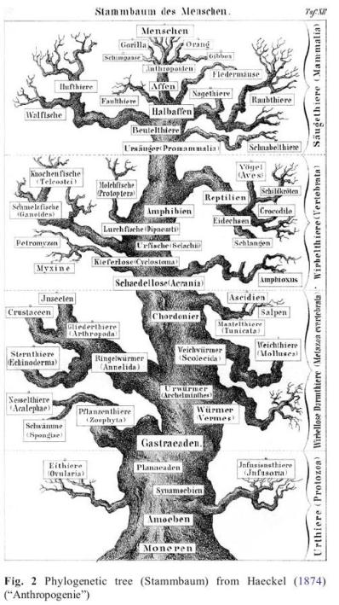
ReVIEW: Tree thinking
Darwin uses trees
as a metaphor for
pattern of evolution.
Hierarchical
Growing
Expansion/die-offs
Single common ancestor (trunk)

Slide 4
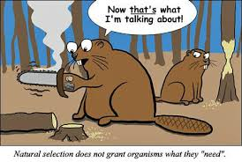
REVIEW: Natural Selection
The most reproductively successful individuals pass their traits to the next generation.

Slide 5
Review: Natural Selection

Slide 6
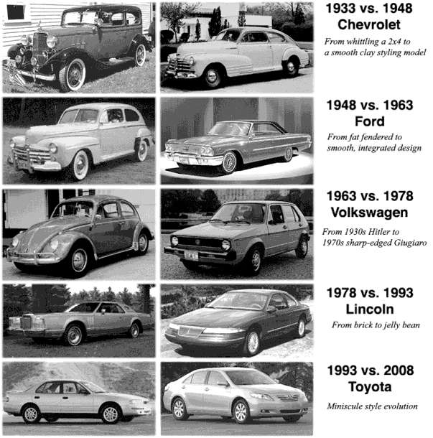
Evolution elsewhere
Automotive evolution

Slide 7
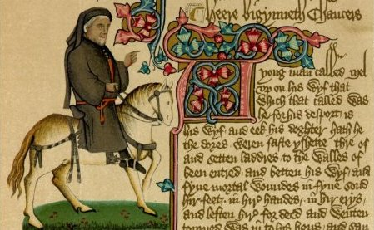
Evolution elsewhere
Linguistic evolution
Whan that Aprill with his shoures soote
The droughte of March hath perced to the roote
Chaucer, Canterbury Tales, Prologue ~1387

Slide 8
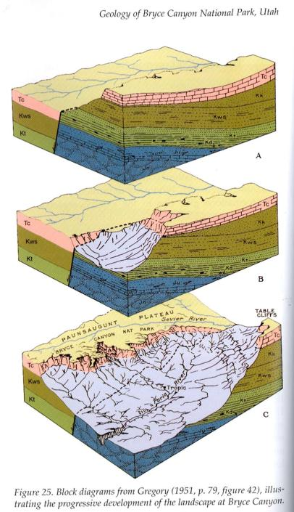
Evolution elsewhere
Geologic evolution

Slide 9
Evidence #1: the fossil record

Slide 10
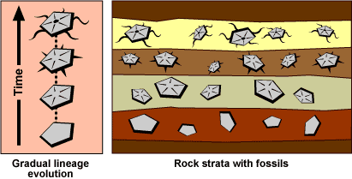
1
2
3
4
What is the evolutionary progression of these fossils? Number from oldest to youngest. Explain your reasoning!

Slide 11
1
2
3
4
Fossil record provides snapshots of the past that can be assembled to illustrate a pattern of evolutionary change over the last 4 billion years.

Slide 12
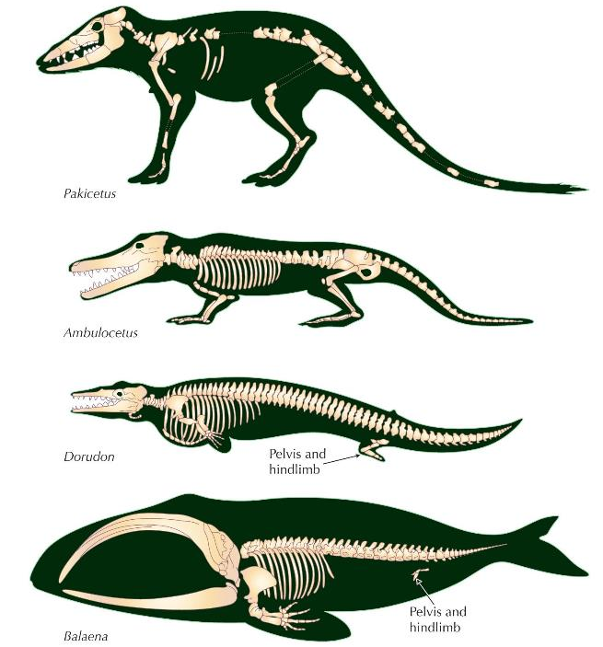

Slide 13
Evidence #2: DNA Sequences

Slide 14
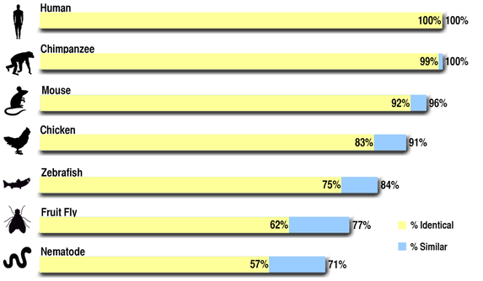
Let’s compare DNA sequences

Slide 15
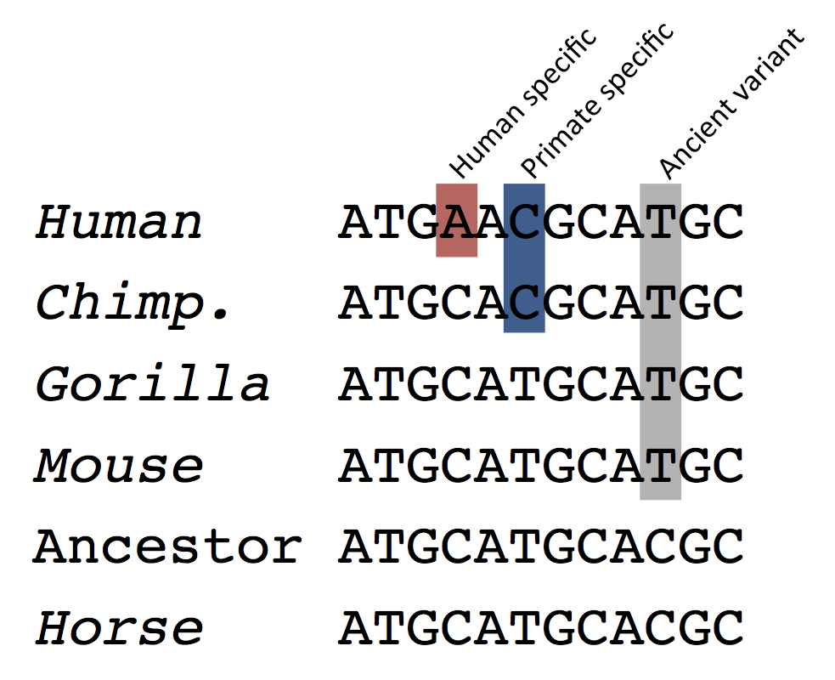
Let’s compare DNA sequences

Slide 16
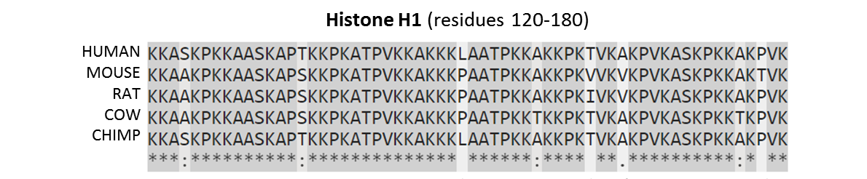
We can also compare protein sequences
These genes and proteins are conserved over time.
This supports descent from a common ancestor whose original DNA sequence has been slightly changed through mutation over long periods of time.

Slide 17
Evidence #3: chromosomal recombination

Slide 18
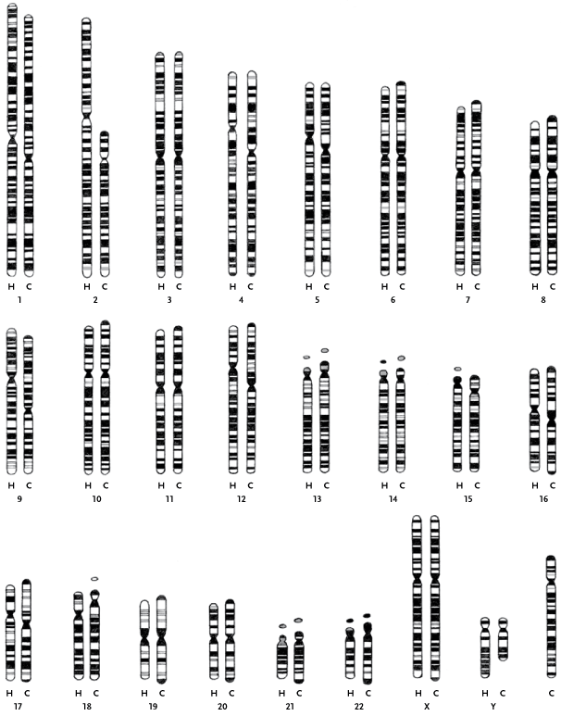
http://www.pbs.org/wgbh/nova/education/evolution/human-chromosome-2.html
Humans and chimps are 99% similar genetically. But humans have 23 pairs of chromosomes and chimpanzees have 24 pairs. How can our chromosome pairs be different when we share almost all the same genes?
#24

Slide 20
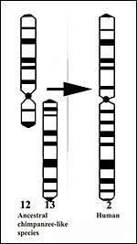

Slide 21
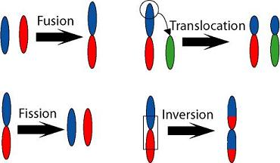

Slide 22
Evidence #4: Embryology

Slide 23
?
?
?
?
?

Slide 24
1
2
3
4
5
What features make these embryos look so similar? Can you identify their species? chicken, fish, human, rabbit, salamander

Slide 26
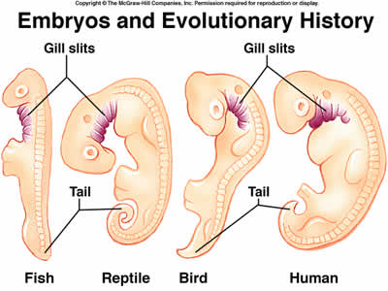

Slide 27
Evidence #5: Homologous structures

Slide 28
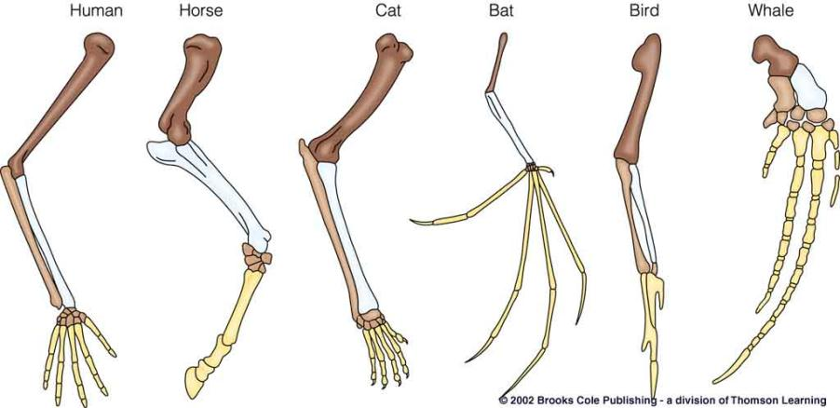
The shading in these drawings indicates what significant fact about vertebrate forearms despite their extreme differences in function and appearance?

Slide 29
ALL VERTEBRATE LIMBS ARE ASSEMBLED THIS WAY REGARDLESS OF THEIR USE!

Slide 30
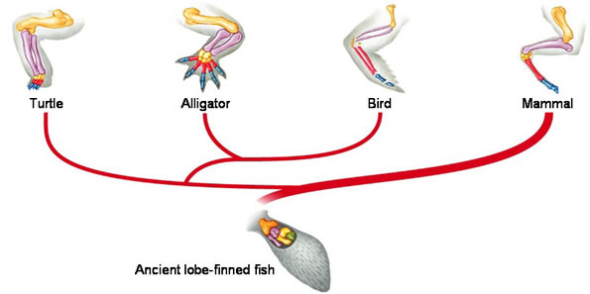
Provides evidence for descent from a common ancestor

Slide 31
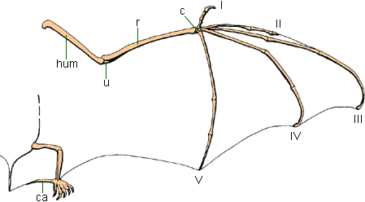
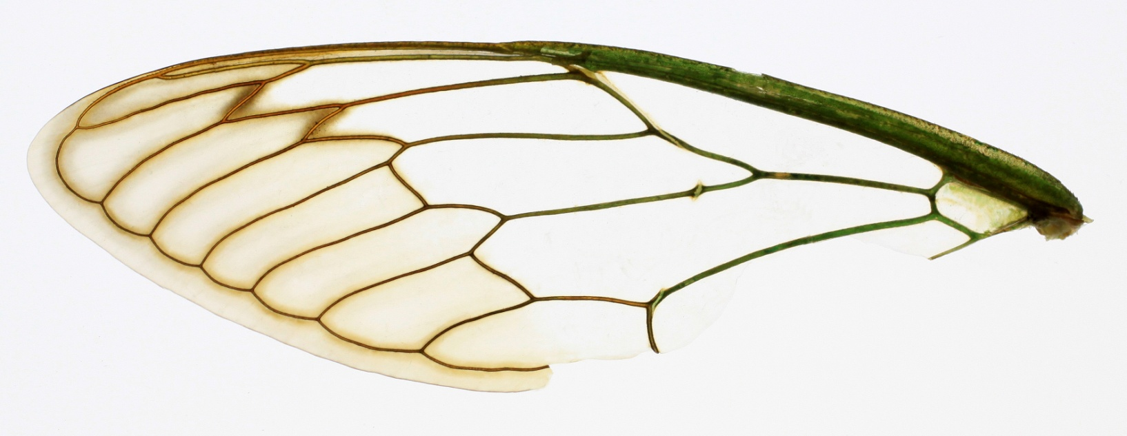
Analogous structures
Bat wings have bones, insect wings do not
Evolved separately and not evidence of a common ancestor

Slide 32
Evidence #6: Vestigial structures

Slide 33
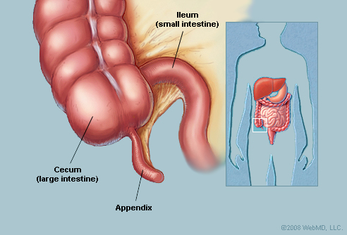
Humans can have their appendix removed and still live a normal life. Where does the appendix come from if it’s non-essential?

Slide 34
Vestigial structures – SciShow on Youtube

Slide 35
Quick Recap
Geologic/fossil records
DNA sequences
Chromosomal data
Embryology
Homologous and
Vestigial structures

Slide 36
Questions?

