Slide 1
GENETIC DISORDERS

Slide 2
What are they?
A condition or disease that is passed from parent to offspring through mutations in alleles
OR caused by the improper separating of sister chromatids in meiosis
NON-DISJUNCTION

Slide 3
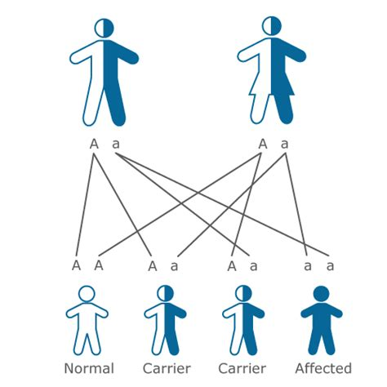
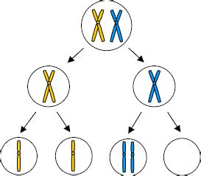

Slide 4
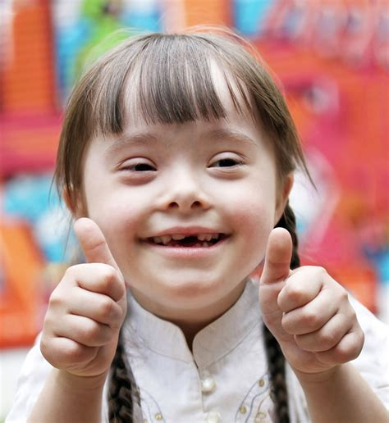
DOWN SYNDROME
Three copies of chromosome 21
“Trisomy 21”

Slide 5
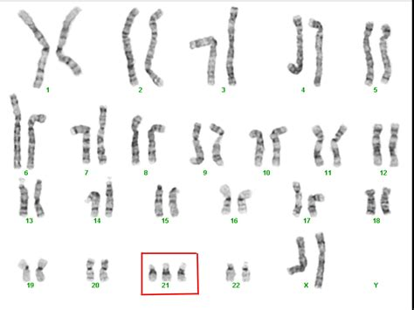

Slide 6
KLINEFELTER’S SYNDROME
Males with two X chromosomes
XXY

Slide 7
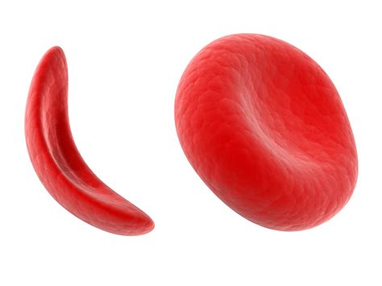
SICKLE CELL ANEMIA
Autosomal recessive disease
Hemoglobin mutation results in misshapen RBCs

Slide 8
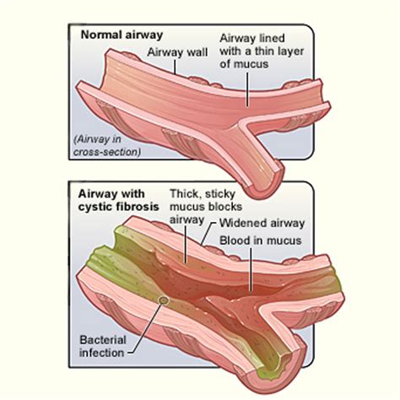
CYSTIC FIBROSIS
Autosomal recessive disease
Ion transport protein mutation results in mucus buildup in lungs

Slide 9
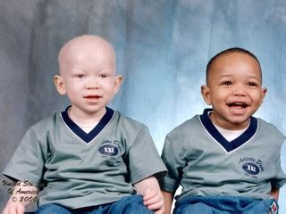
ALBINISM
Autosomal recessive disease
Mutation affects pigment production and eye development

Slide 10
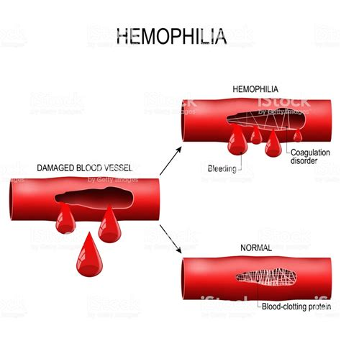
HEMOPHILIA
X-linked recessive disease
Mutation prevents blood clotting

Slide 11
COLOR BLINDNESS
X-linked recessive condition
Mutation prevents ability to perceive certain wavelengths of light

Slide 12
DUCHENNE MUSCULAR DYSTROPHY
X-linked recessive condition
Mutation prevents proper muscle development

Slide 13
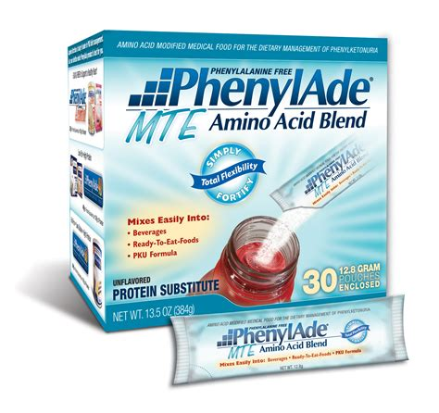
PHENYLKETONURIA (PKU)
Autosomal recessive disease
Cannot metabolize amino acid phenylalanine
Strict diet prevents disease expression

Slide 14
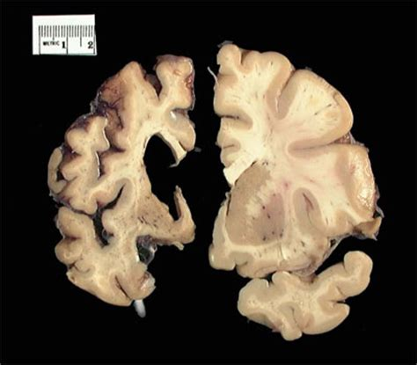
HUNTINGTON’S DISEASE
Autosomal dominant disease
Affects the nervous system
Disease not expressed until middle age

