Slide 1
The Golgi Apparatus
Brandon Hall
1st Period
AP Biology

Slide 2
Functions:
Modifies, sorts, and packages proteins for secretion.
Transports lipids around the cell.
Creates Lysosomes
All the functions that the Golgi Apparatus is responsible for can be compared to the jobs of a post office.

Slide 3
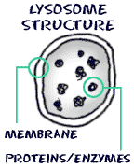
Creation of Lysosomes
Part of the Golgi Body’s job is to create Lysosome.
Lysosomes are enzymatic and break down the cell’s waste.

Slide 4
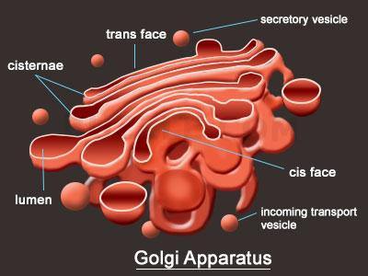
Structure & Appearance
Made up of many folds and sacs called Cisternae.
Cisternae usually range from 5 to 8 per Golgi Apparatus.
Typically are larger organelles.

Slide 5
Relationship with Endoplasmic Reticulum (ER)
When the ER makes a protein, a transition vesicle is also made.
Then the vesicle drifts over into the Golgi Body
The protein is then tagged or given its specific job.*
The protein is secreted to carry out its task or to leave the cell entirely.
*The process in step number three is called PROTEIN TAGGING.

Slide 6
Bibliography
Google Images. (n.d.). Retrieved September 18, 2016, from https://www.google.com/imgres?imgurl=https://i.ytimg.com/vi/87z89L3xVbA/hqdefault.jpg
Function Of Golgi Apparatus." The Function Of Golgi Apparatus. N.p., n.d. Web. 18 Sept. 2016.

