Slide 1
History of Early Earth

Slide 2
Earth’s Age
The earth is 4.6 billion years old!
Scientists and theologians thought the earth was very young.
We know the earth’s age by performing radiometric dating on the oldest parts of the planet we can find.

Slide 3
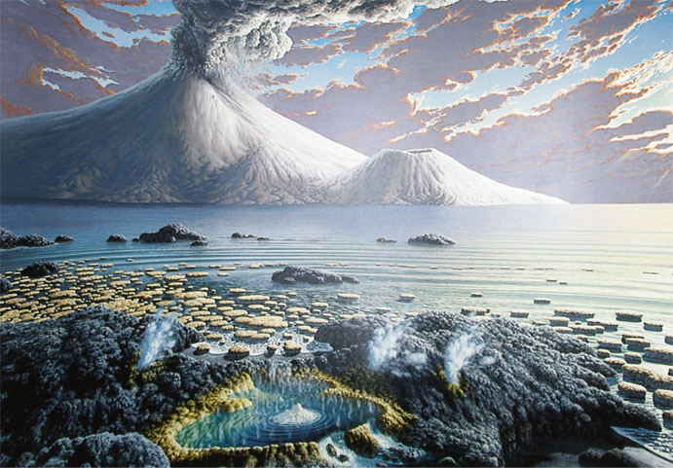
Early Earth’s Atmosphere
It is hypothesized that the atmosphere contained water and chemicals from volcanic eruptions.

Slide 4
Early Earth’s Atmosphere
It is hypothesized that the atmosphere contained water and chemicals from volcanic eruptions.
Methane and ammonia (inorganic)
So how did organic molecules (amino acids, DNA) develop from inorganic compounds??

Slide 5
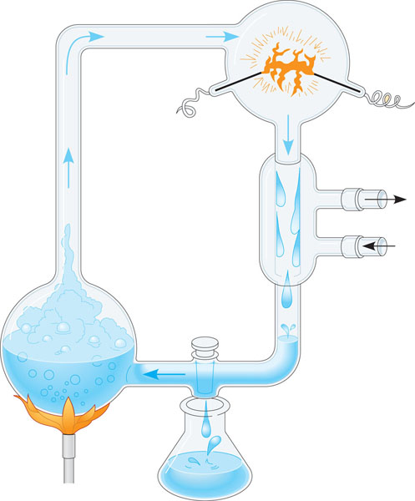
Miller-Urey Experiment
Simulated the conditions of early Earth.
Added energy in the form of electricity (lightning)
Water vapor
CH₄
Electrode
Made some organic compounds, but ideal conditions too unlikely.
NH₃
H₂
Condenser
Cold
water
Cooled water
containing
organic
molecules
H₂O
Sample for
chemical analysis

Slide 6
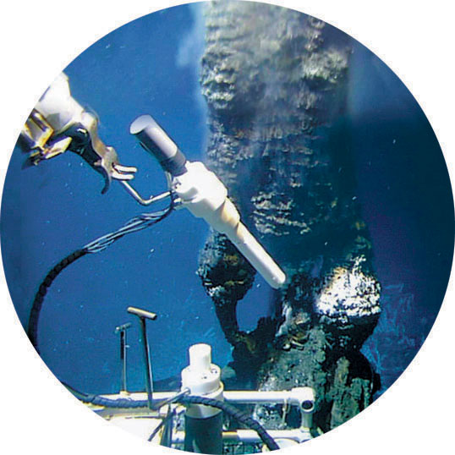
Synthesis of Carbon Compounds
First organic compounds most likely formed in submerged volcanoes and deep-sea vents.

Slide 7
Synthesis of Carbon Compounds
Some carbon-based compounds may have come from meteorites from space.

Slide 8
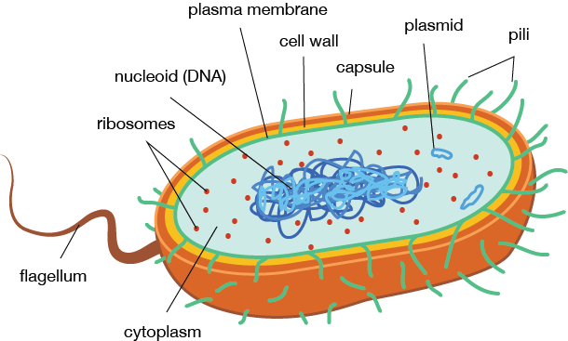
Early Life
First cells were unicellular, anaerobic and prokaryotic

Slide 9
Early Life
First cells were unicellular, anaerobic and prokaryotic
Autotrophic
Chemosynthesis, photosynthesis

Slide 10
Early Life
First cells were unicellular, anaerobic and prokaryotic
Autotrophic
Chemosynthesis, photosynthesis
Why do you think photosynthetic organisms evolved before heterotrophic organisms?

Slide 11
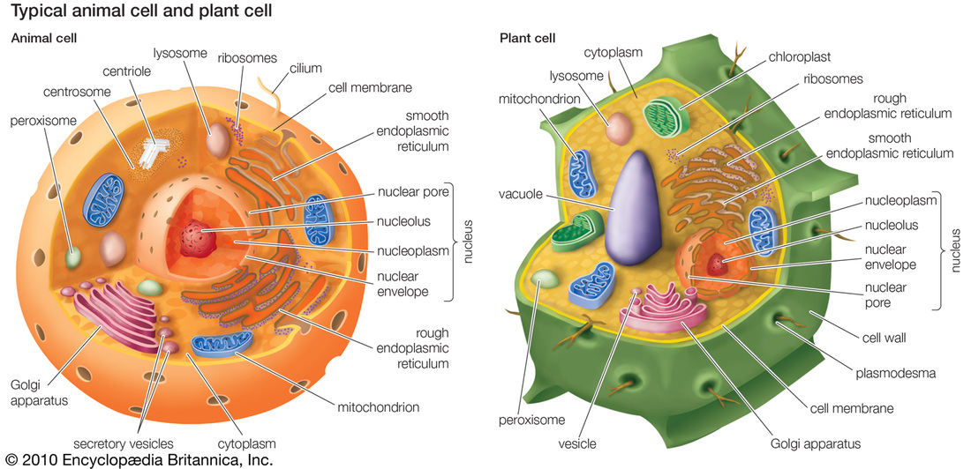
Oxygen on Earth
Accumulation of oxygen provided new ecosystems to exploit
Aerobic bacteria evolved
Eventually eukaryotic cells developed

Slide 12
Endosymbiotic Theory
How DID eukaryotic cells develop from prokaryotic cells?

Slide 13
Endosymbiotic Theory
Evidence supports that mitochondria and chloroplasts were once prokaryotic organisms living in a larger host cell.

Slide 14
Endosymbiotic Theory
Ancestral eukaryote received chemical energy (ATP) and sugars and the bacteria received protection.

Slide 15
Endosymbiotic Theory
As they became more interdependent they became one organism (modern eukaryotic cells).

Slide 16
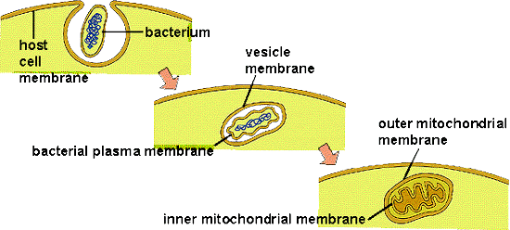
Endosymbiotic Theory
Evidence is found in mitochondria and chloroplasts. They have…
Their own chromosomes (circular DNA)
Double membranes

Slide 17
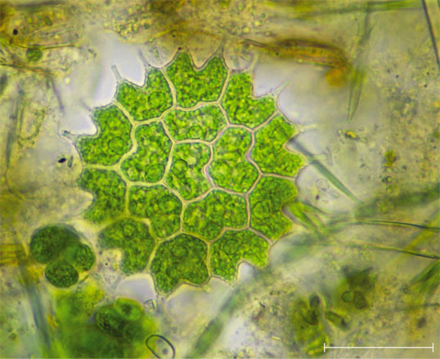
Multicellular Life
First multicellular life were colonies
Eventually true multicellular organisms
10 m

