Slide 1
Lysosomes and Peroxisomes
Andrew Sarji

Slide 2
Main Function of Lysosomes
Lysosomes contain enzymes that break down worn out organelles.
Lysosomes are in charge of waste removal in animal cells and maintaining health and fighting diseases in their host organisms.
They are also in charge of repairing cell membranes and responding to foreign bacteria.

Slide 3
Lysosome Interactions
Lysosomes are formed off of the Golgi Apparatus.
They fuse with vacuoles to deposit waste cells.
Lysosomes can digest old ribosomes

Slide 4
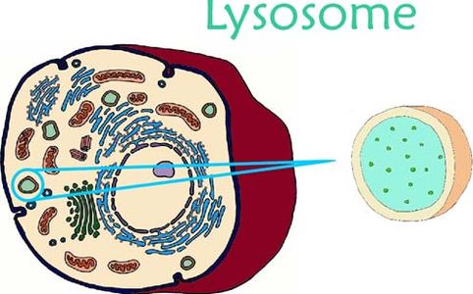
Lysosome Structure
Lysosomes are enclosed by a single-layer membrane that allows the remainder of the cell to be protected from the harsh digestive enzymes that lysosomes use to break down and rid the cell of unwanted materials. This membrane also allows the lysosome to maintain an acidic environment similar to that of the stomach that aids in this same digestion.

Slide 5
Peroxisomes
Found in both animal and plant cells, peroxisomes break down fatty acids through oxidation.
Peroxisomes also break down hydrogen peroxide which is a product of fatty acids.

Slide 6
Peroxisome Interactions
Formed off of endoplasmic reticulum.
There are shuttles for amino acids between peroxisomes and the cytoplasm.

Slide 7
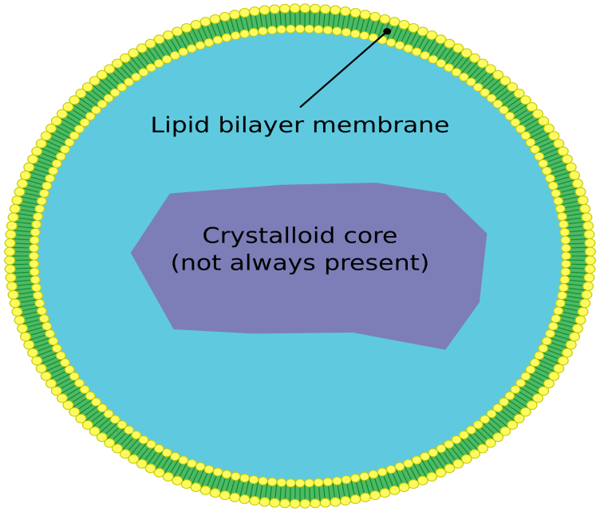
Peroxisome Strucure
Peroxisomes are surrounded by a lipid bilayer which is enclosed with plasma membrane. This structure regulates what goes in and out of the peroxisome. The crystalline core is what executes peroxisomal functions inside the organelle.

Slide 8
Citations
The Function Of Lysosomes
http://www.softschools.com/science/biology/the_function_of_lysosomes/
Study.com
http://study.com/academy/lesson/lysosome-definition-function-quiz.html
Learn About Lysosomes!
https://sites.google.com/site/learnaboutlysosomes/
Lysosomes and Peroxisomes
http://www.biology-pages.info/L/Lysosomes.html
Google Books
https://books.google.com/books?id=dKCdjh3RKDkC
http://www.questionstudy.com/wp-content/uploads/2016/03/a2.jpg (image)
Boundless
https://www.boundless.com/biology/textbooks/boundless-biology-textbook/cell-structure-4/the-endomembrane-system-and-proteins-61/peroxisomes-317-11452/
https://upload.wikimedia.org/wikipedia/commons/thumb/c/cb/Peroxisome.svg/2000px-Peroxisome.svg.png (image)

