Slide 1
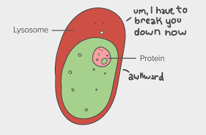
Lysosomes
By: Danny Lam

Slide 2
Definition
Lysosomes- are membrane-enclosed organelles that contain an array of enzymes capable of breaking down all types of biological polymers—proteins, nucleic acids, carbohydrates, and lipids.

Slide 3
Functions
They use enzymes to break down biomolecules like proteins, nucleic acids, carbohydrates, and lipids, almost like a stomach digests food.
Lysosomes also break down leftover cellular wastes, digesting the unwanted materials from throughout the cytoplasm and from outside of the cell, and destroying obsolete components inside the cell
Actively related to maintaining health and fighting diseases in their host organisms
Processes of phagocytosis and autophagy

Slide 4
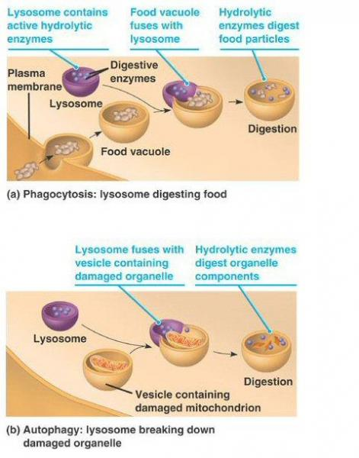

Slide 5
Interactions with other organelles
The enzyme proteins are first created in the rough endoplasmic reticulum. Those proteins are packaged in a vesicle and sent to the Golgi apparatus. The Golgi then does its final work to create the digestive enzymes and pinches off a small, very specific vesicle. That vesicle is a lysosome.
Fuses with damaged organelles in order to replace the damages

Slide 6
Structure
The hydrolytic enzymes in lysosomes help to digest the food particles
The protein in the inner lysosomal membrane protect vulnerable enzymatic attack
The interior of Lysosome is acidic compared with the slightly basic intracellular fluid. Which is also called cytosol that surrounds organelles such as Lysosome within cell.

Slide 7
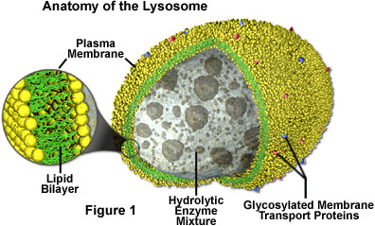

Slide 8
Molecules Used
Breaks down biological molecules such as, proteins, simple sugars, lipids, carbohydrates, and nucleic acids
Digests these products and passes it through the cytosol in order for the molecules to become nutrients for the cell

Slide 9
Sources
Lysosomes. (n.d.). Retrieved September 18, 2017, from
http://www.biologyreference.com/La-Ma/Lysosomes.html
Cooper, G. M. (1970, January 01). Lysosomes. Retrieved September 18, 2017, from
https://www.ncbi.nlm.nih.gov/books/NBK9953/
Reece, J. B., & Campbell, N. A. (2011). Campbell biology. Boston: Benjamin Cummings / Pearson.

