Slide 1
Mitochondria
Dalin Abu
Ap Biology 1st period

Slide 2
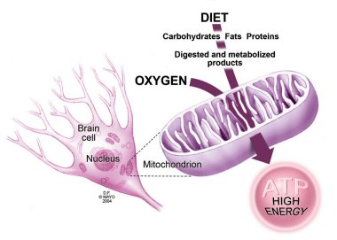
Major processes of the mitochondria
Power House of the cell- they release energy from food or cellular respiration (the breaking down of food to create energy
Molecular fragments from previous conversions into ATP are converted by Mitochondria in CO2 and H2O. Will continue on to become ATP
Help in building certain parts of blood and hormones like testosterone and estrogen
Allow for proper cell death and generation
Supply ALL the necessary biological energy of the cell

Slide 3
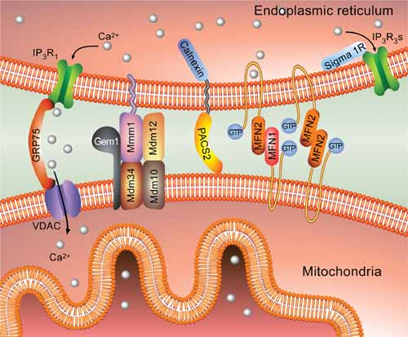
Interactions
Endoplasmic Reticulum and Mitochondria interact to form mitochondria-ER associated membranes, regulates cell fission and transferring of calcium
Photosynthesis occurs in the chloroplast creating the organic molecules the mitochondria uses for cellular respiration
Because mitochondrion's disperse energy throughout the cell, they essentially interact with all other organelles. If it was not for the mitochondria's ability to convert and supply energy, all organelles would fail to function. However, the mitochondria functions independently and even contain their own DNA.

Slide 4
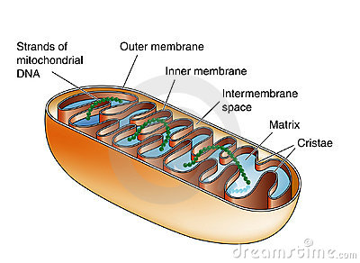
Structure and function
Can move around, change shape and divide in two
Enclosed by two membranes, both with a phospholipid bilayer with embedded proteins
Outer is smooth while Inner contains cristae (folding)
Cristae gives inner area large surface area for proteins, enhancing productivity of cellular respiration
Divided into 2 compartments :
Intermembrane space- narrow region between inner and outer membranes
Contains enzymes that create ATP in cellular respiration
Mitochondrial Matrix- enclosed by the inner membrane
Contains different enzymes, DNA and ribosomes
Some metabolic steps of cellular respiration occur here

Slide 5
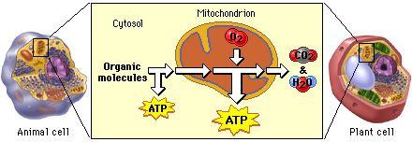
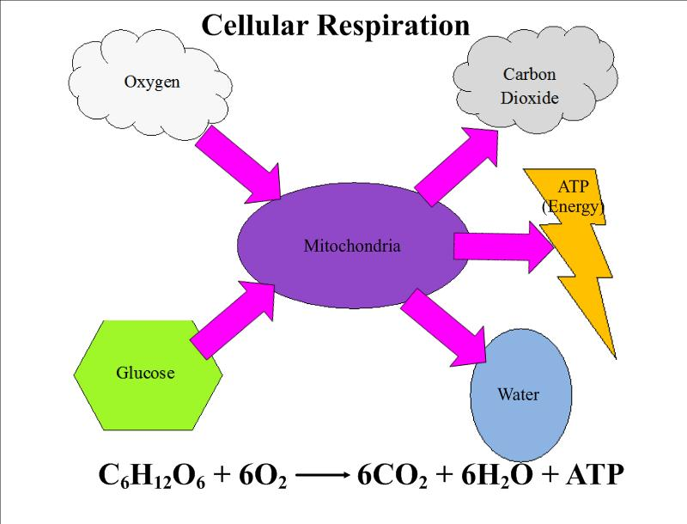
molecules USED AND END PRODUCTS
Cellular Respiration (C₆H₁₂O₆ + 6O₂ → 6CO₂ + 6H₂O + Energy (ATP+heat):
Pyruvate molecules (3-carbon product of glycolysis) transported into the mitochondria.
In the mitochondria, the pyruvate, which have been converted into a 2-carbon molecule, enter the Krebs cycle (stage two).
Energy transfers to electron transport chain. During this step, this energy is used to produce ATP.

Slide 6
Sources
N/A. (2011, July 20)Mitochondria – cell powerhouses. Retrieved from https://www.sciencelearn.org.nz/resources/1839-mitochondria-cell-powerhouses
Harwood, Jessica. Wilkin, Douglas Ph.D. (2012, Nov 29). Process of Cellular Respiration. Retrieved from https://www.ck12.org/book/CK-12-Life-Science-Concepts-For-Middle-School/section/2.14/
Davidson, Michael M.( 2015, Nov 13). Mitochondria. Retrieved from https://micro.magnet.fsu.edu/cells/mitochondria/mitochondria.html

