Slide 1
MUTATIONS

Slide 2
Genes
Contain the instructions within cell for protein production
Unit of inheritance
Genes are composed of DNA (deoxyribonucleic acid)

Slide 3
Protein Synthesis
DNA is read in groups of three (codon).
Each codon codes for an amino acid.
Several codons can code for the same amino acid.
Third base can “wobble” – change without changing the amino acid.

Slide 4
Alleles
Alternative forms of a gene.
Purple and white are alleles for the flower color gene in pea plants
This variation occurs through process of mutation.

Slide 5
Polymorphisms
When an allele is common in at least 1% of the population.
Single nucleotide polymorphism (SNP) = single base differences between individuals
Cause disease (Tay-Sachs)
Genetic marker

Slide 6
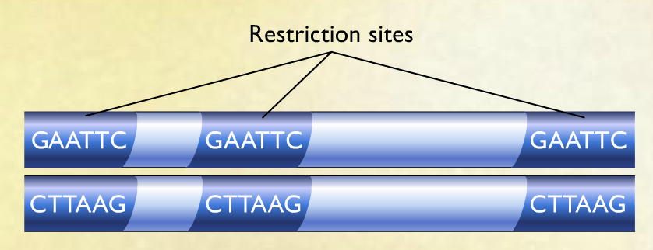
SNP Analysis
Cut DNA sample with restriction enzymes.
Cut at specific sites (ex: GAATTC)

Slide 7
Individuals rarely have same number of restriction sites or distances between sites.
Same restriction enzyme can yield different sized fragments for two different individuals.
Called restriction fragment length polymorphisms (RFLPs)

Slide 8
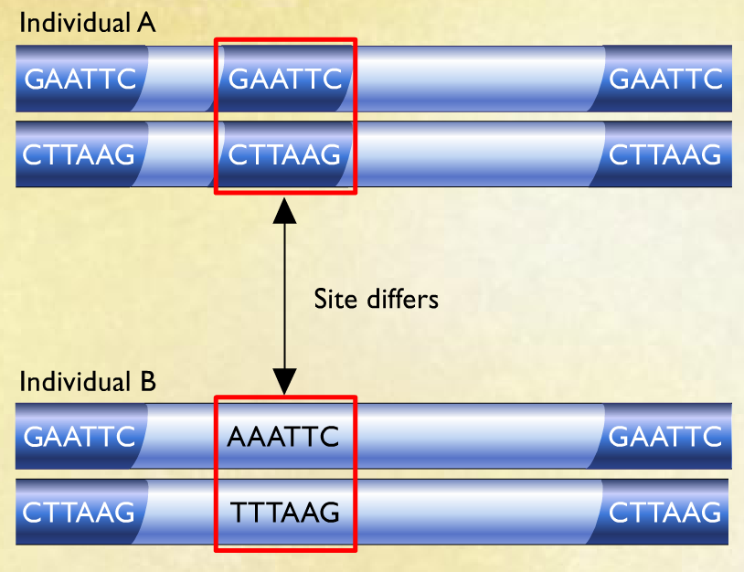

Slide 9
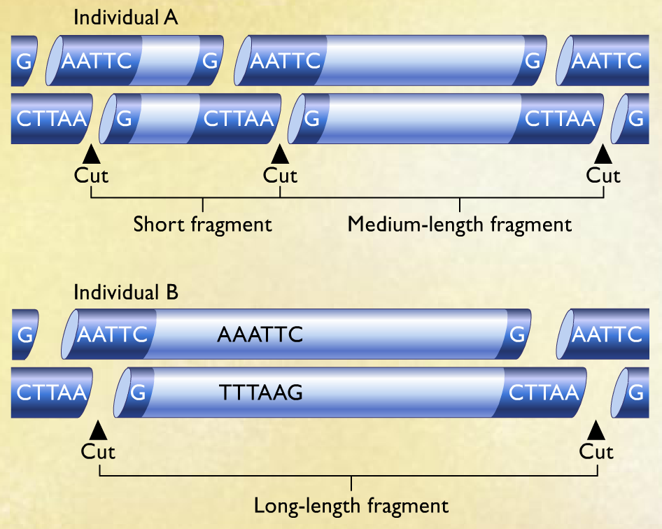

Slide 10
Fragments are separated using gel electrophoresis.
Creates unique pattern of bands.

Slide 11
