Slide 1
The Nucleus
Morgan Gilliam

Slide 2
What is it?
Holds most of the genes
Controls cell growth and reproduction
“Command center” of the eukaryotic cell
Most prominent organelle in the cell

Slide 3
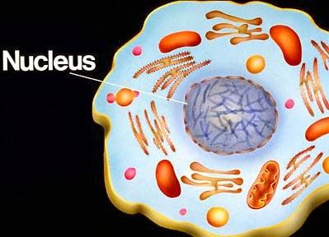
The parts...
Nucleus
Nuclear envelope
Nuclear lamina
Nucleolus
Chromosome
Chromatin

Slide 4
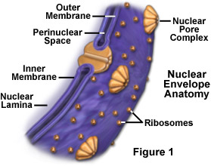
Nuclear envelope
Double membrane; 20-40 nm thick (lipid bilayer)
Porus
Separates the nucleus from cytoplasm

Slide 5
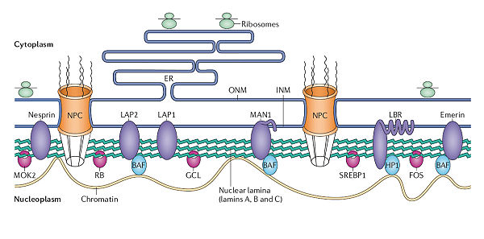
Nuclear lamina
Protein filaments
The backbone of the nuclear envelope

Slide 6
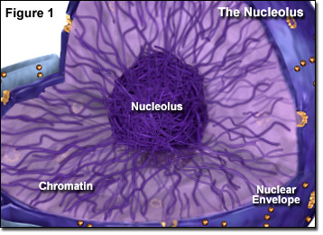
Nucleolus
Only appears through an electron microscope
The center of an nucleus
Major part of protein synthesis
Densely stained granules and fibers adjoining part of chromatin

Slide 7
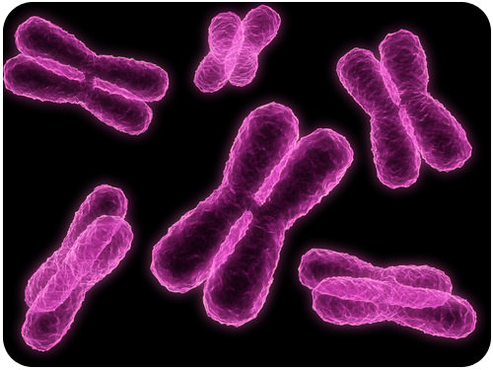
chromosomes
Structures that carry genetic information
Chromatin
A complex of proteins and DNA

Slide 8
What is produced?
A functioning cell, without a nucleus the cell doesn't know what to do. This is why it is called the “brain” of a cell. Products include...
Cell reproduction
Cell growth
“Individuality”

Slide 9
Citations
THE NUCLEUS - CELL COMMAND CENTER
In-text: (ThoughtCo, 2017)
Your Bibliography: ThoughtCo. (2017). The Nucleus - Cell Command Center. [online] Available at: https://www.thoughtco.com/the-cell-nucleus-373362 [Accessed 19 Sep. 2017].
STUDIOS, A.
Biology4Kids.com: Cell Structure: Cell Nucleus
In-text: (Studios, 2017)
Your Bibliography: Studios, A. (2017). Biology4Kids.com: Cell Structure: Cell Nucleus. [online] Biology4kids.com. Available at: http://www.biology4kids.com/files/cell_nucleus.html [Accessed 19 Sep. 2017].
HELP, H.
What other organelles does the Nucleolus work with? Like when it does its functions in the cell, what other organelles does it need to complete its... | eNotes
In-text: (Help, 2017)
Your Bibliography: Help, H. (2017). What other organelles does the Nucleolus work with? Like when it does its functions in the cell, what other organelles does it need to complete its... | eNotes. [online] eNotes. Available at: https://www.enotes.com/homework-help/what-other-organelles-does-nucleolus-work-with-279102 [Accessed 19 Sep. 2017].

