Slide 1
Overview of Genetics

Slide 2
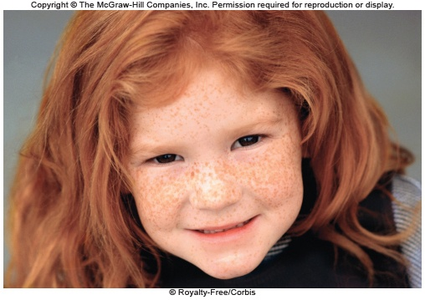
Genetics
Is the study of inherited traits and their variation
Is a life science that should not be confused with genealogy
Figure 1.1
Is also an informational science that is having a huge societal impact

Slide 3
Genes
Contain the instructions within the cells for protein production
Genes are composed of deoxyribonucleic acid (DNA)
Traits are produced by an interaction between the genes and their environment
Figure 1.1

Slide 4
Deoxyribonucleic Acid (DNA)
A double-stranded polymer consisting of a chain of nucleotides
Deoxyribonucleotide components:
- Phosphate
- Sugar: Deoxyribose
- Base: Adenine A Guanine G
Thymine T Cytosine C
The sequence of the bases code for the amino acid sequence in a protein

Slide 5
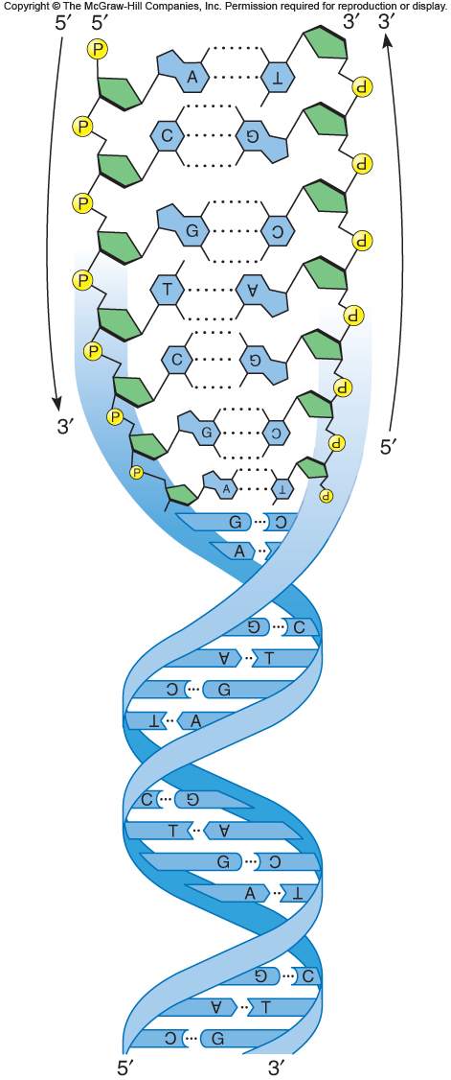
Box, Figure 1
Reading1.1, Figure 1

Slide 6
The Genome
Is the complete set of genetic information for an organism
It includes all of the genes present in an organism
- And also DNA sequences that do not encode genes
Genomics is a field that analyzes and compares genomes of different species

Slide 7
The Human Genome
Only 1.5% of our DNA encodes protein
- About 20,325 protein-encoding genes in all
Rest of the human genome includes highly repeated sequences with unknown functions
Genes known to cause disorders or traits are cataloged

Slide 8
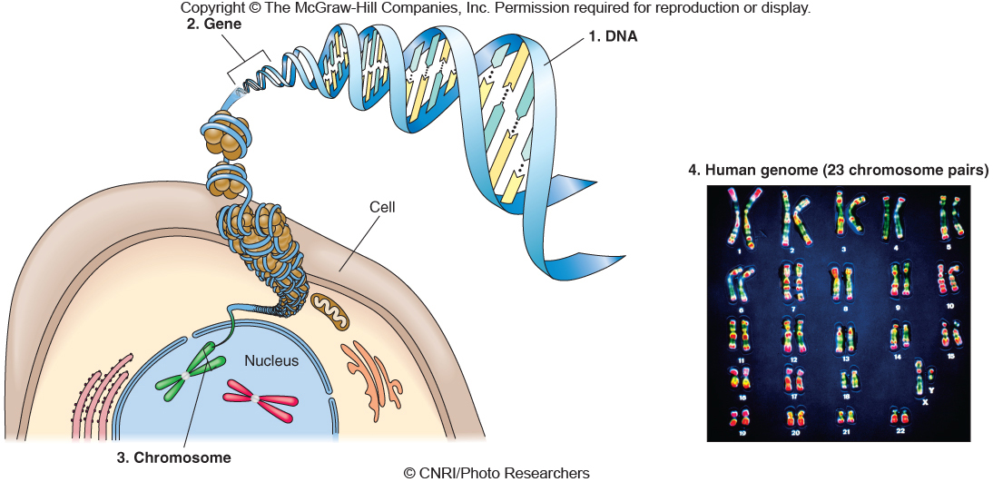
Levels of Genetics
Figure 1.2

Slide 9
Chromosomes
Composed of DNA and protein
Found in the nucleus of the cell
Human somatic cells have 46 chromosomes
- 22 pairs of autosomes
- A pair of sex chromosomes
- Females have two X chromosomes
- Males have one X and a Y

Slide 10
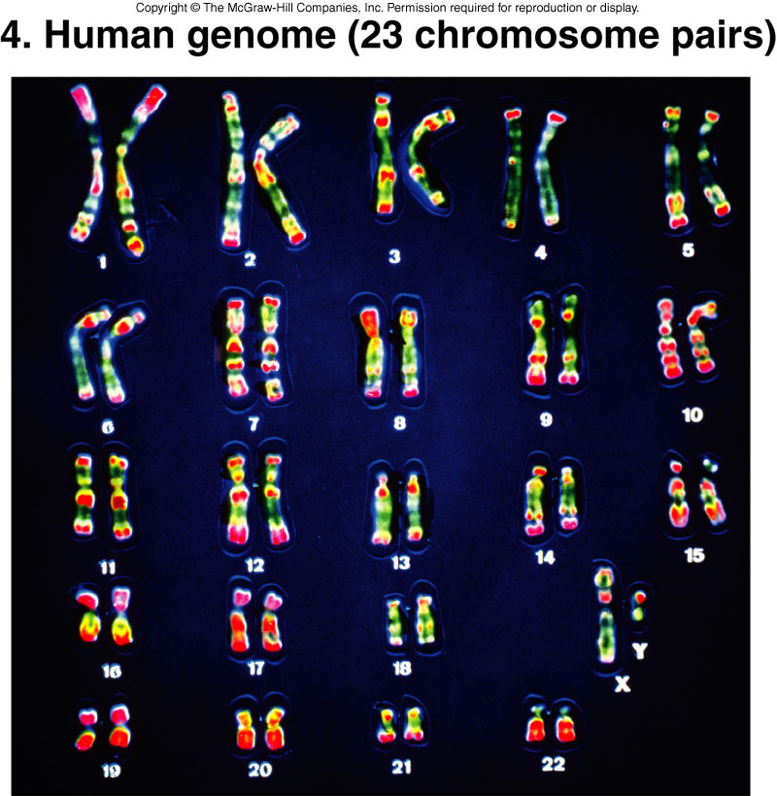
Figure 1.2
Figure 1.2

Slide 11
Population
Is a group of interbreeding individuals
The gene pool is the sum of all alleles in a population
Evolution is the changing allele frequencies in populations over time

Slide 12
Evolution
Genome comparisons among species reveals evolutionary relationships
- The more similar the sequences are, the more recent the divergence from a common ancestor
98% of human DNA sequences are shared with chimpanzees
Humans share genes with mice, pufferfish, fruit flies, yeast, and even bacteria

Slide 13
Agriculture
Traditional agriculture is the controlled breeding of plants and animals
Biotechnology is the use of organisms or their parts to produce goods and services
Genetically-modified (GM) organisms have new genes or over- or under-express their own genes

Slide 14
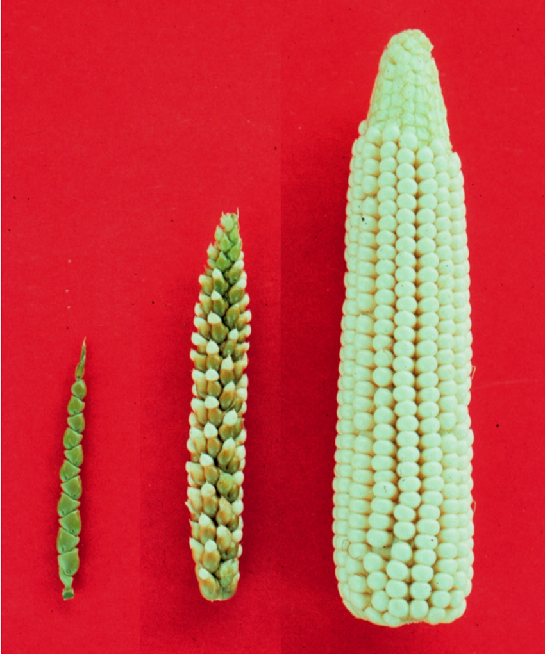
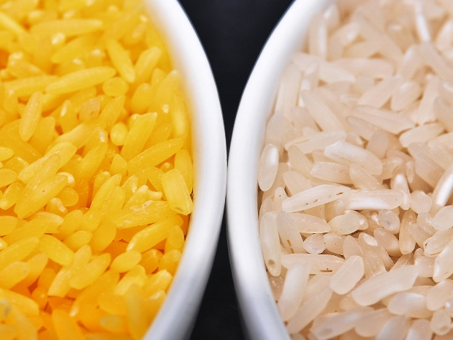

Slide 15
Ecology
Metagenomics is a field that involves sequencing all of the DNA in a habitat
- cow rumen
- The Human Microbiome Project
Metagenomic studies may be used to reconstruct ecosystems

