Slide 1
Reproductive Adaptations

Slide 2
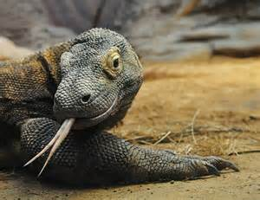
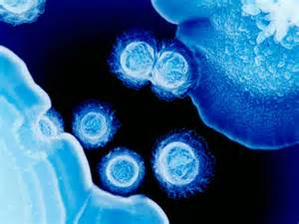
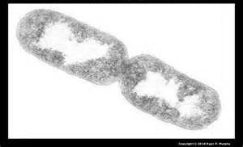
Asexual Reproduction
An organism produces offspring without the genetic contribution from a mate
Budding, binary fission, parthenogenesis

Slide 3
Asexual Reproduction
Benefit: make a lot of offspring quickly.
Usually conditions are ideal

Slide 4
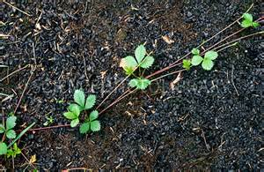
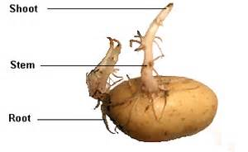
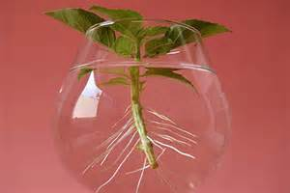
Asexual Reproduction
Plants have unique methods
Runners, cutting, underground stems, etc.

Slide 5
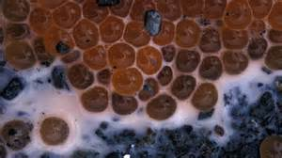
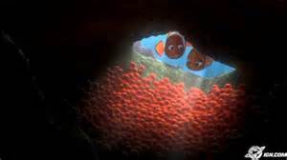
External Fertilization
Eggs are laid then fertilized outside of the body.
(Spawning)

Slide 6
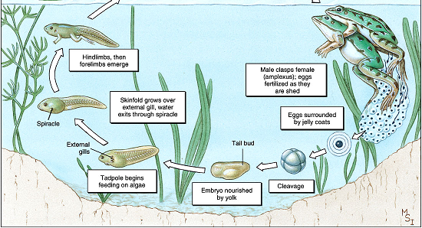
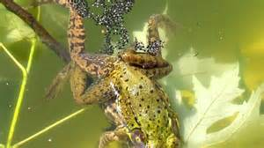
External Fertilization
Amphibians often use this method
Return to water to spawn

Slide 7
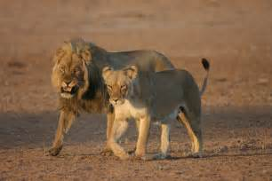
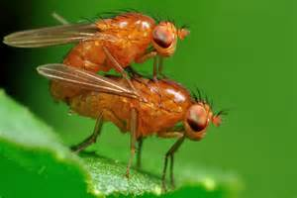
Internal Fertilization
Egg(s) are fertilized inside the female.

Slide 8
Animal Sexual Reproduction
Benefit: greater genetic diversity in offspring

Slide 9
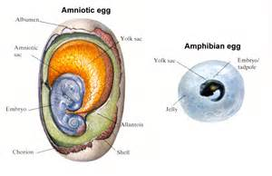
Amniotic Egg
Membrane structure of the embryo that contains fluid
Mammals, birds, reptiles

Slide 10
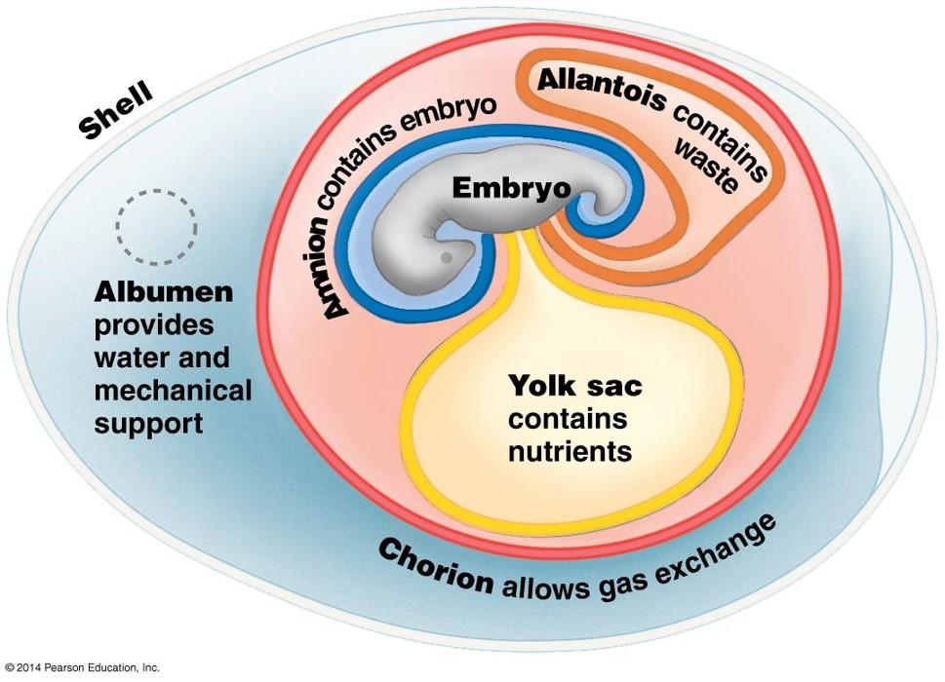

Slide 11
Amniotic Egg
Benefit: allows eggs to be laid on land (water retention)

Slide 12
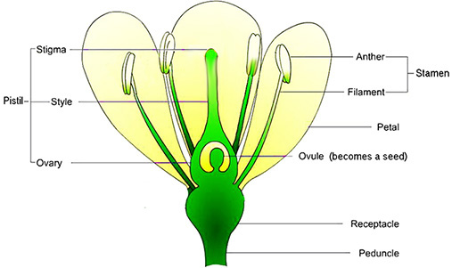
Pollination
Sexual reproduction in land plants
Pollen grains produce male gametes

Slide 13
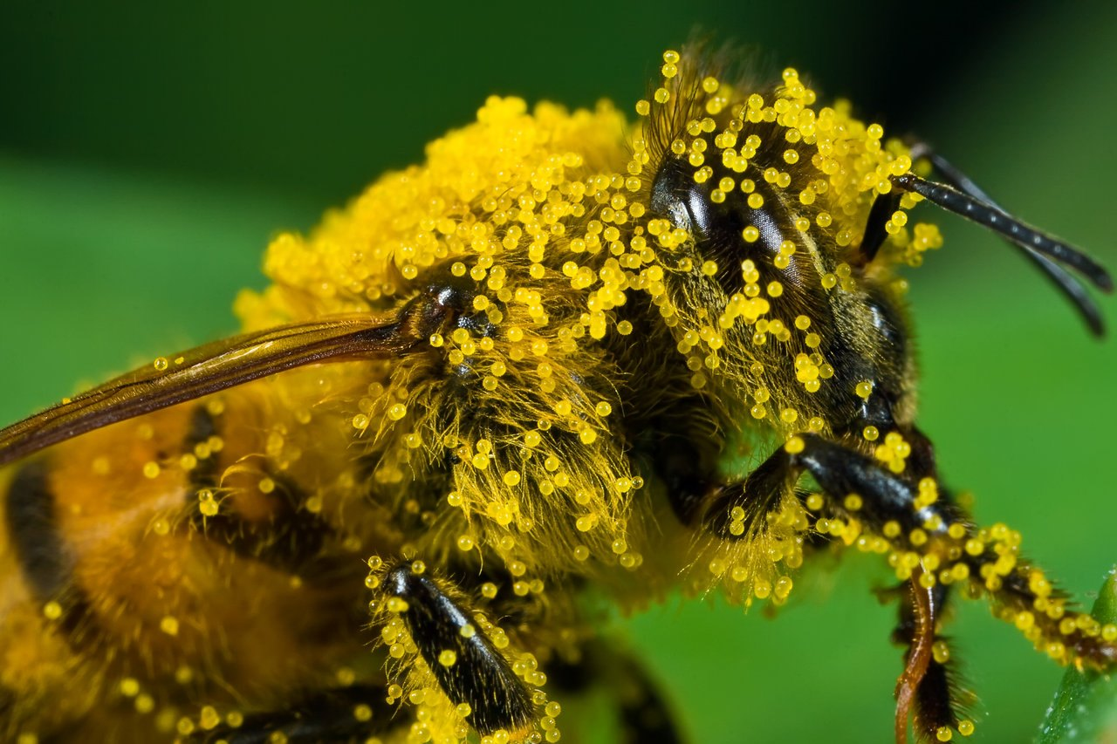
Pollination
Relies on wind or pollinators
Benefit: greater genetic diversity of offspring

Slide 14
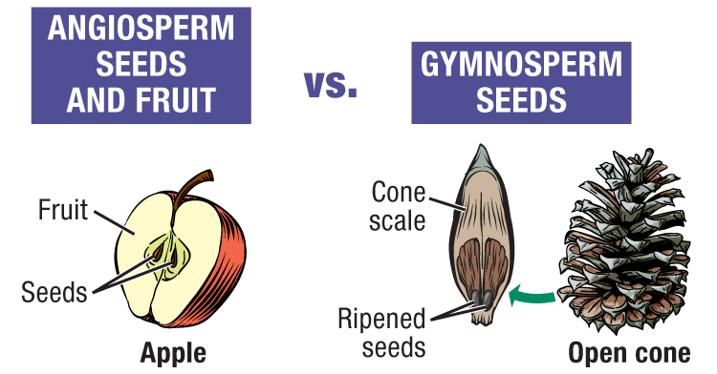
Seeds
Protective structure around plant embryo

Slide 15
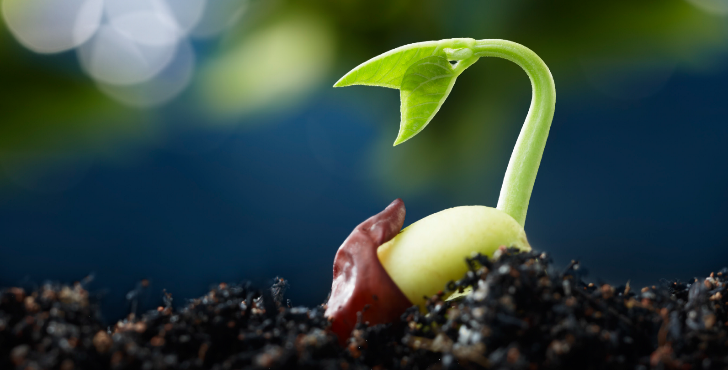
Seeds
Benefit: seed can lie dormant until conditions are ideal for growing

Slide 16
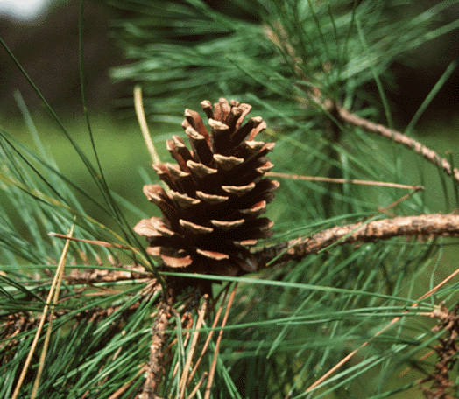
Cones
Some land plants produce their seeds inside of cones
Fir, pine, juniper, etc.

Slide 17
Cones
Benefit: protection from herbivores, fire, etc.

Slide 18
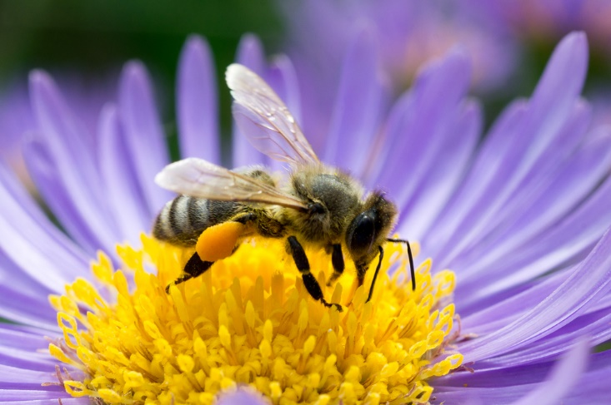
Flowers & Fruits
Flowers attract pollinators to plants for sexual reproduction

Slide 19
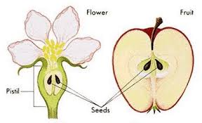
Flowers & Fruits
Fruits grow around the seeds

Slide 20
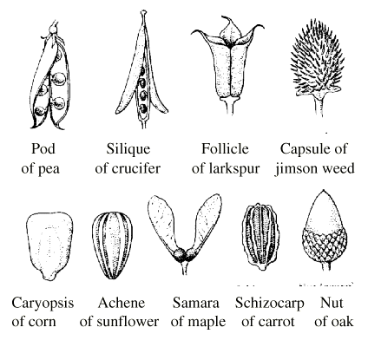
Flowers & Fruits
Lots of different fruit types!

Slide 21
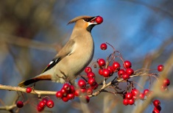
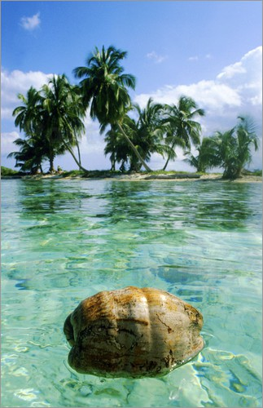
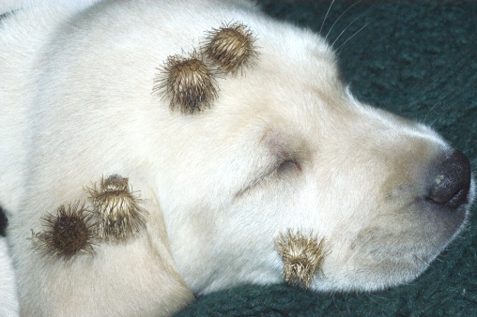
Flowers & Fruits
Lots of different fruit types!

Slide 22
Flowers & Fruits
Flower benefit: more pollination
Fruit benefit: seeds get dispersed

