Slide 1
Bell Ringer
Where do you get your energy from?
What are the waste products from consuming this fuel?

Slide 2
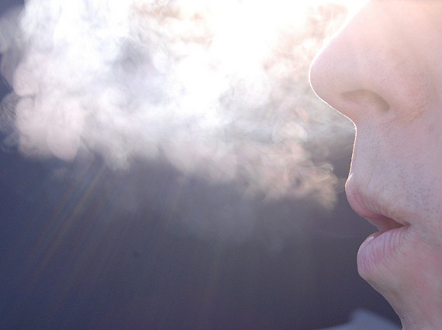
Cellular Respiration

Slide 3
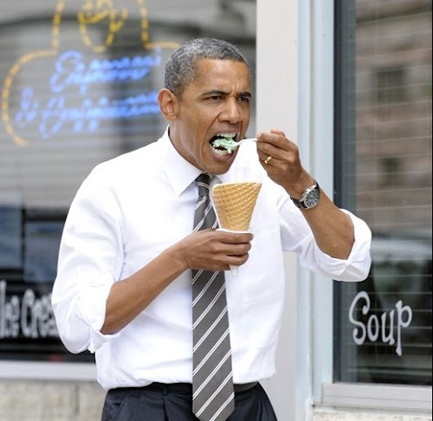
What is it?
How organisms turn food into energy.

Slide 4
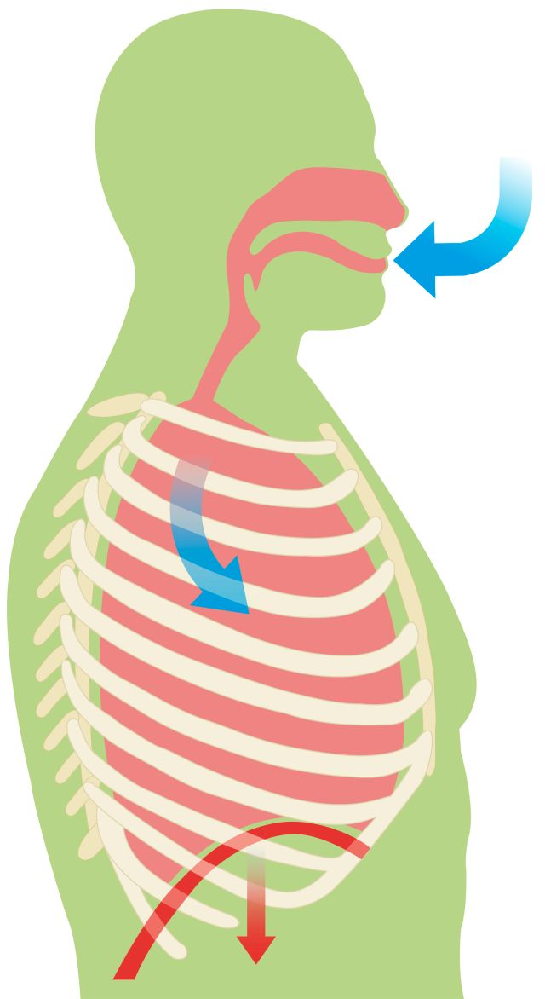
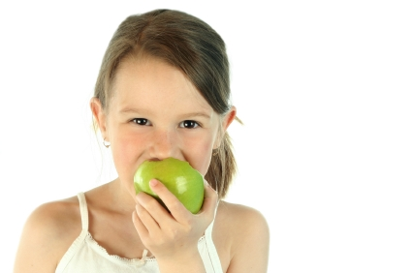
Reactants
What goes into a chemical reaction.
Reactants for respiration = oxygen and sugar
+
O₂
C₆H₁₂O₆

Slide 5
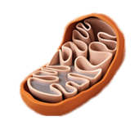
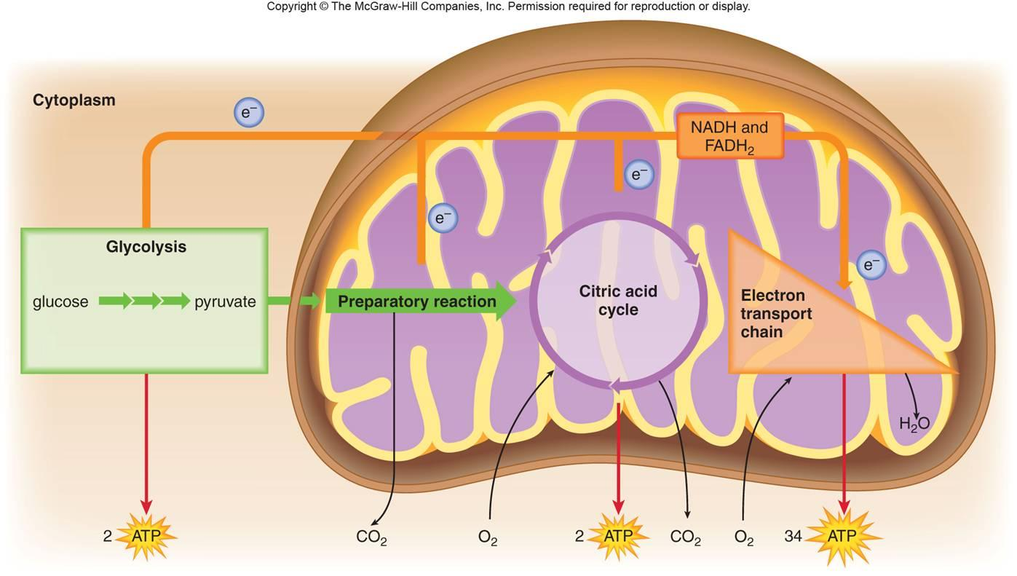
Tools
Enzymes in the mitochondria
They perform a series of steps to release the energy stored in sugar’s chemical bonds

Slide 6
Tools
The chemical reactions in each step transfer energy from glucose (sugar) to ATP (energy storage molecule) using the high surface area of the mitochondria

Slide 7
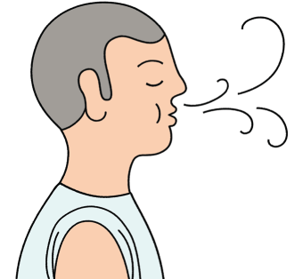
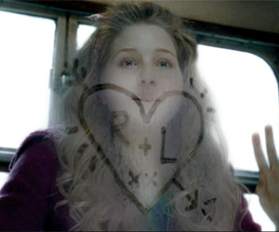
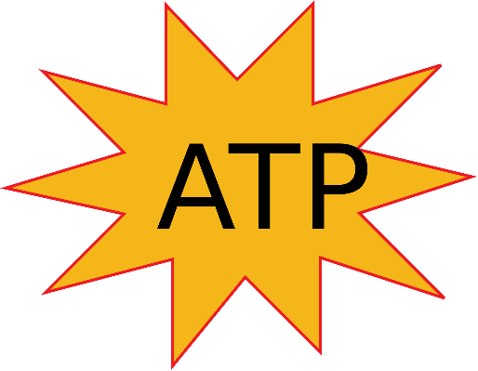
Products
What is produced after a chemical reaction occurs.
Products of respiration =
carbon dioxide, water, energy (ATP)
+ +
CO₂
H₂O

Slide 8
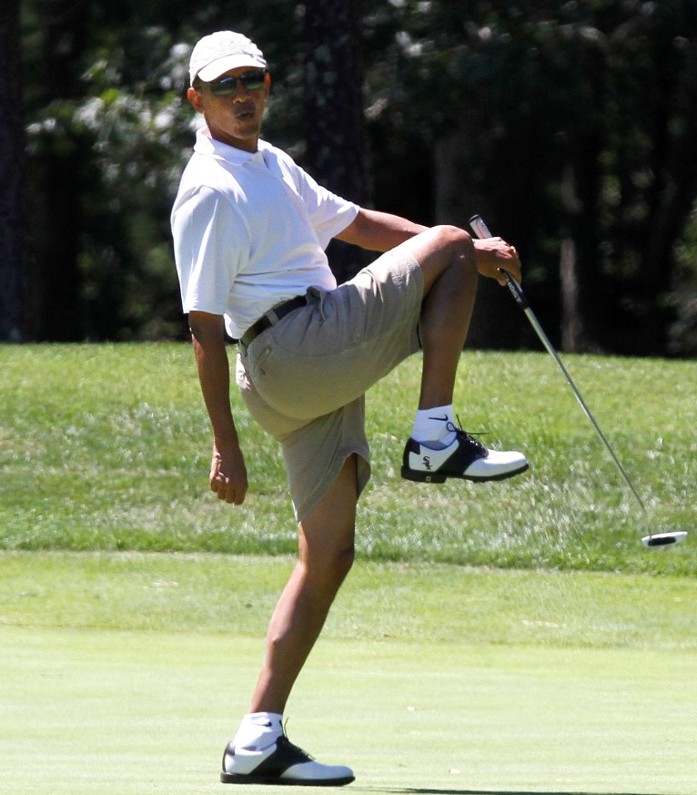
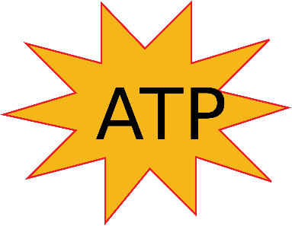
Review
O₂ + C₆H₁₂O₆ → CO₂ + H₂O + ATP
O₂
H₂O
CO₂
O₂
CO₂
O₂

Slide 9
Combustion
Cellular respiration is a type of combustion reaction
What everyday phenomena use combustion?

Slide 10
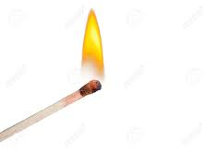
Combustion
Cellular respiration is a type of combustion reaction
Bonfire
Car engine
Power plant (burn fossil fuels)

Slide 11
Combustion
Cellular respiration is a type of combustion reaction
O₂
CO₂
H₂O
Light & heat
C₆H₁₀O₅

Slide 12
Anaerobic Respiration
Sometimes organisms need energy when no oxygen is present.
An- = without
Aero = air

Slide 13
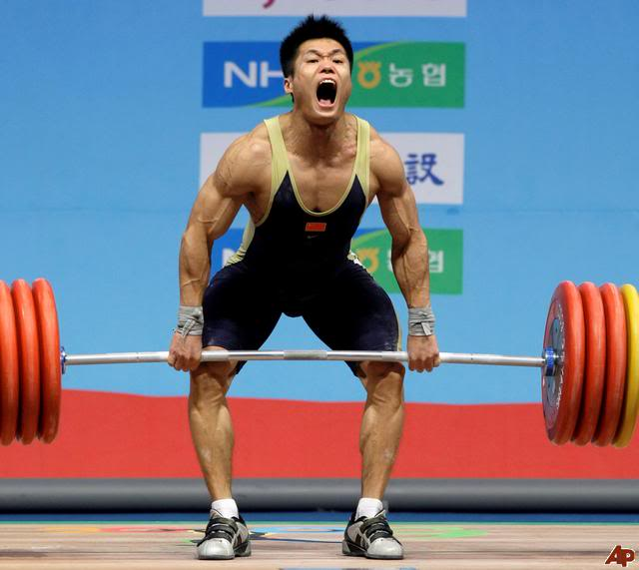
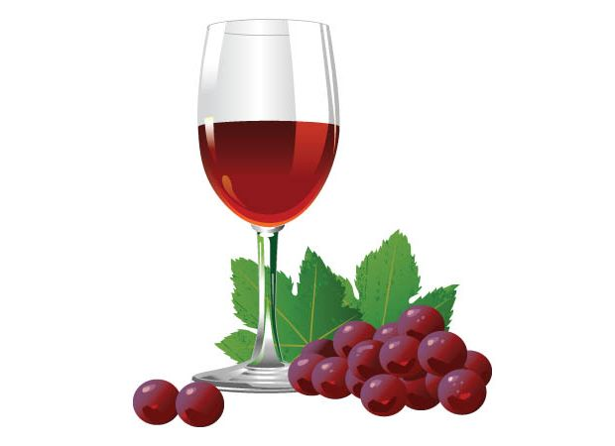
Fermentation
A series of chemical reactions that produces ATP without the need for oxygen.
Produces ethanol (in yeast, bacteria) or lactic acid (humans)

Slide 14
Exit Task
How are the reactions for respiration and combustion similar?

