Slide 1
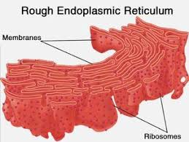
ROUGH E.R
By:ISAIAH HAIRSTON

Slide 2
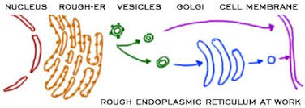
MAJOR PROCESS OF THE ROUGH E.R.
The endoplasmic reticulum (ER) is an important organelle in eukaryotic cells. It plays a major role in the production, processing, and transport of proteins and lipids. The ER produces transmembrane proteins and lipids for its membrane and for many other cell components including lysosomes, secretory vesicles, the Golgi appatatus, the cell membrane, and plant cell vacuoles.The rough ER get its name because it has ribosomes attached to the cytoplasmic side of the membrane.

Slide 3
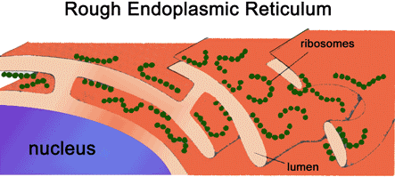
ROUGH E.R INTERACTIONS WITH OTHER ORGANELLES
The Rough E.R interacts with other organells by processing proteins and prepares them for transport and secretion. The cell membrane receives the vesicles that contain proteins tagged for secretion from the cell.

Slide 4
MOLECULES USED BY THE ORGANELLE,AND END PRODUCTS PRODUCED
The ER, Golgi apparatus, and lysosomes are all members of a network of membranes, but they are not continuous with one another. Therefore, the membrane lipids and proteins that are synthesized in the ER must be transported through the network to their final destination in membrane-bound vesicles. From the endoplasmic reticulum, proteins are transported in vesicles to the Golgi apparatus, where they are further processed and sorted for transport to lysosomes, where they remove waste from the proteins.

Slide 5
CITATIONS
“Endoplasmic Reticulum, Golgi Apparatus, and Lysosomes.” Nature News, Nature Publishing Group, 2014, www.nature.com/scitable/topicpage/endoplasmic-reticulum-golgi-apparatus-and-lysosomes-14053361.
Arrington, Derrick. “Rough Endoplasmic Reticulum: Definition, Structure & Functions.” Study.com, Study.com, study.com/academy/lesson/rough-endoplasmic-reticulum-definition-structure-functions.html.
Schaeberle, Emma. “How Organelles Interact.” Prezi.com, 27 Oct. 2013, prezi.com/stokgtwzrtht/how-organelles-interact/.
ARTICE CITATION
Schwarz, Dianne S., and Michael D. Blower. “The Endoplasmic Reticulum: Structure, Function and Response to Cellular Signaling.” Cellular and Molecular Life Sciences, Springer International Publishing, 3 Oct. 2016, www.ncbi.nlm.nih.gov/pmc/articles/PMC4700099/.

