Slide 1
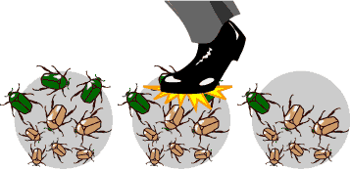
Genetic drift

Slide 2
Genetic drift
Random fluctuation in gene frequency
One allele becomes more common in the population at the expense of the other allele

Slide 3
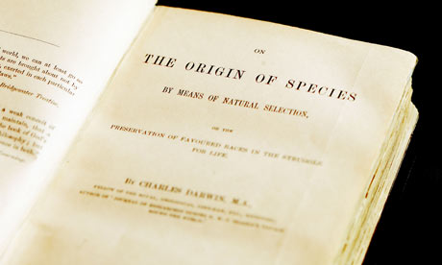
Speciation

Slide 4
SPECIATION
IS ALL ABOUT
ISOLATION!
(allows populations to evolve independently)

Slide 5
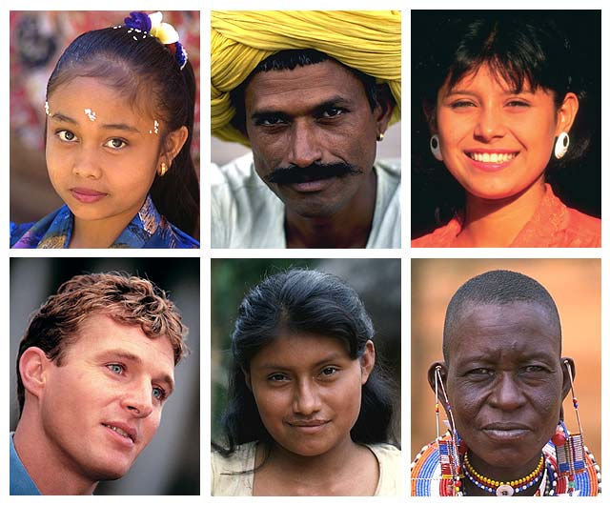
What is a species?
population whose members can interbreed & produce viable, fertile offspring
reproductively compatible
We look so different and yet…
We are an interbreeding population = species Homo sapiens

Slide 6
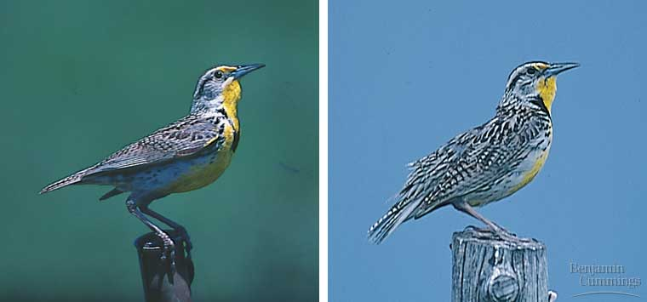
Looks aren’t everything!
These meadowlarks look similar but are two different species. Their songs and behavior prevent interbreeding.
Eastern Meadowlark
Western Meadowlark

Slide 7
Geographic vs. reproductive isolation
ALLOPATRIC SPECIATION
sympatric SPECIATION

Slide 8
Geographic vs. reproductive isolation
Separately geographically
Various mechanisms prevent interbreeding
ALLOPATRIC SPECIATION
sympatric SPECIATION

Slide 9
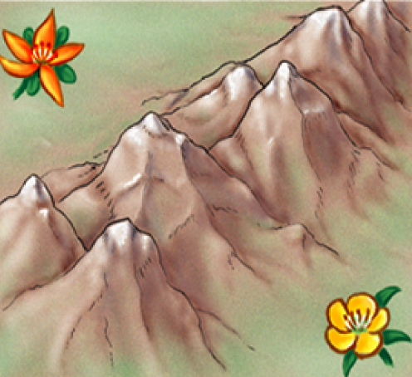
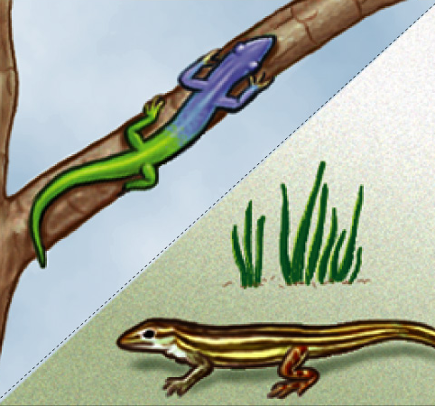
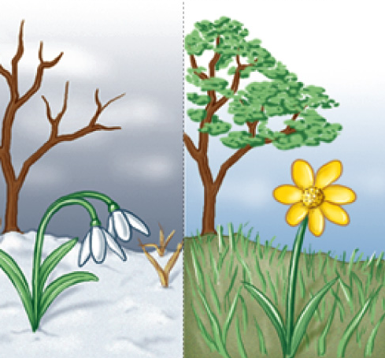
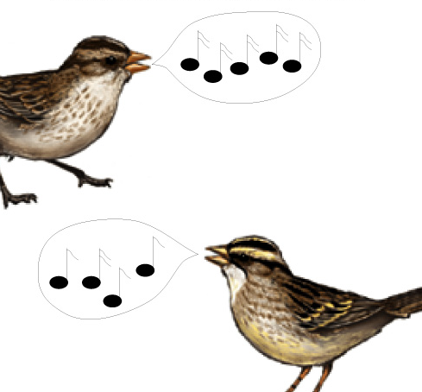
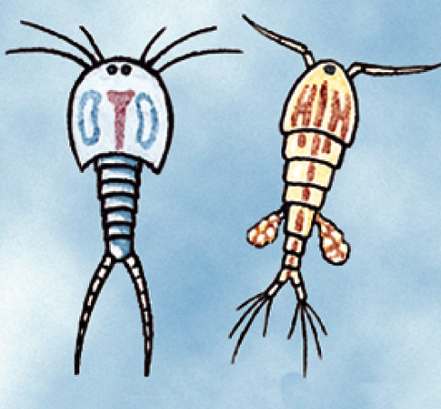
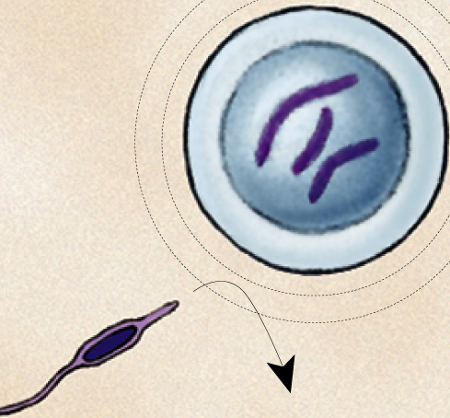
Types of isolation
geographic isolation
ecological isolation
temporal isolation
behavioral isolation
mechanical isolation
gametic isolation

Slide 10
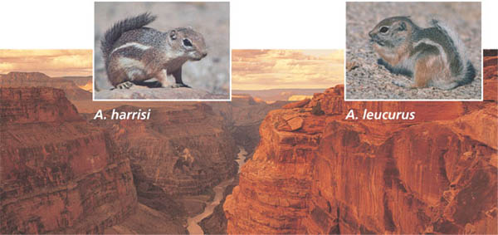
Geographic isolation
A.K.A. Allopatric isolation
Latin = “other country”
Physical barriers prevent interbreeding
Over time the populations diverge
Harris’s antelope squirrel inhabits the canyon’s south rim (L). Just a few miles away on the north rim (R) lives the closely related white-tailed antelope squirrel

Slide 11
Ecological isolation
First example of reproductive, A.K.A. sympatric isolation
Latin = “same country”
Species are found in the same area but occupy different habitats
Rarely encounter each other
These two species of garter snake, Thamnophis, live in the same geographical area but have different ecological niches.
Terrestrial
Aquatic →

Slide 12
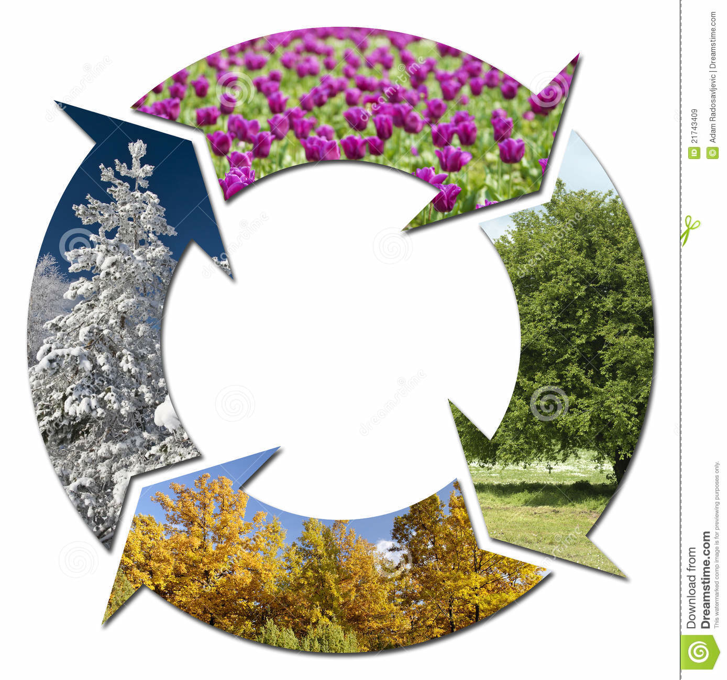
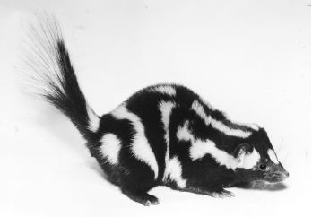
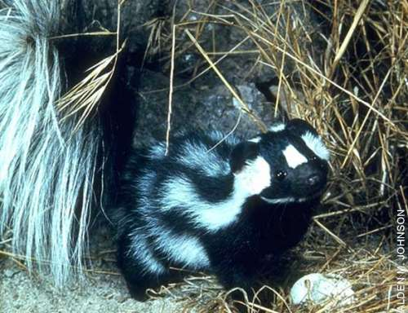
Temporal isolation
Species that breed during different times of day, different seasons, or different years cannot mix gametes
Eastern spotted skunk
Western spotted skunk

Slide 13
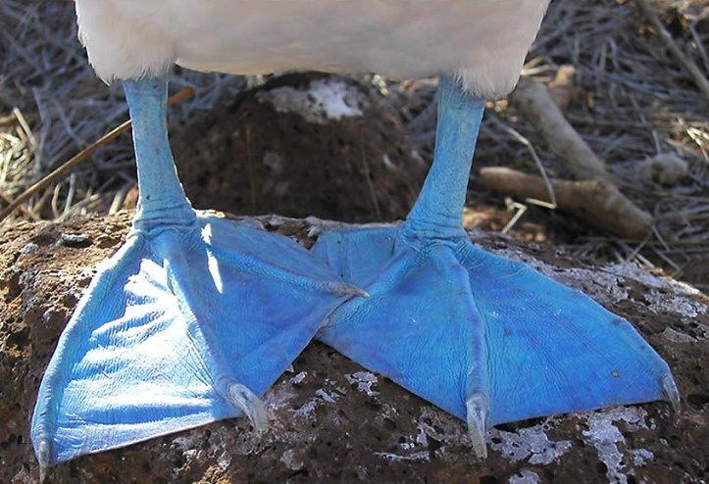
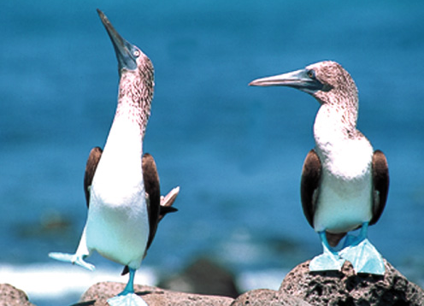
Behavioral isolation
Unique behavioral patterns & rituals isolate species
Identifies members of species
Attract mates of same species
Courtship rituals, mating calls
Blue footed boobies mate only after a courtship display unique to their species.

Slide 14
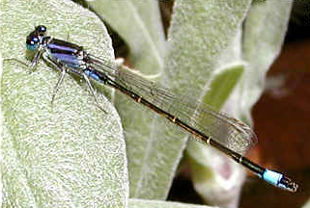
Mechanical isolation
Morphological differences can prevent successful mating
Monkey flower species differ in shape and color attracting different pollinators – no cross-pollination
Closely related species of insects often have very different sex organs – male and female don’t fit together so no sperm transfer

Slide 15
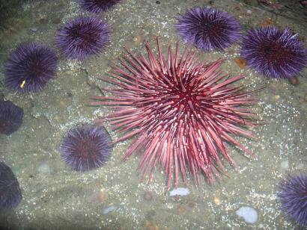
Gametic isolation
Sperm of one species may not be able to fertilize eggs of another species
biochemical barrier so sperm cannot penetrate egg or sperm cannot survive in female reproductive tract
Sea urchins release sperm & eggs into surrounding waters where they fuse & form zygotes. Gametes of different species— red & purple —are unable to fuse.

Slide 16
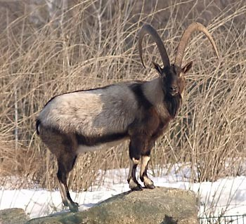
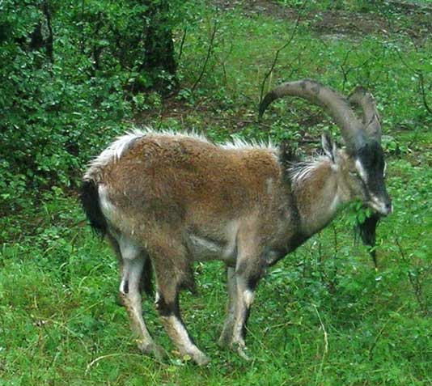
Hybridization – it’s possible
Creating an offspring (hybrid) from parents of different species
Hybrid may not be viable (functional)
Hybrid may be sterile
Hybrids are usually less fit than either parent
This pressure prevents such species from hybridizing

Slide 17
Gradualism
Gradual divergence over long periods of time
Assumes that big changes occur as small changes accumulate

Slide 18
Punctuated equilibrium
Rate of speciation is not constant
Species undergo rapid change when they first split from parent population
Long periods of little/no change with bursts of rapid change

Slide 19
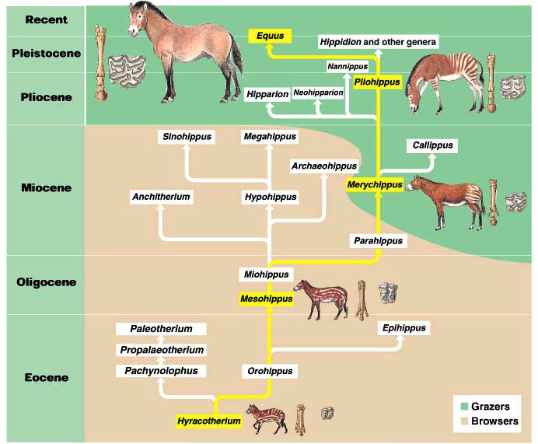
Evolution is not goal-oriented

Slide 20
Evolution is not goal-oriented
Evolutionary trends do not indicate evolution is working toward some larger goal.
Surviving species are not perfect – random chance and compromise are involved in creating the life on earth we have today.
Survival of the good-enough!
THIS ALSO APPLIES TO HUMAN EVOLUTION!

Slide 21
Questions?

