Slide 1
Structural Adaptations (ANIMALS)

Slide 2
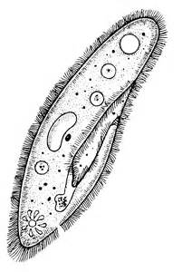
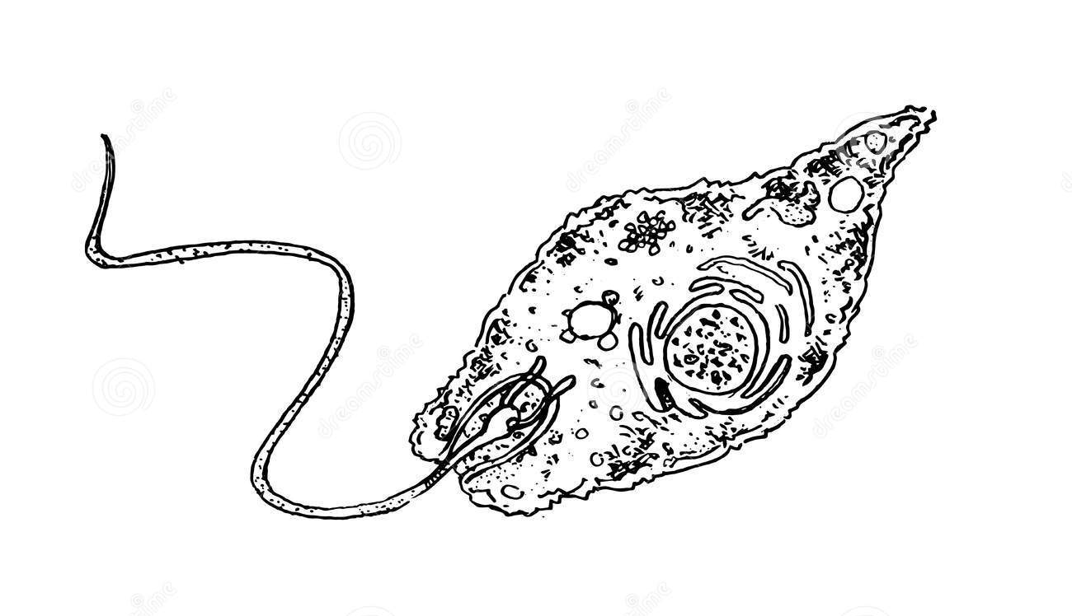
Movement Adaptations
Cilia, flagellum, pseudopods
Many animals have an endoskeleton

Slide 3
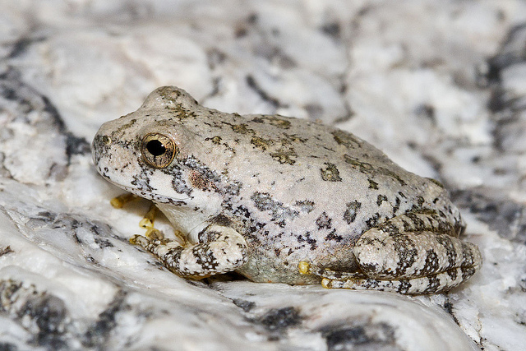
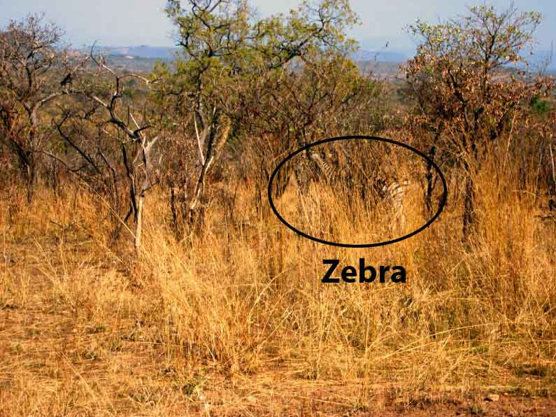
Camouflage
Animals blend in to the pattern and/or colors of their environment
Hide from predators

Slide 4
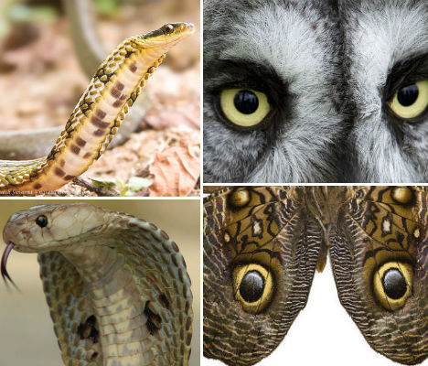
Mimicry
An animal copies or mimics the phenotype of another animal
The original animal usually poisonous/dangerous and the mimic is not

Slide 5
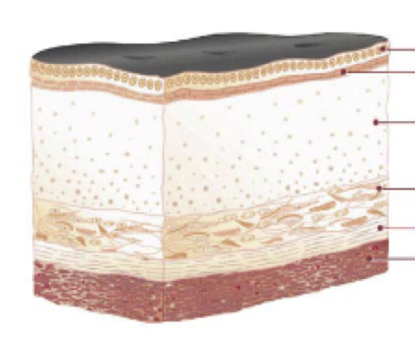
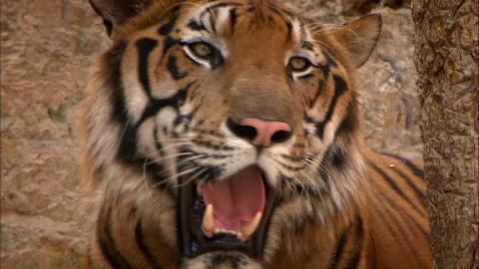
Thermoregulation
Mammals have a coat of fur/hair, layer of fat
Sweat glands, panting to cool off

Slide 6
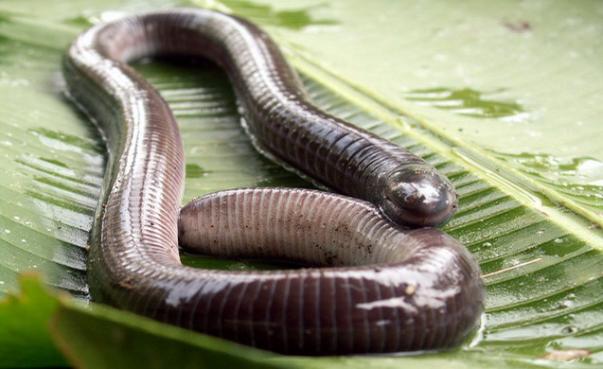
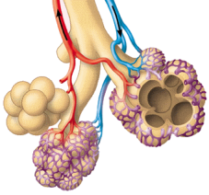
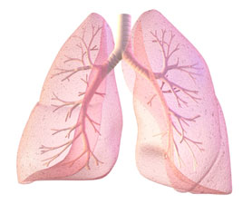
Respiratory Adaptations
Moisture required for effective respiration
Facilitates exchange of oxygen for carbon dioxide
Water is limited!
Internal respiratory structures stay moist

Slide 7
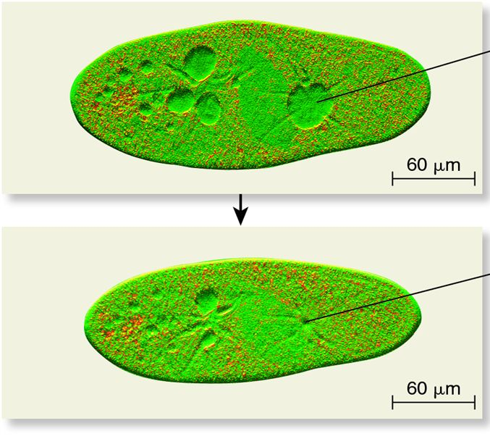
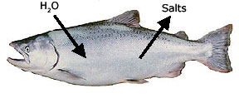
Osmoregulation
Contractile vacuole regulates amount of water in unicellular protists.
Aquatic animals regulate water based on environment
Fresh water = excrete dilute urine
Salt water = drink water, secrete excess salt

Slide 8
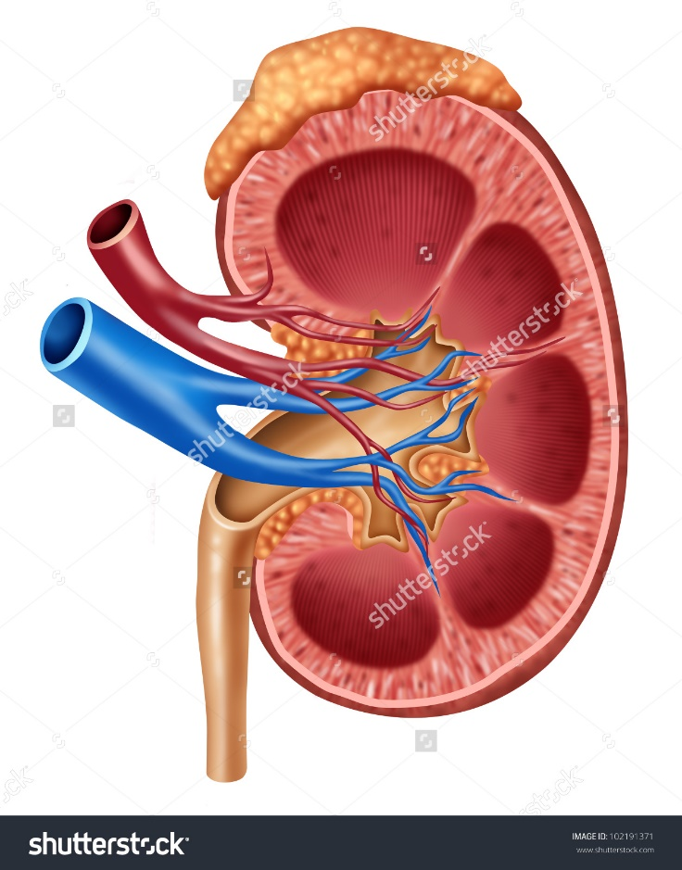
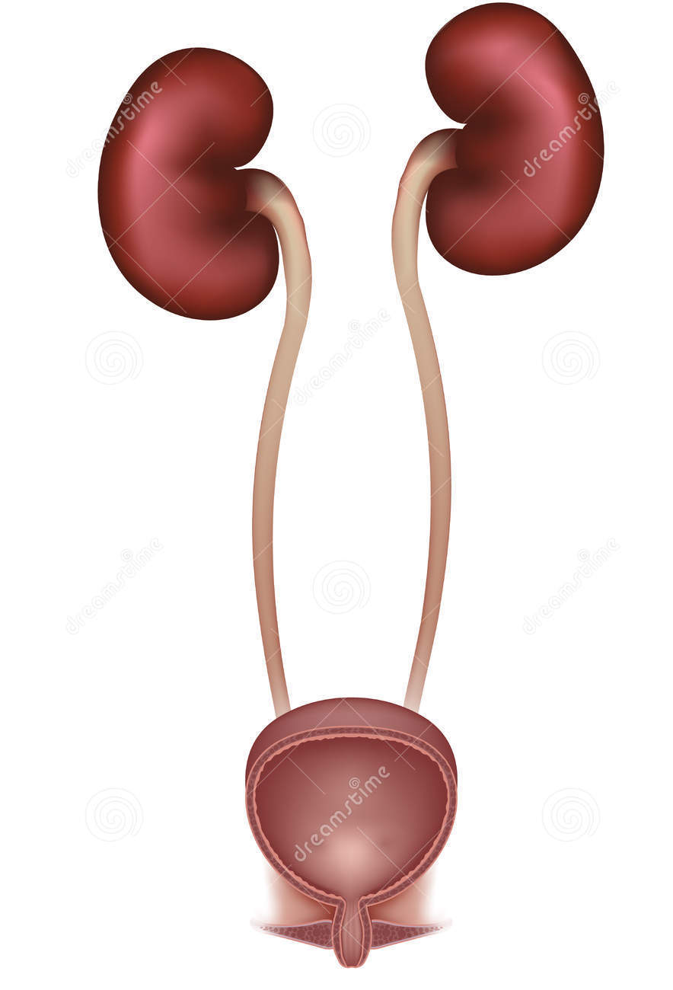
Osmoregulation
Terrestrial animals have concentrated urine to conserve water

