Slide 1
Structural Adaptations (PLANTS & FUNGI)

Slide 2
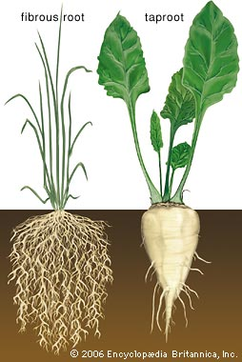
Nourishment
Plants have a vascular system (roots, vessels) for moving water, sugars and minerals through the organism.
Many fungi have network of hyphae
Secrete enzymes for digestion
Absorb nutrients afterward

Slide 3
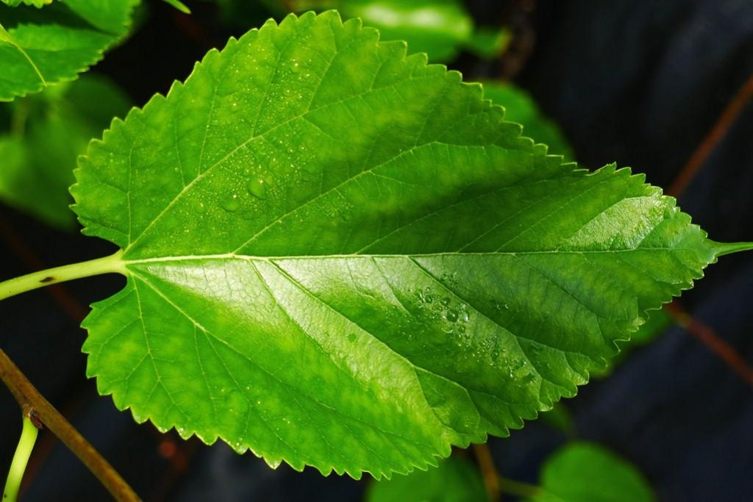
Nourishment
Plants also have leaves for capturing sunlight to use in photosynthesis.
More surface area = more sunlight = more sugars made

Slide 4
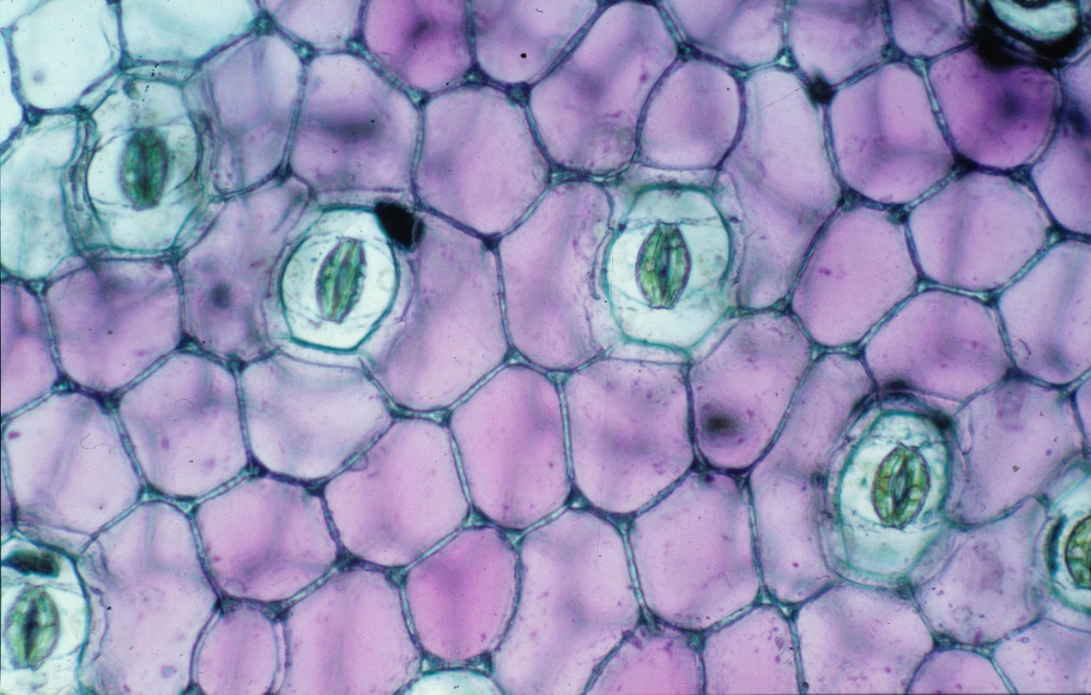
Stomata
“Pores” in the leaf for gas exchange
CO2 into plant for photosynthesis
O2 as waste product

Slide 5
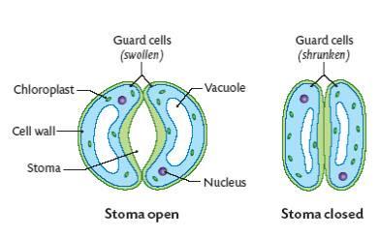
Stomata
Guard cells control opening
Swell with water to open
Lose water to close

Slide 6
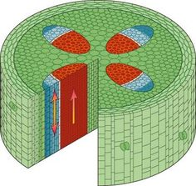
Transport
Xylem = vessels of dead cells that carry water from roots to leaves

Slide 7
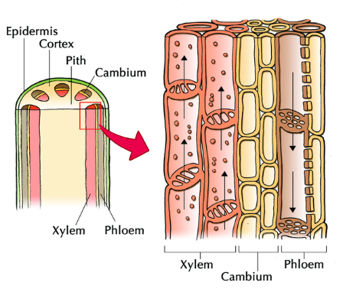
Transport
Phloem = vessels that carry sugars from leaves to rest of plant

Slide 8
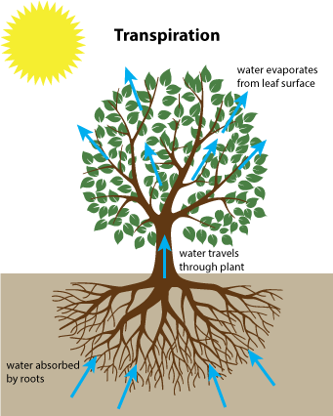
Thermoregulation
Stomata opening also releases water (like sweating)
Transpiration
Evaporating water cools the plant

