Slide 1
TELOMERES

Slide 2
Telomeres
Located at the ends of the chromosomes
Contain hundreds to thousands of repeats of a 6-base DNA sequence
Most cells lose 50-200 endmost bases after each cell division
After about 50 divisions, shortened telomeres signal the cell to stop dividing
Sperm, eggs, bone marrow, and cancer cells produce telomerase that prevent shortening of telomeres
Figure 2.3

Slide 3
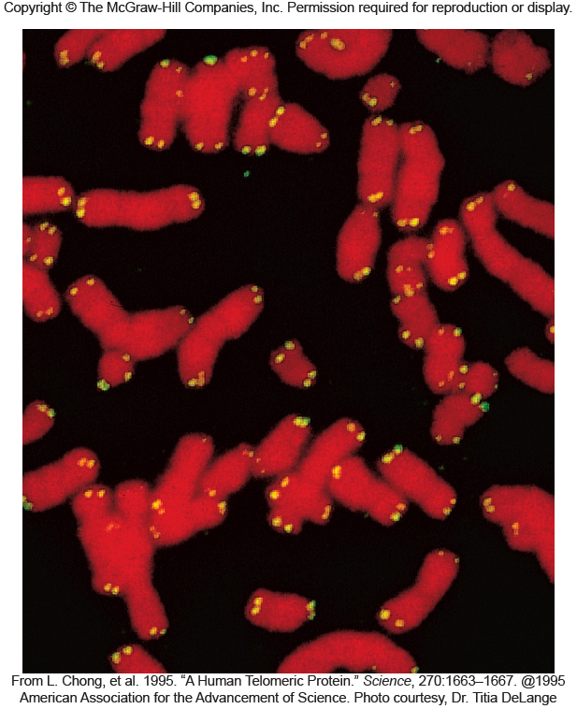
Figure 2.18

