Slide 1
BELL RINGER
What is a virus? What does it look like?

Slide 2
The History of DNA

Slide 3
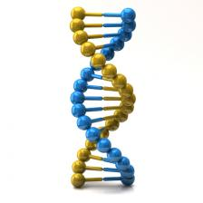
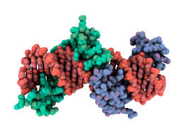
What is our “heritable” material?
Inheritance has been studied since the 1800s.
DNA has been known since the 1880s.
Did not know what macromolecule was responsible for heritable traits.

Slide 4
Griffith’s Experiment (1928)
Frederick Griffith wanted to study how information could be transferred between bacteria.

Slide 5
Griffith’s Experiment
Frederick Griffith wanted to study how information could be transferred between bacteria.
Injected mice with 2 different strains of pneumococcus bacteria
Rough (R) = no protective coat, did not cause disease
Smooth (S) = protective coat, caused disease

Slide 6
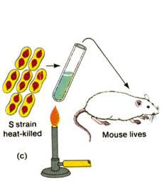
Griffith’s Experiment
Third test involves killing S-strain bacteria using heat before injection

Slide 7
Griffith’s Experiment
Fourth test involved combining heat-killed S with R-strain bacteria before injection.

Slide 8
Questions
What is the independent variable? Dependent?
Why do the heat-killed S-strain test?
Why did mixing the bacteria result in death in the fourth test?

Slide 9
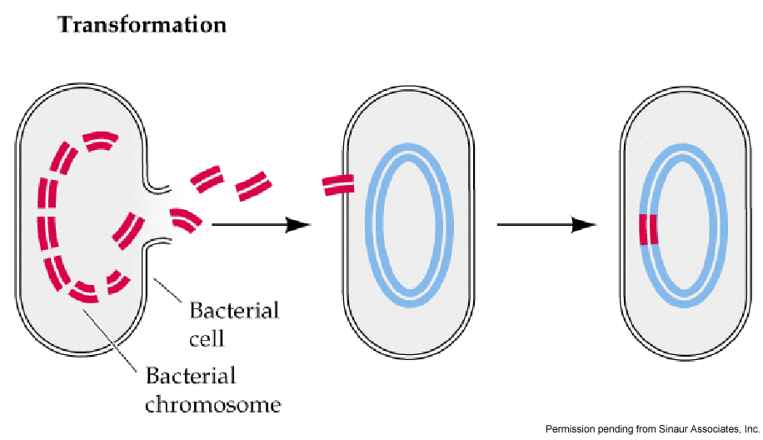
Transformation
Bacteria can be “transformed” by taking in DNA from the environment or other cells.

Slide 10
Avery-MacLeod-McCarty Experiment (1944)
Expanded on Griffith’s experiment to determine what molecules would be involved in bacteria transformation.
They repeated the third test with heat-killed bacteria and separated out the different parts of the dead cells.

Slide 11
Avery-MacLeod-McCarty Experiment
Adding S-strain DNA to R-strain bacteria killed the mice.
Adding S-strain protein to R-strain bacteria did not.

Slide 12
Question
This experiment was the first to show that what molecule was most likely the genetic material?

Slide 13
Hershey-Chase Experiment (1952)
Alfred Hershey and Martha Chase
Wanted to confirm the results of the Avery-MacLeod-McCarty experiment.
Most scientists were convinced that proteins were the genetic material.

Slide 14
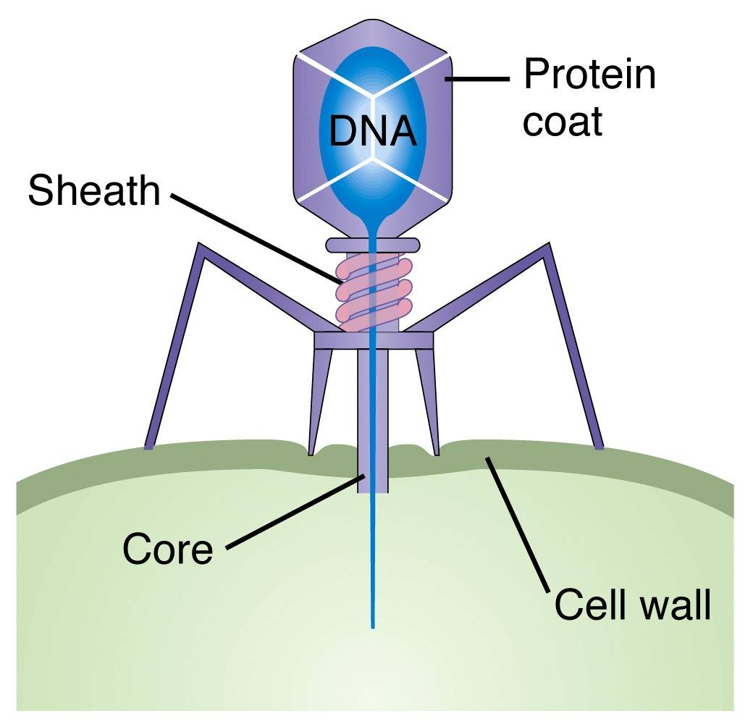
Hershey-Chase Experiment
Used bacteriophage virus on bacteria cells

Slide 15
Hershey-Chase Experiment
Created two sets of radioactively labeled bacteriophage
Sulfur label = protein (red)
Phosphorus label = DNA (green)

Slide 16
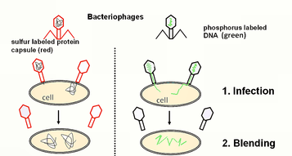
Hershey-Chase Experiment
They infected bacteria using the two types of bacteriophage.

Slide 17
Hershey-Chase Experiment
After blending they used a centrifuge.
Bacteria cells are heavier, should end up at the bottom.

Slide 18
Questions
How did the virus infect the bacteria?
Do you think DNA or protein carry genetic information?

Slide 19
EXIT TASK
Summarize the purpose and results of each experiment in your own words.

