Slide 1
Bell Ringer
In the Naked Egg Lab, what is your manipulated variable? What is your responding variable?

Slide 2
Bell Ringer
In the summer of 2014 a student athlete consumed four gallons of water during practice and later died from water intoxication. Drinking too much water very quickly causes your blood to become diluted (watery). What type of solution is this and describe what happens to the shape of your cells.

Slide 3
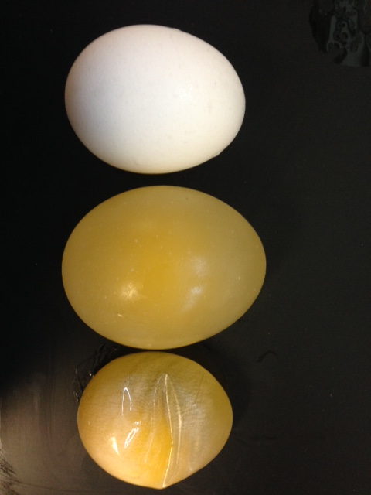
Tonicity

Slide 4
What is it?
The relative concentration of solutions separated by a semi-permeable membrane.
Let’s us know the direction and amount of diffusion/osmosis.

Slide 5
What is it?
The relative concentration of solutions separated by a semi-permeable membrane.
Let’s us know the direction and amount of diffusion/osmosis.

Slide 6
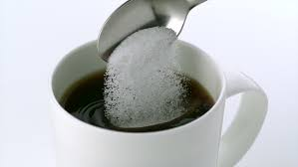
Solution
A homogenous (well combined) mixture of two or more substances.
Ex: Kool-aid, coffee with sugar, salt water

Slide 7
Solute
The substance that gets dissolved in the solution.
Ex: sugar, salt, drink mix can all be dissolved in liquid.

Slide 8
Solvent
The substance that does the dissolving.
Ex: water, alcohol, oil, beverages can all dissolve other substances.

Slide 9
Isotonic
Iso- = equal
The concentration of water in the solution and in the cell is equal.
Water continuously diffuses back and forth across the membrane.

Slide 10
Isotonic
Iso- = equal
The concentration of water in the solution and in the cell is equal.
Water continuously diffuses back and forth across the membrane.

Slide 11
Hypotonic
Hypo- = under, below
The solute concentration outside the cell is less than the solute concentration inside the cell.
Where is there more water?

Slide 12
Hypotonic
Hypo- = under, below
The solute concentration outside the cell is less than the solute concentration inside the cell.
More water outside the cell means water will move into the cell.

Slide 13
Hypotonic
Hypo- = under, below
The solute concentration outside the cell is less than the solute concentration inside the cell.
More water outside the cell means water will move into the cell.

Slide 14
Hypertonic
Hyper- = over, above
The solute concentration outside the cell is greater than the solute concentration inside the cell.
Where is there more water?

Slide 15
Hypertonic
Hyper- = over, above
The solute concentration outside the cell is greater than the solute concentration inside the cell.
More water inside the cell means water will move out of the cell.

Slide 16
Hypertonic
Hyper- = over, above
The solute concentration outside the cell is greater than the solute concentration inside the cell.
More water inside the cell means water will move out of the cell.

Slide 17
Review

Slide 18
EXIT TASK
What will your claim be for your conclusion paragraph? What is one piece of evidence that supports it?

Slide 19
Exit Task
In the summer of 2014 a student athlete consumed four gallons of water during practice and later died from water intoxication. Drinking too much water very quickly causes your blood to become diluted (watery). What type of solution is this and describe what happens to the shape of your cells.

