Slide 1
Transgenic Organisms

Slide 2
What is a Transgenic Organism?
Transgenic Organisms – organisms that contain foreign DNA (DNA from another organism).

Slide 3
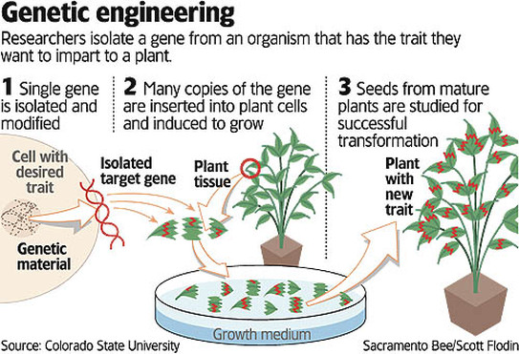

Slide 4
Recombinant DNA
DNA made by connecting or recombining fragments of DNA from different sources.
Transgenic organisms are created using recombinant DNA.

Slide 5
Making a Transgenic Organism
STEP 1
Isolate the gene you wish to insert into your organism
Cut out gene using restriction enzyme

Slide 6
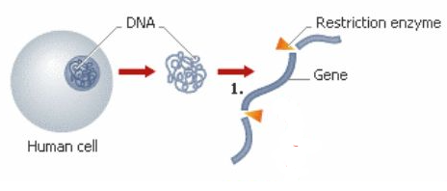

Slide 7
Making a Transgenic Organism
STEP 2
A bacterial plasmid is removed from a bacterium
Plasmid = circular bacterial chromosome
Plasmid is cut using same restriction enzyme as Step 1 to create opening

Slide 9
Making a Transgenic Organism
STEP 3
Your gene is “pasted” into the plasmid you prepared in Step 2
DNA must become part of the genetic material of living cells before the genes they contain can be activated.

Slide 11
Making a Transgenic Organism
STEP 4
The newly made recombinant DNA with the foreign gene is returned to the organism (ex: bacteria or an embryo).
The transgenic organism will show a new trait when that gene is expressed (a protein is made).

Slide 12
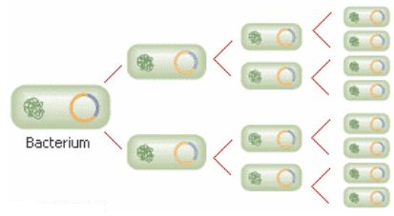

Slide 13
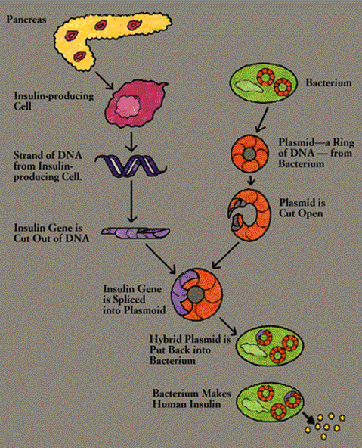

Slide 14
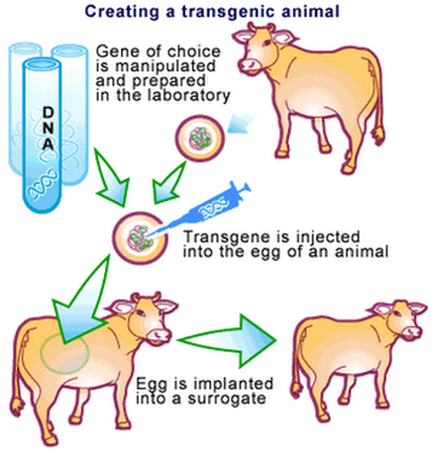

Slide 15
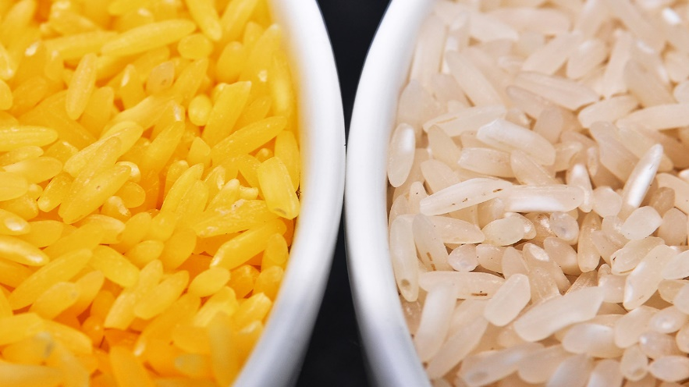
Applications of Biotechnology
1. Pharmaceutical use, to treat human disorders.
EX: Diabetes – condition where people cannot make insulin. Transgenic bacteria use human insulin gene to make human insulin.
EX: Golden Rice – transgenic rice with Vitamin A to treat eye problems in poor countries

Slide 16
Applications of Biotechnology
2. Industry Ex: Create bacteria that can break down oil from oil spills faster than normal bacteria. They are the first patented organisms.
Ex: High protein corn with protein levels similar to beef.

Slide 17
Applications of Biotechnology
3. Agriculture
Ex: Corn, broccoli, potatoes and cotton have been developed to produce BT toxin from bacterial gene, which makes them resistant to certain pests.
Ex: Plants that are resistant to frost damage
GOAL IS ALWAYS INCREASED PRODUCTION OF CROPS

Slide 18
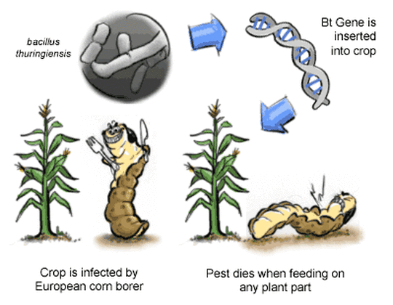

Slide 19
Gene Therapy
Gene therapy is the insertion of normal genes into human cells to correct genetic disorders.
Trial stages – first attempted with cystic fibrosis.

Slide 20
How does gene therapy work?
Create transgenic virus with functional gene

Slide 21
How does gene therapy work?
Create transgenic virus with functional gene
Introduce the virus to the lungs (the organ manly affected by cystic fibrosis) using a nasal spray.

Slide 22
How does gene therapy work?
Create transgenic virus with functional gene
Introduce the virus to the lungs (the organ manly affected by cystic fibrosis) using a nasal spray.
Hope that the lung cells take up the functional gene into their chromosomes and make the normal protein.

Slide 23
How does gene therapy work?
Create transgenic virus with functional gene
Introduce the virus to the lungs (the organ manly affected by cystic fibrosis) using a nasal spray.
Hope that the lung cells take up the functional gene into their chromosomes and make the normal protein.
Drawback = the genes do not always stay active for long periods of time.

Slide 24
