Slide 1
Transgenic Organisms

Slide 2
What is genetic engineering?
A method of cutting DNA from one organism and inserting the DNA fragments into a host organism of the same or different species.

Slide 3
What is a Transgenic Organism?
Transgenic Organisms – organisms that contain foreign DNA (DNA from another organism).

Slide 4
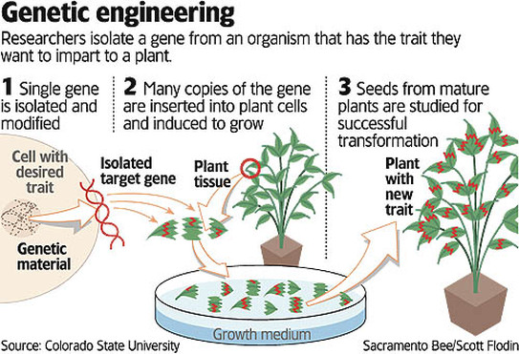

Slide 5
Recombinant DNA
Transgenic organisms are created using recombinant DNA.
DNA made by connecting or recombining fragments of DNA from different sources.

Slide 6
Making a Transgenic Organism
STEP 1
Cut and Paste (Just like word processing)
Restriction enzymes (bacterial proteins) cut DNA (like scissors) at specific sequences (the gene you want) from the original organism’s chromosome.

Slide 7
Making a Transgenic Organism
STEP 1
Cut and Paste (Just like word processing)
Restriction enzymes (bacterial proteins) cut DNA (like scissors) at specific sequences (the gene you want) from the original organism’s chromosome.
What structure on your restriction fragment would make “pasting” it into a chromosome much easier?

Slide 8
Making a Transgenic Organism
STEP 2
The DNA fragments are incorporated into part of the recipient cell’s genetic material.
DNA fragments cannot function all by themselves. They must become part of the genetic material of living cells before the genes they contain can be activated.

Slide 9
Making a Transgenic Organism
STEP 3
The newly made recombinant DNA with the foreign gene is returned to an organism (ex: bacteria or an embryo).
The transgenic organism will show a new trait when that gene is expressed (a protein is made).

Slide 10
Bacteria and Recombination
DNA fragments may be combined with bacterial DNA so they can later be inserted into a bacterial cell.
Bacteria contain small circular DNA molecules known as plasmids in addition to their chromosomes. These plasmids can be removed from the bacterial cells and cut with the same restriction enzyme used to produce the DNA fragments.

Slide 11
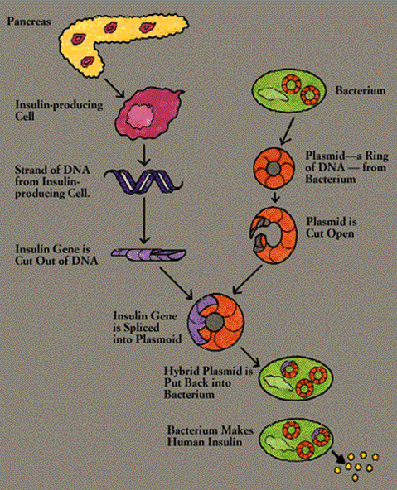

Slide 12
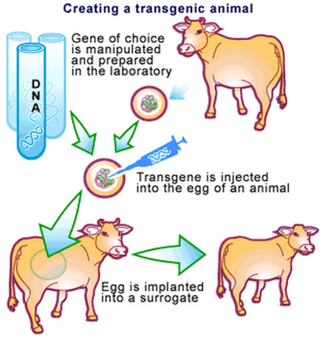

Slide 13
Making a Recombinant Plasmid
The cuts made by the restriction enzymes produce the same “sticky ends” on the DNA and the cut plasmids. These sticky ends are the sites at which the DNA fragment and the plasmid can be joined end to end (paste), thereby forming a new plasmid that contains a piece of foreign DNA (recombinant DNA).

Slide 14
Why do it?
1. Pharmaceutical use, to treat human disorders.
Diabetes – condition where people cannot make insulin. Transgenic bacteria use human insulin gene to make human insulin.
Vaccines – Transgenic pathogens that don’t hurt humans contain harmless viral genes so that your body can recognize viral proteins when you do get sick.

Slide 15
Why do it?
2. Industry Create bacteria that can break down oil from oil spills faster than normal bacteria. They are the first patented organisms.
High protein corn with protein levels similar to beef.
Automobile fuel from discarded corn stalks.
Goats that produce spider silk in their milk.
http://www.bbc.com/news/science-environment-16554357

Slide 16
Why do it?
3. Agriculture
Corn, broccoli, potatoes and cotton have been developed to produce BT toxin from bacterial gene, which makes them resistant to certain pests.
Plants that are resistant to frost damage
Crops that are better tasting, stay fresher longer

Slide 17
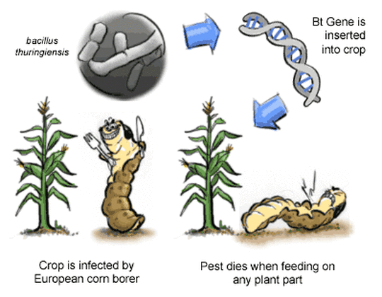

Slide 18
Gene Therapy
Gene Therapy is the insertion of normal genes into human cells to correct genetic disorders.
Trial stages – first attempted with cystic fibrosis.

Slide 19
How does gene therapy work?
Put the normal gene (the one that makes the normal transport protein) in a cold virus.
Introduce the virus to the lungs (the organ manly affected by cystic fibrosis) using a nasal spray.
Hope that the lung cells take up the normal gene into their chromosomes and make up normal protein.
Drawback = the genes do not always stay active for long periods of time.

Slide 20
