Slide 1
Bacterial Transformation

Slide 2
Objective
Produce bacterial colonies with a new trait (ex: antibiotic resistance, green fluorescence) by facilitating the bacterial uptake of a recombinant bacterial chromosome (transformation).

Slide 3
Step 1: Create recombinant plasmid
Determine restriction enzyme for cutting out gene of interest (antibiotic resistance gene).
Same enzyme must cut circular bacterial chromosome (plasmid) into a single linear strand.
“Sticky ends” of resistance gene and plasmid are complementary – makes it easier for ligase to heal DNA backbone.

Slide 4
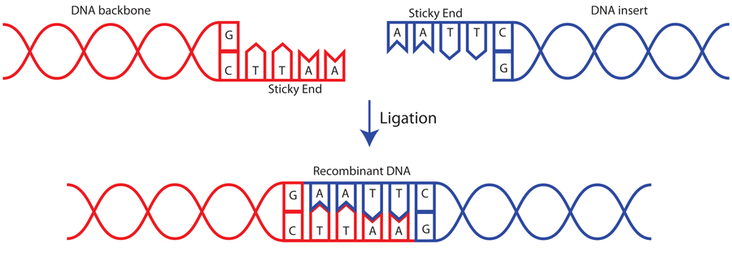

Slide 5
Step 2: Transformation
Control: bacteria transformed in the absence of recombinant plasmid.
Bacteria mixed with calcium chloride (and plasmid).
Kept on ice until heat shock step (less than 1 minute), return to ice.
Shock induces bacteria to take in plasmid from environment.
Plate bacteria on agar plates and incubate 24-48 hours.

Slide 6
Step 3: Plating
Plate transformed cells on agar growth plates with ampicillin
What will this show us?
What will be our control plates? Why?

Slide 7
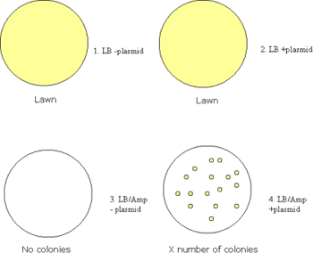
Step 3: Plating

Slide 8
Step 3: Plating

