Slide 1
Behavioral Adaptations

Slide 2
Innate Behavior
What is it?

Slide 3
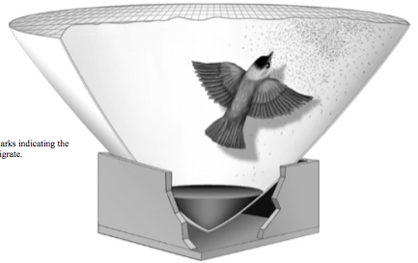
Innate Behavior
“Automatic” behavior
AKA instinct
Strong genetic component

Slide 4
Learned Behavior
What is it?

Slide 5
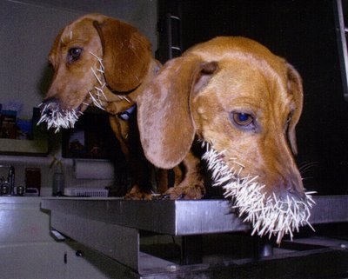
Learned Behavior
Behavior that is the result of experience or observation

Slide 6
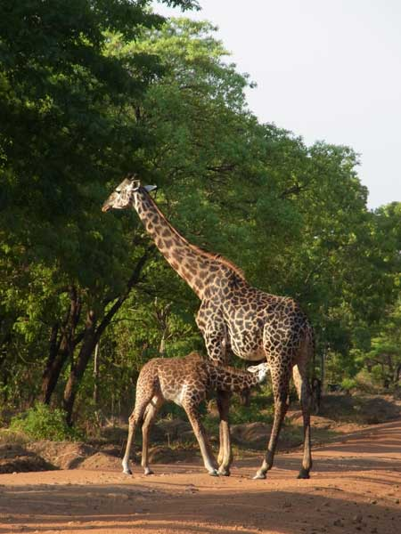
Suckling
Allows mammalian offspring to get nutrient-rich food safely
Innate or learned??

Slide 7
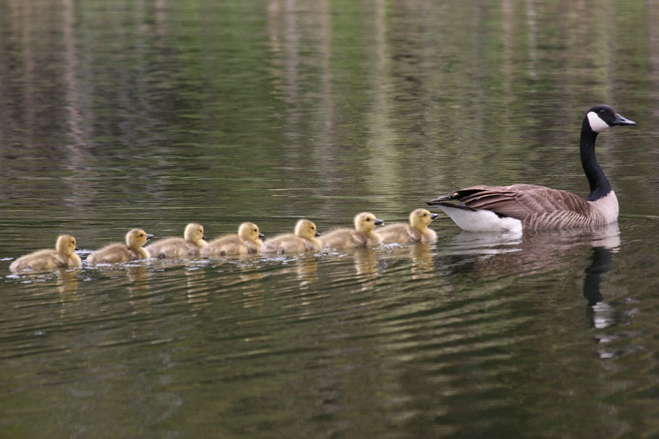
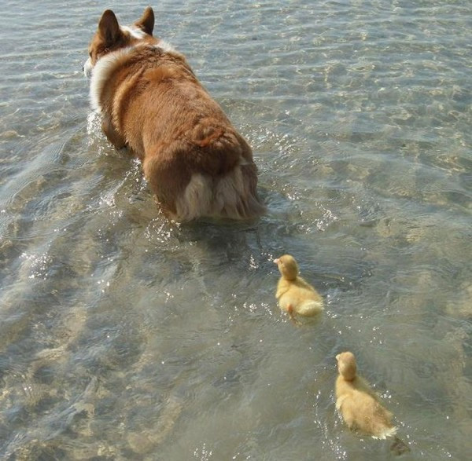
Imprinting
Offspring determine who parent is during a “sensitive period”
Parent learns to recognize its offspring
Offspring learn the behaviors of its species

Slide 8
Imprinting
Innate or learned??

Slide 9
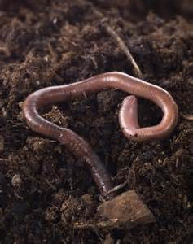
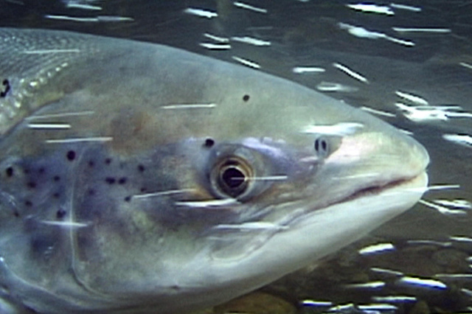
Taxis
Oriented movement toward or away from a stimulus
Innate or learned??

Slide 10
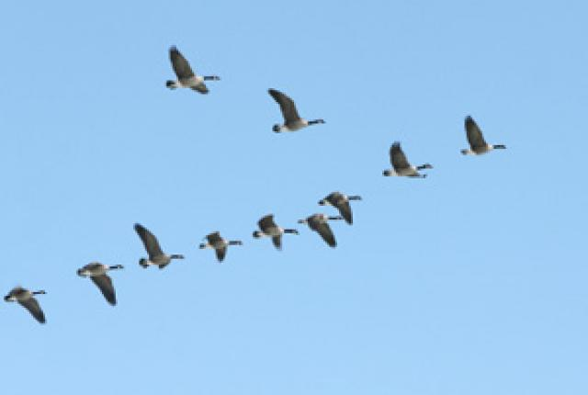
Migration
Moving as a group to a new environment
Usually during certain times of year.
Innate or learned??

Slide 11
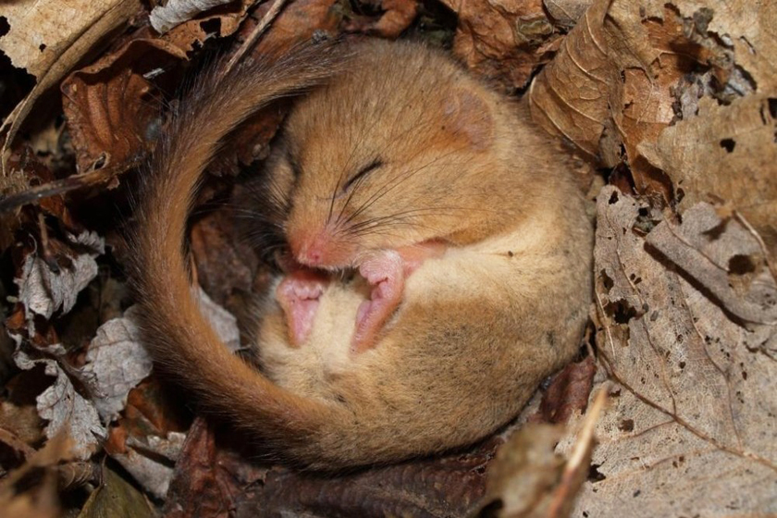
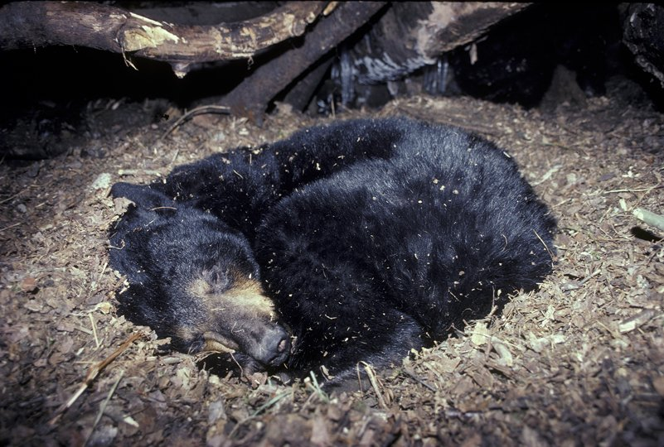
Hibernation
A state of inactivity during long periods of cold temperatures and reduced food supplies
Innate or learned??

Slide 12
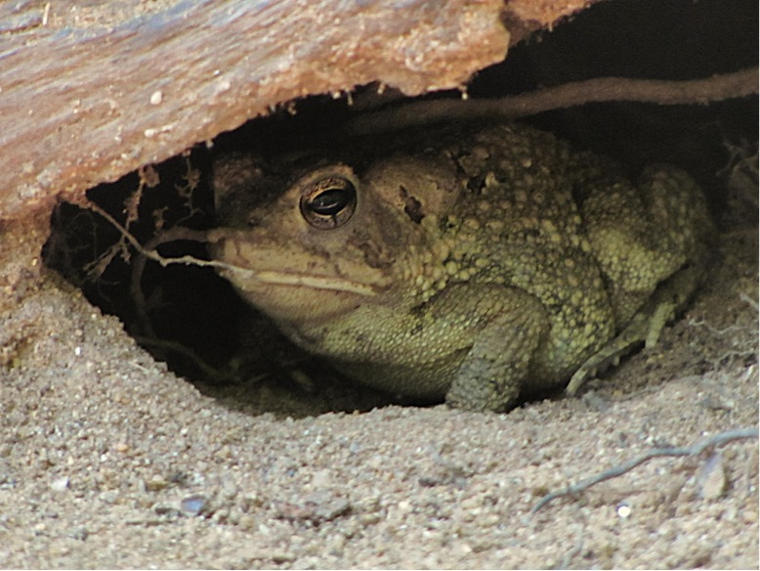
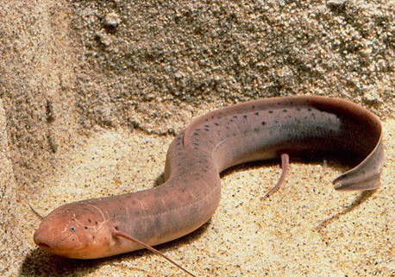
Estivation
A state of inactivity during long periods of high temperatures and reduced water supplies
Innate or learned??

Slide 13
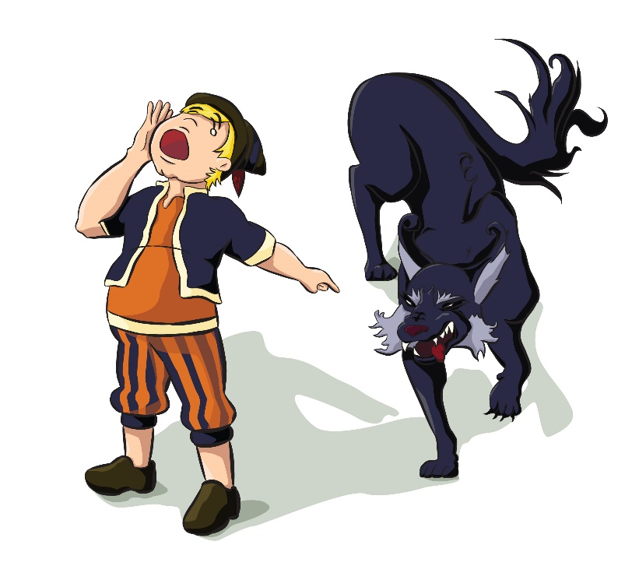
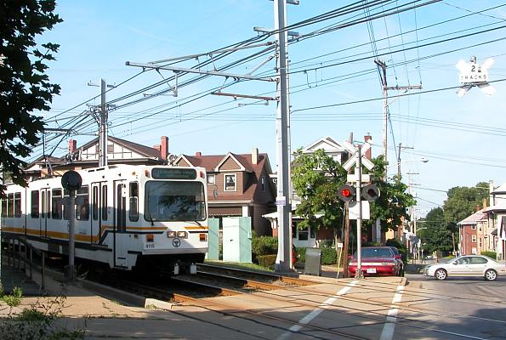
Habituation
A loss of responsiveness to stimuli that convey little or no information.
Innate or learned??

Slide 14
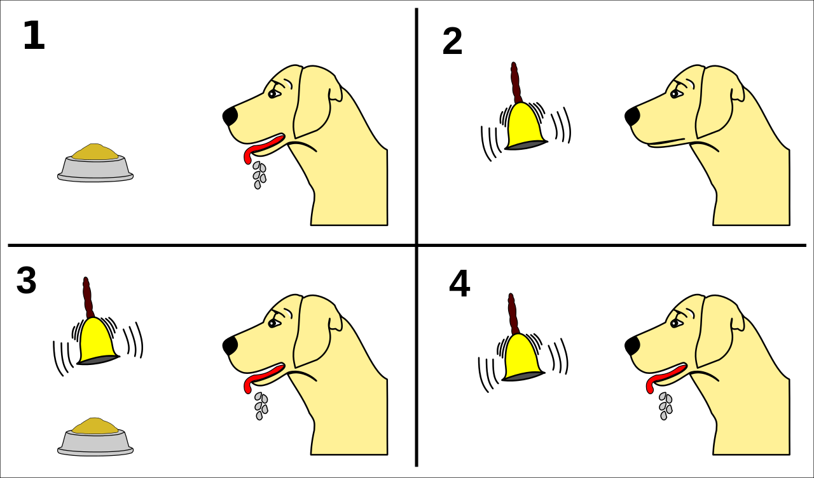
Classical conditioning
The association of a normally irrelevant stimulus with a behavioral response

Slide 15
Classical conditioning
Innate or learned??

Slide 16
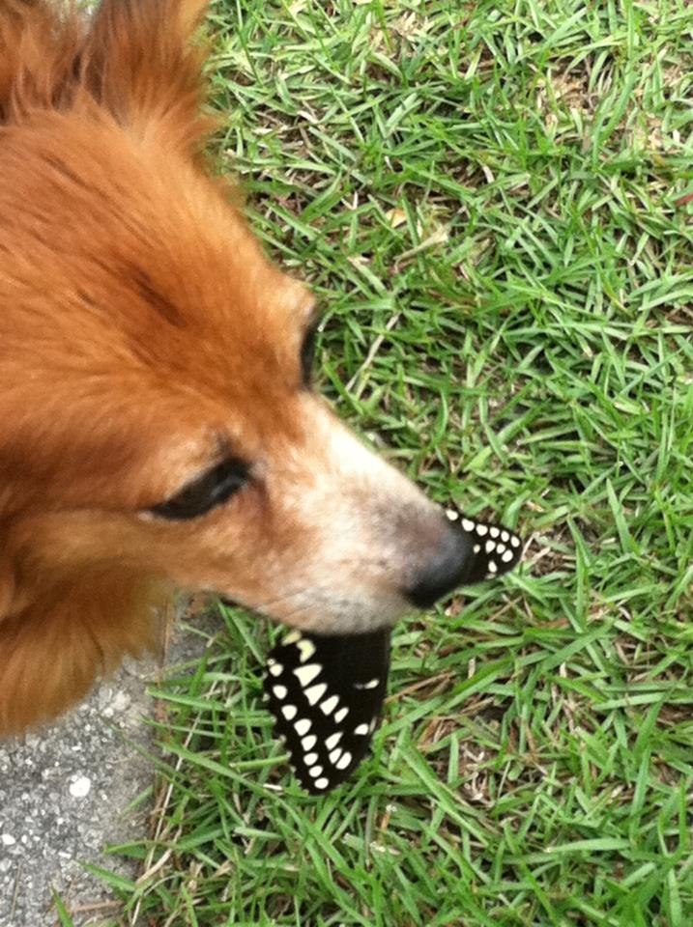
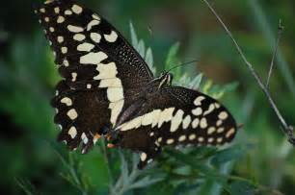
Operant conditioning
The association of a behavior with a reward or punishment
Animal tends to repeat or avoid that behavior

Slide 17
Operant conditioning
Innate or learned??

Slide 18
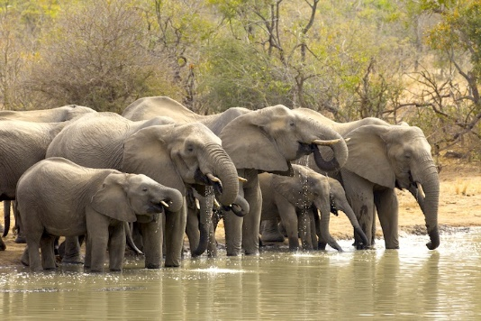
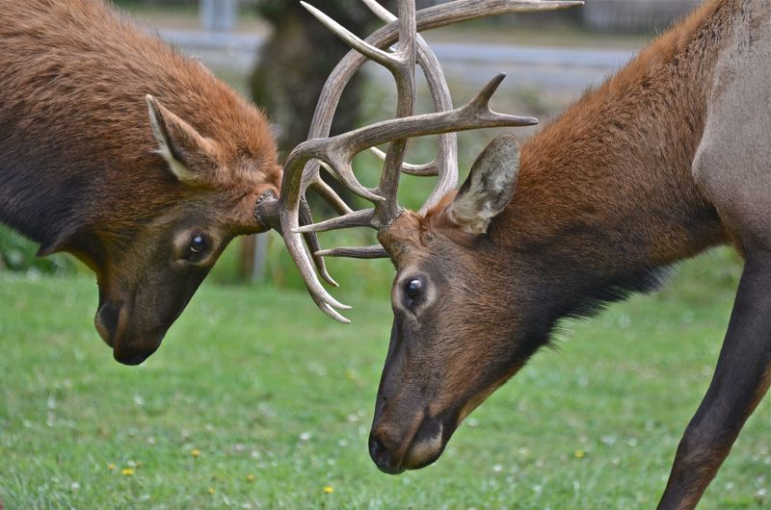
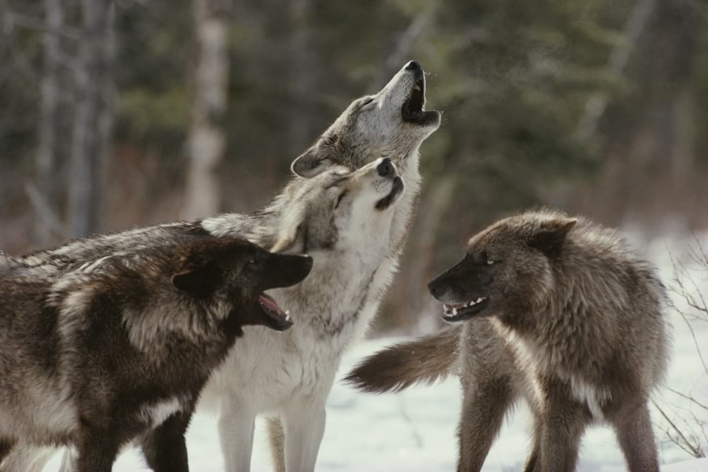
Social behavior
Interactions between individuals of the same species
Communication, hierarchy, agonistic

Slide 19
Social behavior
Innate or learned??

Slide 20
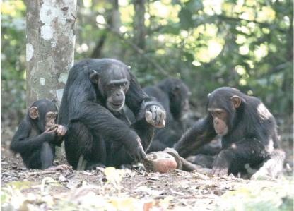
Social behavior
Social learning:
Modification of behavior through the observation of other individuals.

