Slide 1
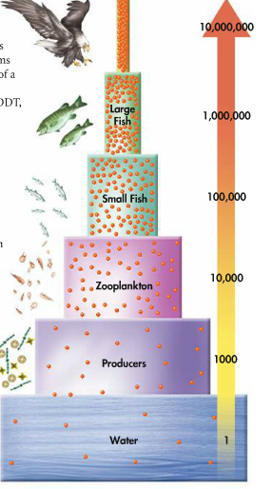
BELL RINGER
What do you think this image is showing?

Slide 2
“DDT and Bald Eagles” Comprehension Questions
Answer each question in complete sentences, incorporate the question in your response.
How was DDT originally used?
How was DDT used after World War 2?
Describe the chain of events that resulted in high levels of DDT in bald eagles.
How did DDT affect bald eagles and what did this do to its population?
According to the article how have humans tried to mitigate the effects of DDT on the environment?

Slide 3
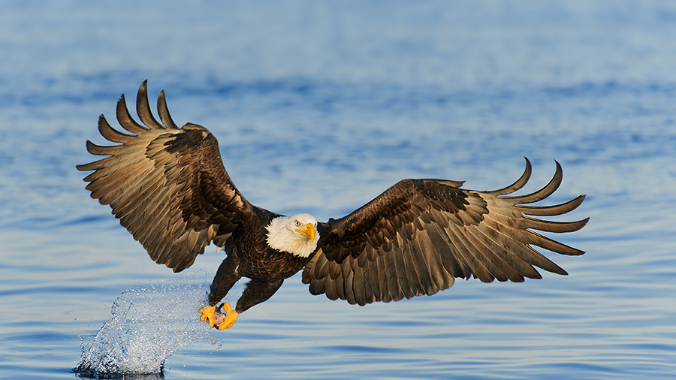
Bioaccumulation

Slide 4
What is it?
The accumulation of substances (i.e. pesticides) in an organism as it absorbs a toxic substance faster than it loses it.

Slide 5
How does it happen?
Producers absorb the toxic substance and store it.
Toxic substances end up stored in the tissue of a first-level (primary) consumer.
When the consumer is eaten by another consumer the toxic substances are transferred to the secondary consumer.
The substance is not expelled from the body of each consumer at the rate that it is consumed, so as you move up the food chain you see a greater concentration of the substance.

Slide 6
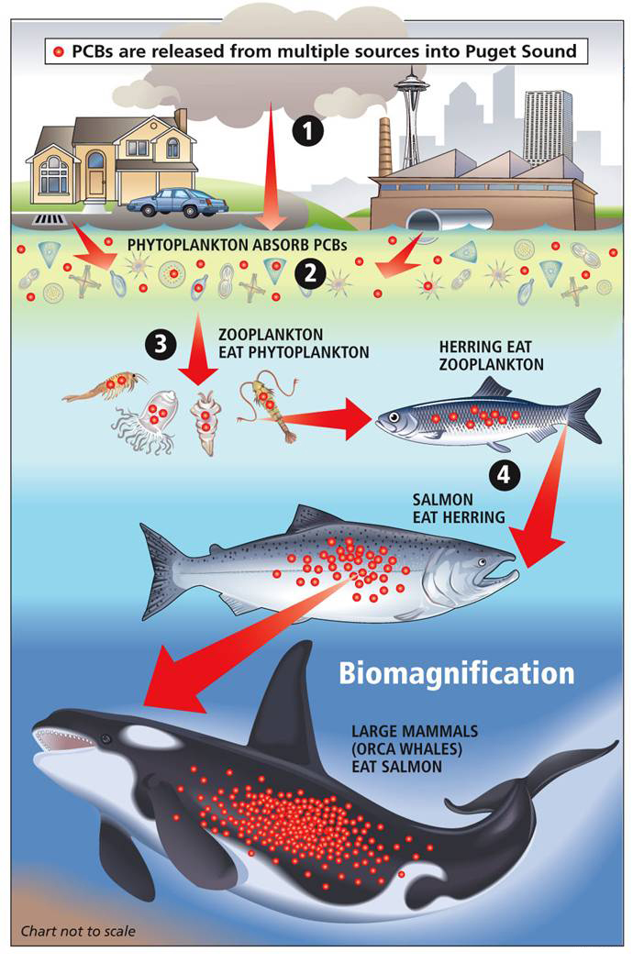
What are the consequences?
The large-scale effects of a chemical on an ecosystem are truly unknown until we can see how it accumulates in a food chain/web.
By then the damage has already been done.

Slide 7
EXIT TASK
For most people there is no health risk to eating seafood, however doctors recommend that pregnant women and young children avoid eating too much seafood or certain kinds of fish altogether.
Based on what you’ve learned, why do you think this recommendation exists?

