Slide 1
Cell Differentiation

Slide 2
Stem Cell Review
What kinds of cells are found in the embryo?

Slide 3
Stem Cell Review
What kinds of cells are found in the embryo?
These cells have what kind of function?

Slide 4
Stem Cell Review
What kinds of cells are found in the embryo?
These cells have what kind of function?
Embryos have totipotent stem cells and yet when a baby is born it has 260+ specialized cell types. HOW?

Slide 5
Differentiation
The process of a cell becoming specialized.
Your somatic cells have all the genes that make you who you are.
But each cell type only needs the instructions to perform its specific job.

Slide 6
Differentiation
The process of a cell becoming specialized.
Your somatic cells have all the genes that make you who you are.
But each cell type only needs the instructions to perform its specific job.
Genes that are not needed are turned off.
Specialized cells usually cannot become other cell types!

Slide 7
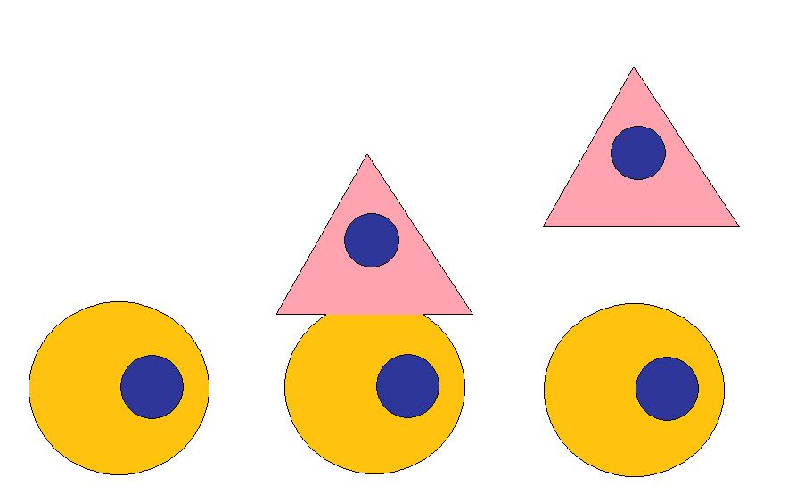
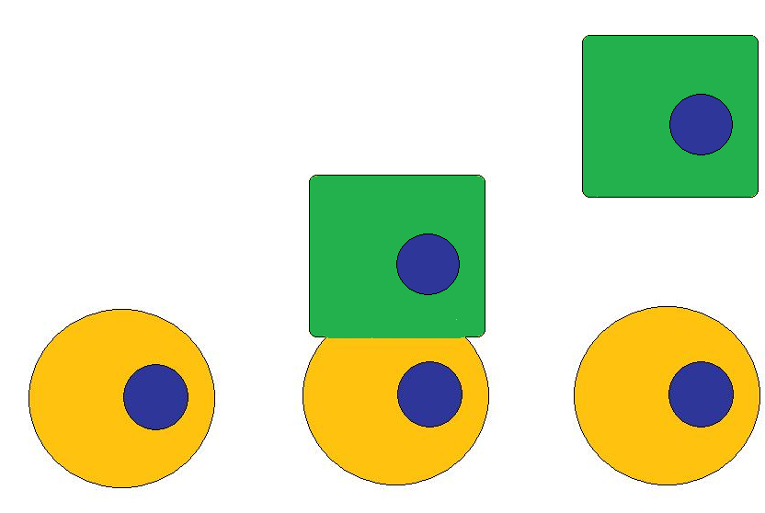
DIFFERENTIATION
DIFFERENTIATION
→ SELF – RENEWAL →
Notes:
Ok so that stem cell divided to produce a green progenitor cell which differentiates into a green skin cell (CLICK!). That stem cell can divide again, this time producing a different type of progenitor cell CLICK! which matures into yet another cell type, CLICK! like this brain cell.
OK so what makes a stem cell unique? (wait for answers) FIRST: it maintains its own population—self-renewal—and SECOND: its capacity to give rise to different progenitors that change into a mature cell—differentiation.

Slide 8
DIFFERENTIATION
DIFFERENTIATION
→ SELF – RENEWAL →
Notes:
Ok so that stem cell divided to produce a green progenitor cell which differentiates into a green skin cell (CLICK!). That stem cell can divide again, this time producing a different type of progenitor cell CLICK! which matures into yet another cell type, CLICK! like this brain cell.
OK so what makes a stem cell unique? (wait for answers) FIRST: it maintains its own population—self-renewal—and SECOND: its capacity to give rise to different progenitors that change into a mature cell—differentiation.

Slide 9
DIFFERENTIATION
DIFFERENTIATION
→ SELF – RENEWAL →
Notes:
Ok so that stem cell divided to produce a green progenitor cell which differentiates into a green skin cell (CLICK!). That stem cell can divide again, this time producing a different type of progenitor cell CLICK! which matures into yet another cell type, CLICK! like this brain cell.
OK so what makes a stem cell unique? (wait for answers) FIRST: it maintains its own population—self-renewal—and SECOND: its capacity to give rise to different progenitors that change into a mature cell—differentiation.

Slide 10
Central Dogma of Biology
The main idea of biology
DNA → RNA → proteins → phenotype

Slide 11
Central Dogma of Biology
By only having certain genes turned on, specialized cells only produce certain proteins.

Slide 12
Central Dogma of Biology
By only having certain genes turned on, specialized cells only produce certain proteins.
These certain proteins determine the cell’s phenotype (which includes its specific function for the body).

Slide 13
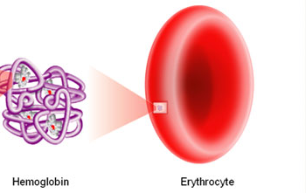
Central Dogma of Biology
By only having certain genes turned on, specialized cells only produce certain proteins.
These certain proteins determine the cell’s phenotype (which includes its specific function for the body).
RED BLOOD CELLS → Hemoglobin

Slide 14
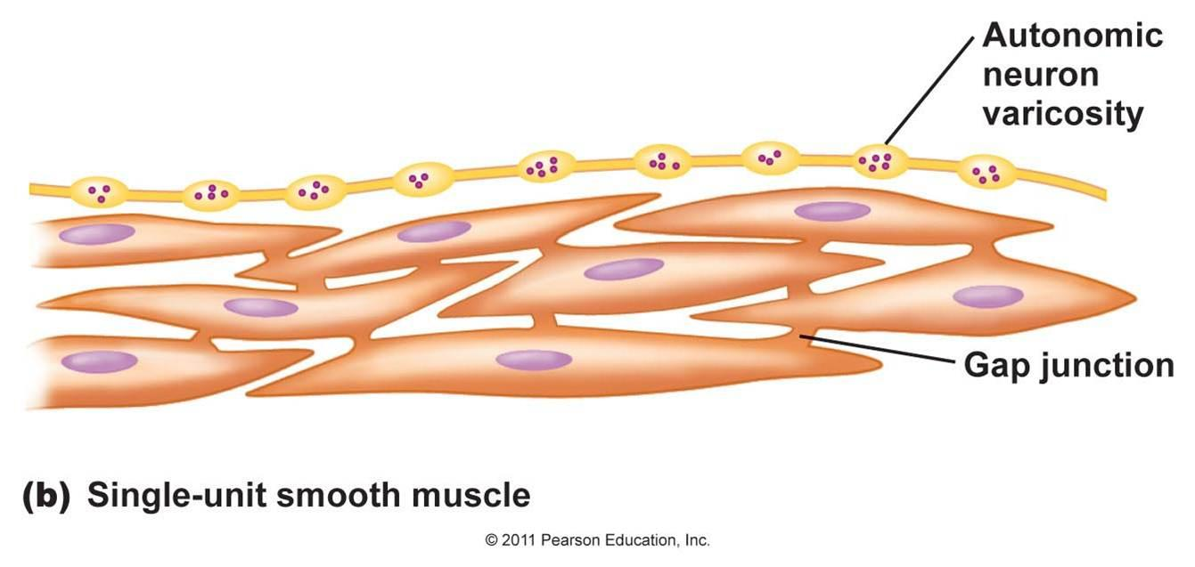
Central Dogma of Biology
By only having certain genes turned on, specialized cells only produce certain proteins.
These certain proteins determine the cell’s phenotype (which includes its specific function for the body).
MUSCLE CELL→ Actin & Myosin

Slide 15
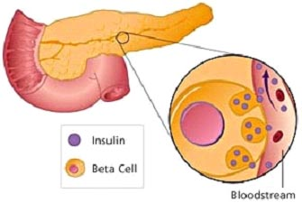
Central Dogma of Biology
By only having certain genes turned on, specialized cells only produce certain proteins.
These certain proteins determine the cell’s phenotype (which includes its specific function for the body).
PANCREAS CELL→ Insulin

