Slide 1
CELL MEMBRANE

Slide 2
The cell membrane is made of lipids
Phospholipids
Hydrophilic head
Hydrophobic tails

Slide 3
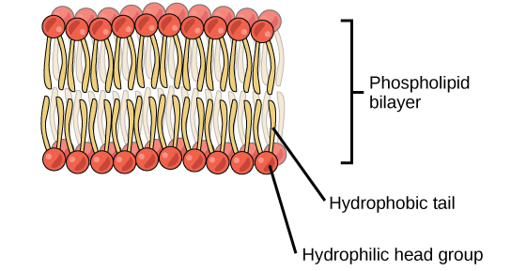
Membrane is a lipid bilayer

Slide 4
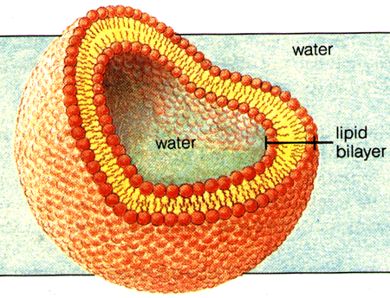
Membrane is a lipid bilayer
Allows membrane to interact with water inside and outside the cell

Slide 5
The cell membrane is fluid
Constantly moving and flowing
(video)

Slide 6
“Fluid mosaic” model
Other molecules are attached to or embedded in the membrane.

Slide 7
“Fluid mosaic” model
Other molecules are attached to or embedded in the membrane.
Cholesterol – regulates how temperature affects membrane fluidity
Peripheral proteins – membrane proteins that stick to the inside or outside of the membrane
Integral proteins – membrane proteins that span the entire width of the membrane

Slide 8
