Slide 1
Cell Wall Project
Brandon Vilorio

Slide 2
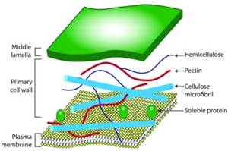
Major Processes
Along with protecting the contents of the cell, the cell wall gives structure to the plant, provides a porous medium for the circulation and distribution of water, minerals, and other nutrients, and houses specialized molecules that regulate growth and protect the plant from disease. As well as resist the turgor pressure that plant cells exert.

Slide 3
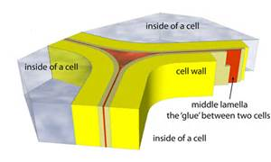
Interactions with other organelles
The Cell wall helps the cell not burst when the central vacuole fills up completely with water.
The Cell wall helps to keep molecules out of the cell membrane.

Slide 4
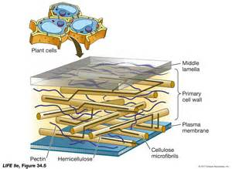
Relation of Structure to its Functions
The cell wall’s multilayered structure helps maintain the stability that the organelle gives it’s cell, it allows itself to glue to other cell walls to build upon each other, and form the rigid structure of the plant stem.
The porous interior of the cell wall allows it to transport water between all the cells within a plant.

Slide 5
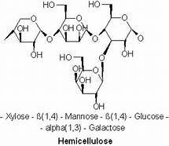
Molecules used and Products produced
The main molecules used in the cell wall are cellulose, a polysaccharide sugar, hemicellulose branched polysaccharides that are structurally homolgous to cellulose because they have a backbone composed of 1,4-linked β-D-hexosyl residues, and pectin a family of complex polysaccharides that all contain 1,4-linked α-D-galacturonic acid
The Cell wall does not produce any products in the cell

Slide 6
Sources Used
Retrieved September 18, 2016, from http://micro.magnet.fsu.edu/cells/plants/cellwall.html
(n.d.). Retrieved September 18, 2016, from https://msu.edu/~potters6/te801/Biology/biounits/cellstructure&function.htm
(n.d.). Retrieved September 18, 2016, from http://www.psu.edu/dept/cellwall/cellwall.pdf
Plant Cell Wall Basics. (n.d.). Retrieved September 18, 2016, from https://www.ccrc.uga.edu/~mao/intro/ouline.htm

