Slide 1
Chloroplast
By Joseph Grieco

Slide 2
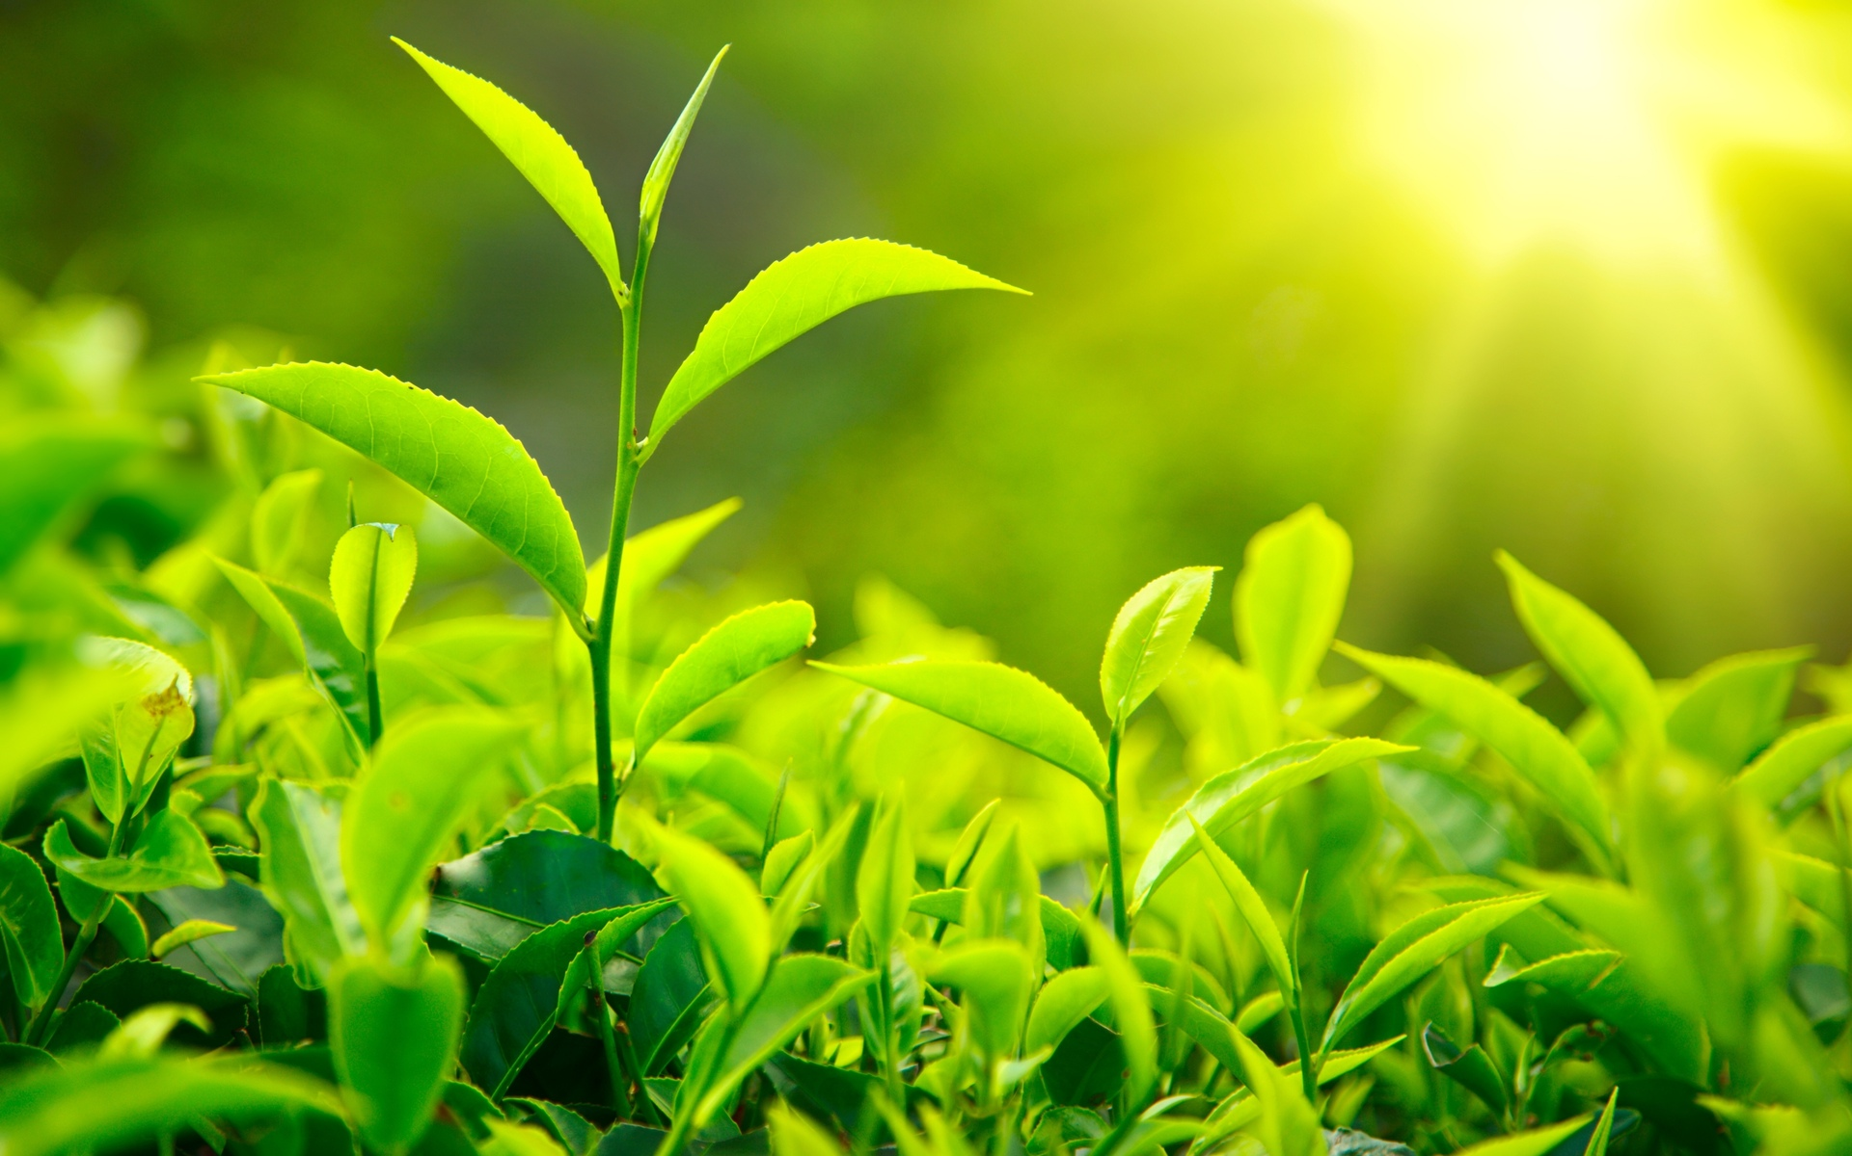
What are chloroplasts? Where are they found?
Plastids (organelles found in plants cells containing pigment or food) that contain chlorophyll, and facilitate photosynthesis.

Slide 3
Structure and function
Thykaloid (membrane sacs)
stroma (dense fluid of the chloroplast)
chlorophyll (green pigment in the thykaloid membrane)

Slide 4
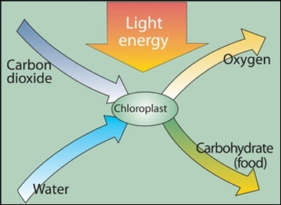
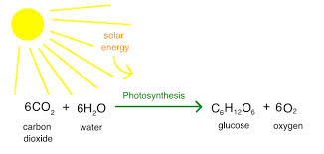
Major Process
Photosynthesis

Slide 5
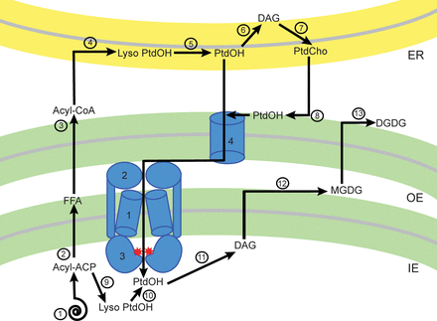
Synthesis of Lipids
remain in the plastid where they are assembled into complex lipids
exported to the ER entering the eukaryotic pathway of lipid assembly

Slide 6
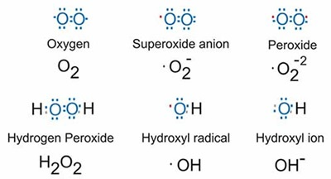
Interaction with other organelles
Protects from pathogens
The chloroplasts stimulate warning signals in cells by producing reactive oxygen species that cause an hypersensitive response. This triggers the cell to begin producing defensive molecules.
In some situations the chloroplasts will even move closer to the infection and nucleus

Slide 7
Sources used
https://www.ncbi.nlm.nih.gov/books/NBK9905/
https://en.wikipedia.org/wiki/Chloroplast#Function_and_chemistry
https://www.ncbi.nlm.nih.gov/books/NBK26819/
http://www.biochemsoctrans.org/content/40/2/457

