Slide 1
Cystic Fibrosis
Andrew Sarji

Slide 2
Introduction
Cystic Fibrosis was discovered in 1938.
Cystic Fibrosis affects both males and females from all racial and ethnic groups.
Cystic Fibrosis is more common in Caucasians of North European descent and is less common African Americans and Asian Americans.
Approximately 1,000 new cases of Cystic Fibrosis are diagnosed each year.

Slide 3
Description
Symptoms include: shortness of breath, fatigue, pain in the abdomen, heartburn, delayed development, and wheezing.
Signs include: a baby’s skin tasting salty when kissed or the baby doesn’t pass stool when first born. People who have Cystic Fibrosis have thick mucus buildup in their airways and frequent sinus infections. Also, mucus blocking the pathways to the pancreas and an unbalance of minerals in the blood.

Slide 4
Prognosis
Cystic Fibrosis does not have a cure, however there are therapies to increase the possibility of Cystic Fibrosis remaining healthy until they are adults. As lung function declines the individual becomes disabled. The average life span of someone with Cystic Fibrosis is 40 years and sufferers usually die of lung complications.

Slide 5
Inheritance
Located on human chromosome 7, the Cystic Fibrosis Transmembrane Conductance Regulator or CFTR gene is made up of 250,000 DNA nucleotides.
The CFTR protein functions as a channel for the movement of chloride ions in and out of cells, which is important for the salt and water balance on epithelial surfaces, such as in the lungs or pancreas. Changes in the CFTR gene can affect the structure of the CFTR protein.
Cystic Fibrosis is an autosomal and recessive disorder.

Slide 6
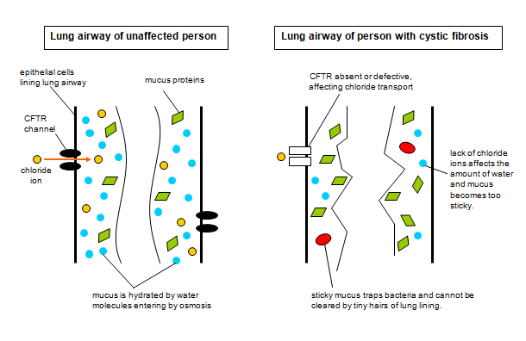

Slide 7
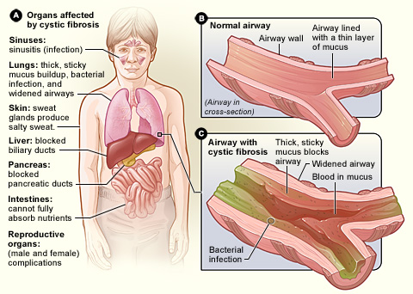

Slide 8
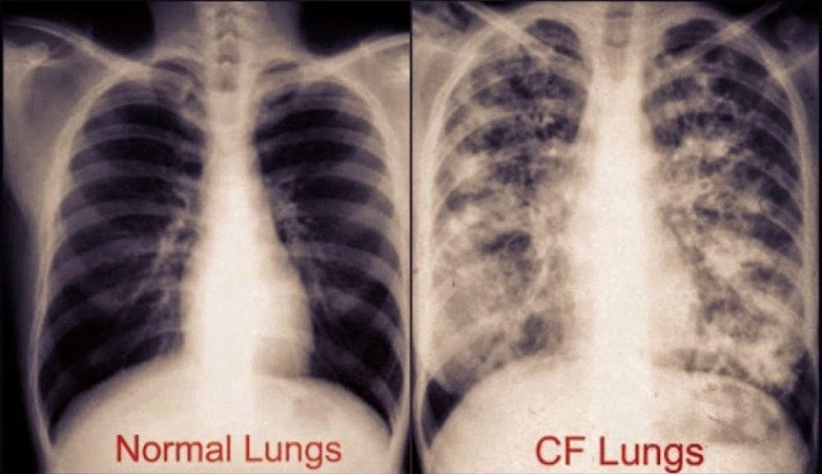

Slide 9
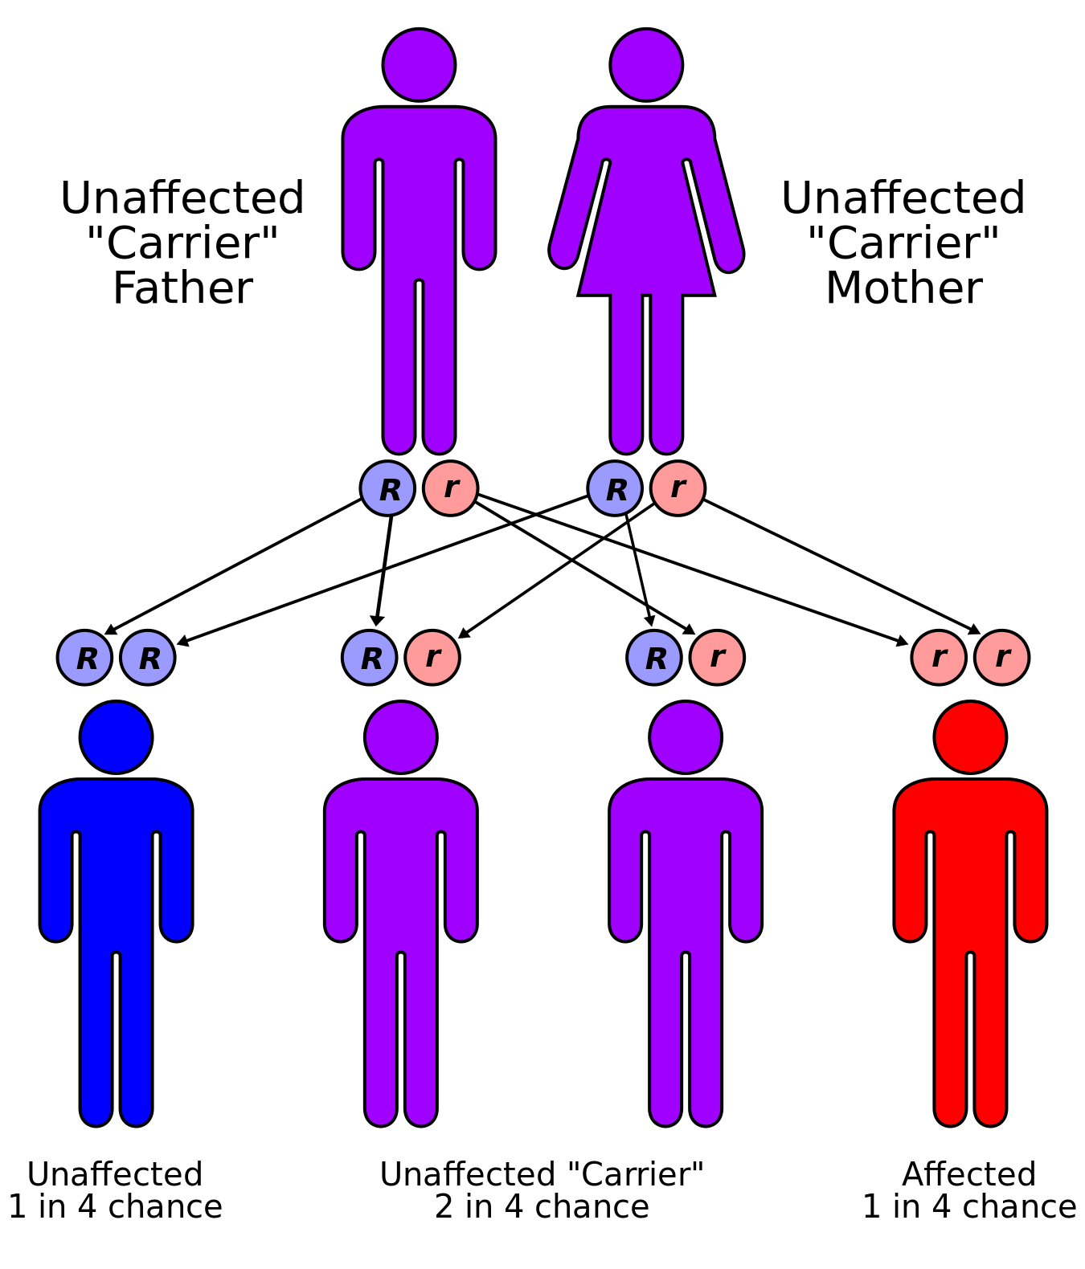

Slide 10
Treatment
There are many treatments and therapies for Cystic Fibrosis including; inhalers to open airways, breathing in mists of high salt concentration to break down mucus, flu and bacterial vaccines, high calorie and protein diets, exercise, staying hydrated, lung transplants, and not smoking.
There is not a cure for Cystic Fibrosis.

Slide 11
Prevention
Cystic Fibrosis is a genetic disorder that cannot be prevented.
Diagnosing Cystic Fibrosis is a multistage process. The diagnostic evaluation includes a newborn screening, a sweat chloride test, a genetic and carrier test and a clinical evaluation.

Slide 12
Works Cited
Cystic Fibrosis Foundation. (n.d.). Retrieved November 16, 2016, from https://www.cff.org/What-is-CF/About-Cystic-Fibrosis/
Cystic Fibrosis Foundation. (n.d.). Retrieved November 16, 2016, from https://www.cff.org/What-is-CF/About-Cystic-Fibrosis/
What Are the Signs and Symptoms of Cystic Fibrosis? - NHLBI, NIH. (n.d.). Retrieved November 16, 2016, fromhttps://www.nhlbi.nih.gov/health/health-topics/topics/cf/signs
@. (n.d.). Cystic Fibrosis Prognosis & Therapies - Cystic Fibrosis News Today. Retrieved November 16, 2016, fromhttp://cysticfibrosisnewstoday.com/cystic-fibrosis-prognosis-therapies/
BBC - GCSE Bitesize: Recessive and dominant alleles. (n.d.). Retrieved November 16, 2016, fromhttp://www.bbc.co.uk/schools/gcsebitesize/science/edexcel_pre_2011/genes/genesrev2.shtml
Cystic Fibrosis-Prevention. (n.d.). Retrieved November 16, 2016, from http://www.webmd.com/children/tc/cystic-fibrosis-prevention
The Embryo Project Encyclopedia. (n.d.). Retrieved November 16, 2016, from https://embryo.asu.edu/pages/cystic-fibrosis

