Slide 1
DNA Sequencing

Slide 2
What is it?
The process of determining the precise sequence (order) of nucleotides in a sample of DNA
EX: ATCGGCTAGTATAGA

Slide 3
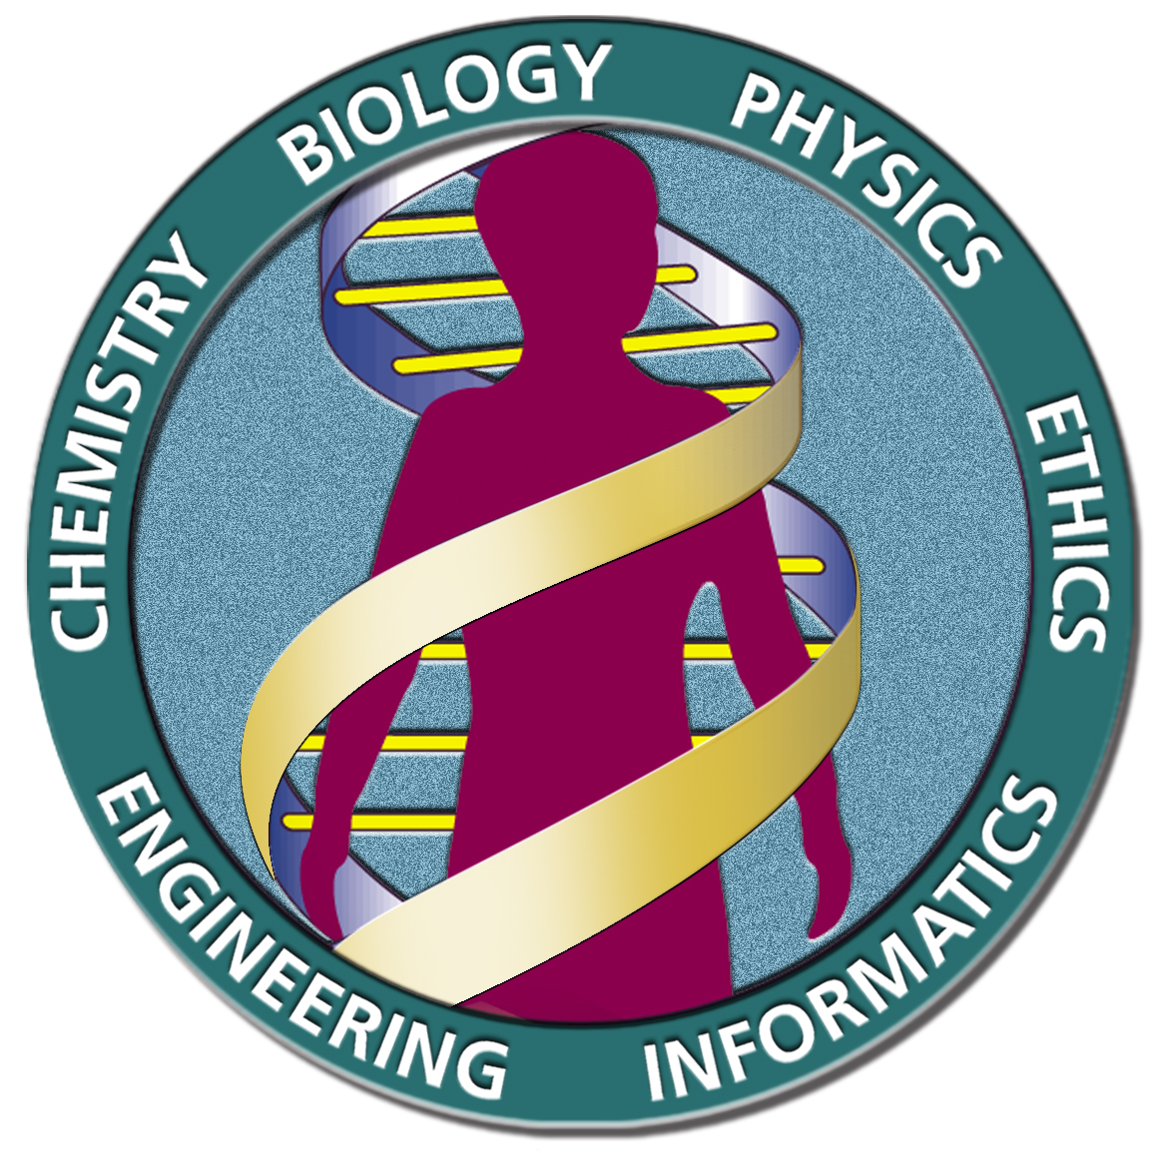
HUMAN GENOME PROJECT
Federally-funded project to determine all 3.2 billion base pairs (letters) of the human genome using DNA sequencing
Completed in 2003

Slide 4
HUMAN GENOME PROJECT
Hopes:
Identify genes associated with genetic diseases
Develop tests and therapies for genetic diseases

Slide 5
Human genome project
Concerns:
How will companies use genetic information
Which agencies have access to personal genetic information

Slide 6
Human genome project
ELSI (Ethical, Legal and Social Implications Research Program)
Developed with HGP to study how it would impact individuals, families and communities

Slide 7
How does it work?
Sanger Method
Uses special dideoxynucleotides to create DNA fragments of varying lengths
DNA fragments run through a type of gel electrophoresis to sort by size

Slide 8
How does it work?
Dideoxynucleotides (ddNTPs) are free-floating nucleotides that are missing a chemical group
When added to a growing DNA strand, no other nucleotides can be added after it

Slide 10
How does it work?
As the DNA is replicated from the original DNA sample, each fragment ends in a different ddNTP
You create every possible length of DNA strand from one letter long to the full length of the original sample

Slide 11
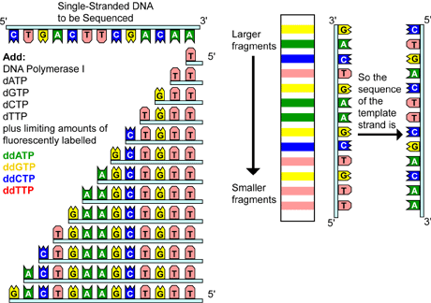

Slide 12
How does it work?
Then you run your fragments through gel electrophoresis to organize them from shortest to longest
As the fragments run off the gel they pass across a laser and a computer reads the ddNTP at the end of the fragment
Each ddNTP has a fluorescent tag with a color that matches its letter (Ex: A is red, G is green, etc.)

Slide 14
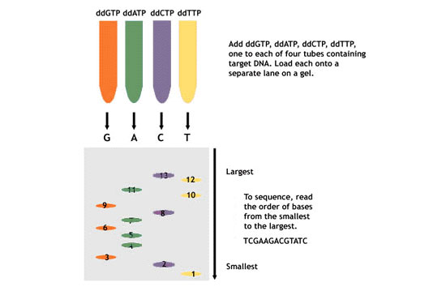

Slide 15
How does it work?
The order of the ddNTPs from shortest to longest fragment is the sequence of letters that complements your original DNA sample

