Slide 1
Down Syndrome
By Todd Martorano

Slide 2
Introduction
In 1866, Dr. John Langdon Down first described Down syndrome as a disorder, but he didn’t understand how Down syndrome was caused. But in 1959 Dr. Jerome Lejeune discovered Down syndrome is a genetic disorder whereby a person has three copies of chromosome 21 instead of two.
Down Syndrome does not affect a certain ethnic group or gender more than another
Down syndrome is the most common chromosomal disorder. This disease occurs in about 1in every 700 babies born.

Slide 3
Description
Symptoms of Down Syndrome are delayed development, learning disability, short stature, or speech delay in a child
Some signs of Down Syndrome are short attention span, impulsive behavior, deafness, and underlying heart disease

Slide 4
Prognosis
The prognosis of Down Syndrome has increased drastically over the past 50 years. Currently they life expectancy of someone with Down Syndrome is 50 years and older. Also now they are able to live better lives and have the ability to form relationships.

Slide 5
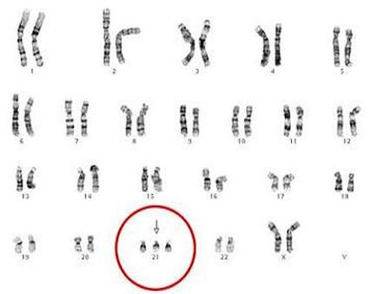
Inheritance
The mutation that causes Down Syndrome is nondisjunction. This is when chromosomes fail to separate during meiosis. This causes gametes to have too many or too few chromosomes. For Down Syndrome there is an extra copy of chromosome 21.
Down Syndrome is an autosomal trait because it happens when there is an extra copy of chromosome 21. It is also not dominant or recessive because it is just the error of translation of chromosome 21.

Slide 6
Treatment
Treatment for Down Syndrome are special education classes, treatment for deafness, and treatment for heart disease
There is no cure for Down Syndrome

Slide 7
Prevention
To prevent Down Syndrome you should see a genetic counseling to see if you are at risk of having a Down Syndrome child
Also the chance of having a Down Syndrome child increases when the mother's age is 35 years or older

Slide 8
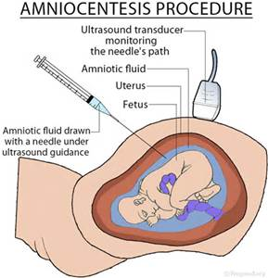
Screening
A screen test for Down Syndrome is an Amniocentesis. This is when a small amount of amniotic fluid, which contains fetal tissues, is sampled from the amniotic sac surrounding a developing fetus. Then the DNA from this is tested for Genetic abnormalities

Slide 9
Works Cited
Facts and FAQ About Down Syndrome. (2015). Retrieved November 15, 2016, from http://www.globaldownsyndrome.org/about-down-syndrome/facts-about-down-syndrome/
Down Syndrome: Facts on this Congenital Disorder. (n.d.). Retrieved November 15, 2016, from http://www.emedicinehealth.com/down_syndrome/article_em.htm
Down Syndrome Facts. (n.d.). Retrieved November 15, 2016, from http://www.ndss.org/Down-Syndrome/Down-Syndrome-Facts/
DOWN SYNDROME. (n.d.). Retrieved November 15, 2016, from http://www.webmd.com/children/tc/down-syndrome-topic-overview#1
Down Syndrome: Condition Information. (n.d.). Retrieved November 15, 2016, from https://www.nichd.nih.gov/health/topics/down/conditioninfo/Pages/default.aspx

