Slide 1
Bell Ringer
Biofuels from crops such as corn, soybeans, and cassava have been proposed as a supplement or even replacement for fossil fuels. Why would using plants for fuel be considered a long-term solution to our dependence on fossil fuels?

Slide 2
Bell Ringer
We know we get our energy from food, but where does our food get ITS energy?

Slide 3
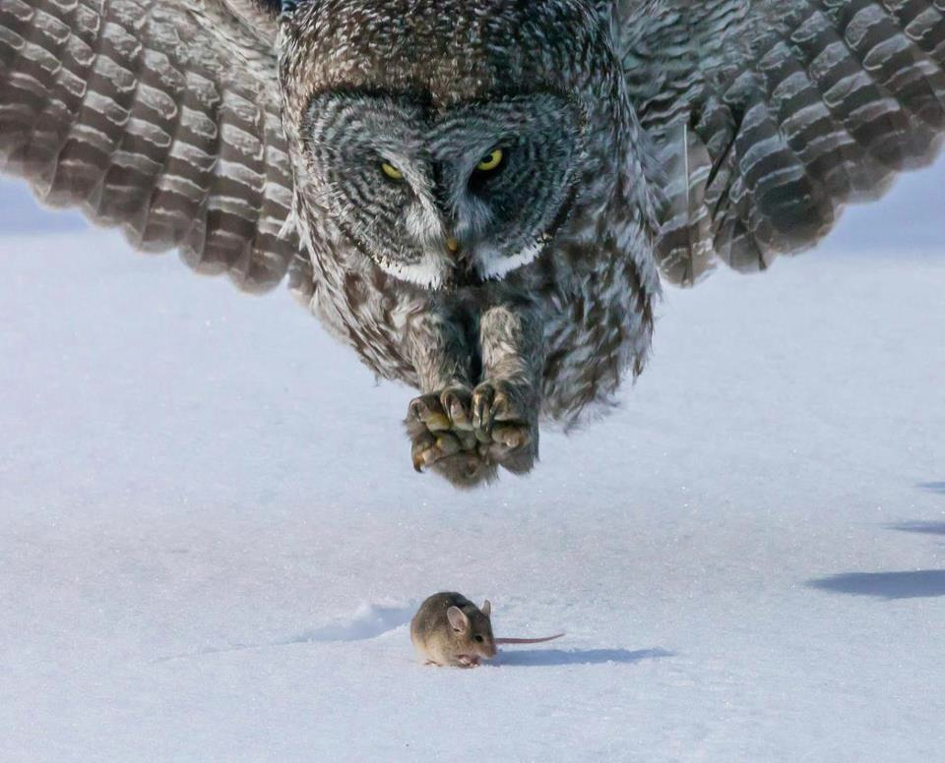
Ecosystem energy part i

Slide 4
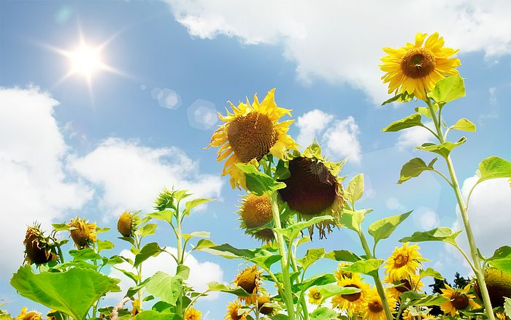
Plants vs. Animals
How do plants get their energy?

Slide 5
Plants vs. Animals
THE SUN! Plants make their own food using light energy

Slide 6
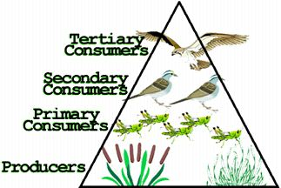
Producers
Organisms that make their own food (AKA plants) are called producers.

Slide 7
Animals
They eat other organisms for their energy (can’t make their own)
What do animals eat?

Slide 8
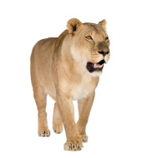
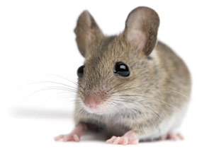
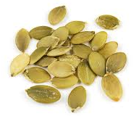
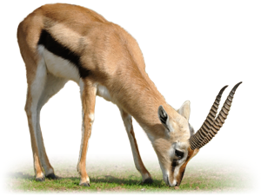
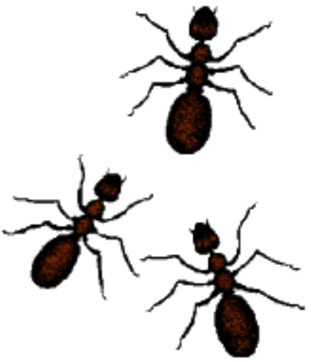
Animals
They eat other organisms for their energy (can’t make their own)
What do animals eat?

Slide 9
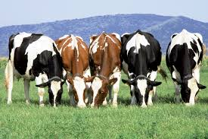
Herbivores
Animals that eat only plants

Slide 10
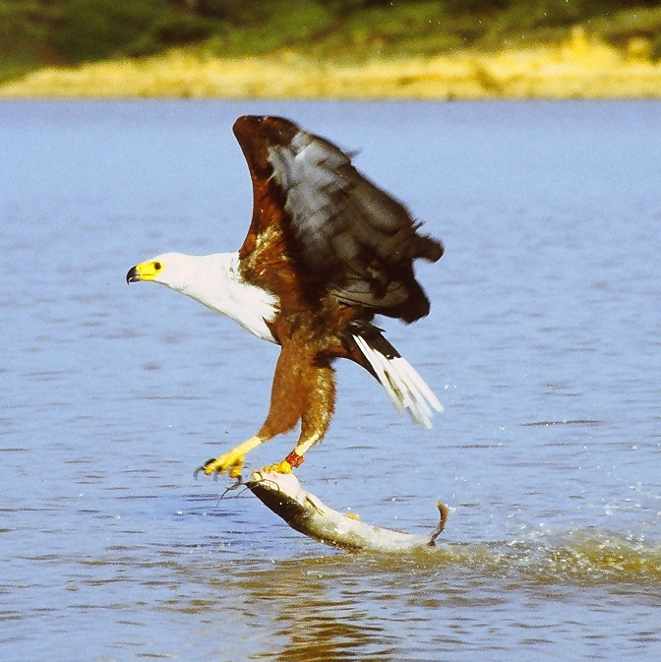
Carnivores
Animals that eat only other animals

Slide 11
Omnivores
Animals that eat plants AND other animals

Slide 12
Consumers
Most animals are considered consumers because they must eat (consume) other organisms to survive.

Slide 13
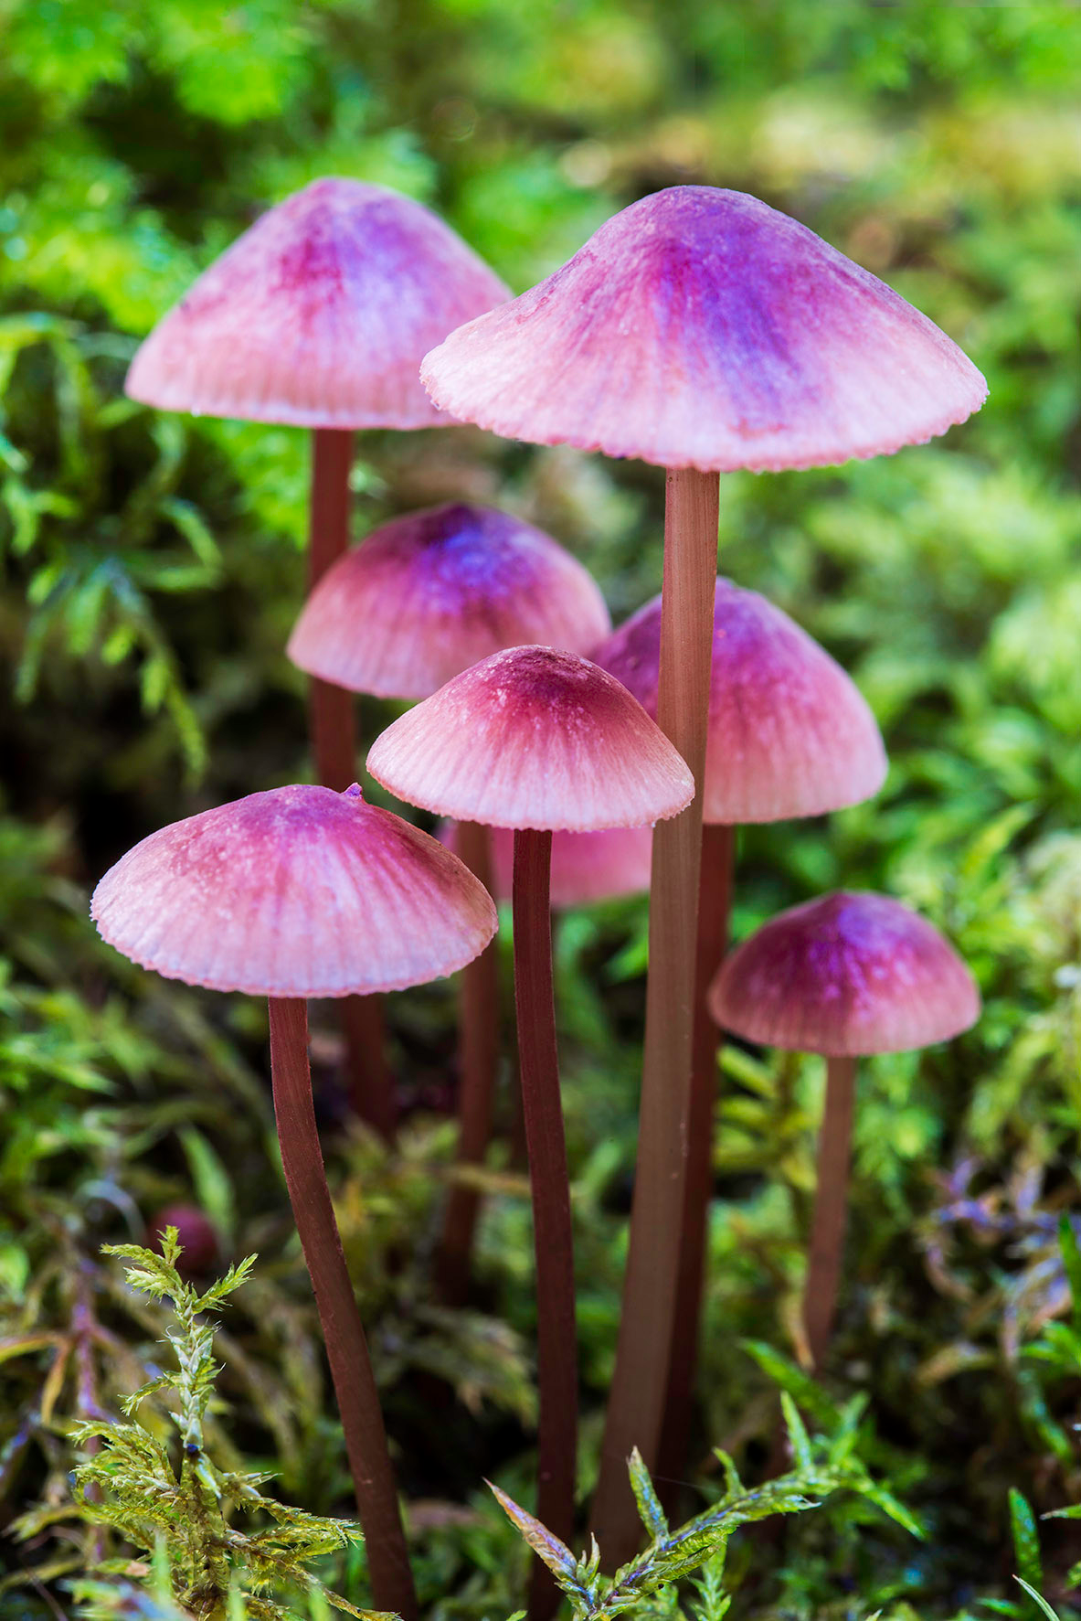
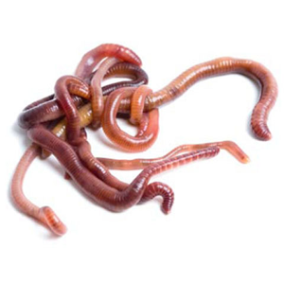
What about dead stuff?
Decomposers break down dead organisms to return nutrients to the soil for producers to use.

Slide 14
4 Corners Review!

Slide 15
4 Corners Review!

Slide 16
4 Corners Review!

Slide 17
4 Corners Review!

Slide 18
EXIT TASK
How would you use the terms “autotroph” and “heterotroph” to explain producer, consumer and decomposer?
Teach your neighbor your definitions.

