Slide 1
ENERGY & ATP

Slide 2
Forms of energy
Kinetic energy = energy of motion
All molecules vibrate and move to some degree (temperature is a measure of kinetic energy of mlcls)

Slide 3
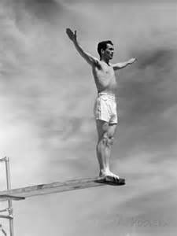
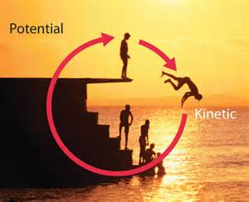
Forms of energy
Potential energy = energy that could be released

Slide 4
Forms of energy
Thermal energy = heat energy
Chemical energy = energy stored in chemical bonds
Electrical energy = energy from electricity
Mechanical energy = energy that does work

Slide 5
Practice
Provide an example of each type of energy

Slide 6
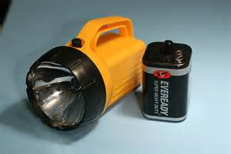
1st Law of Thermodynamics
Energy cannot be created or destroyed
Energy can be transformed

Slide 7
Practice
Can you come up with three different ways energy can be transformed?

Slide 8
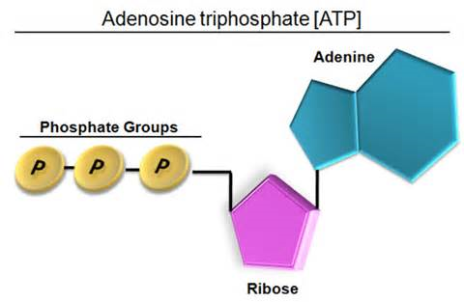
Cell energy
The chemical energy in food/glucose is processed by the mitochondria and becomes stored in ATP.
ATP (adenosine triphosphate) = the energy "currency" of the cell
Stores chemical energy (potential energy)

Slide 9
How ATP works
ATP stores chemical energy in the bonds of the phosphate groups.
Removing a phosphate group to create ADP allows the chemical energy to do work in the cell.
ENERGY

