Slide 1
Enzymes

Slide 2
Review
What is a protein?

Slide 3
Review
What is a protein?
Amino acids chained together and folded into a particular structure.

Slide 4
Review
What is a protein?
Amino acids chained together and folded into a particular structure.
What do proteins do?

Slide 5
Review
What is a protein?
Amino acids chained together and folded into a particular structure.
What do proteins do?
They carry out functions in the body (digestion, hormone signaling, immune responses, etc.)

Slide 6
Protein function
Some proteins help chemical reactions in the body to happen faster.
Digestion

Slide 7
Protein function
Some proteins help chemical reactions in the body to happen faster.
Enzymes act as catalysts.

Slide 8
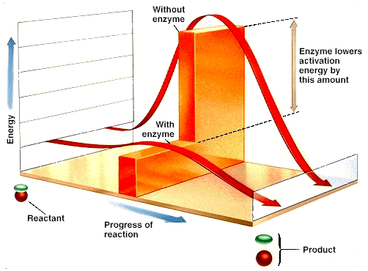
Catalysts
Enzymes lower the activation energy of a chemical reaction.
Activation energy = energy required for a chemical reaction to take place.

Slide 10
Enzyme – what is it?
They are proteins that help chemical reactions to take place.
They are specific for each reaction.
They are reusable.

Slide 11
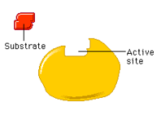
Parts of enzymatic reactions
Substrate = molecule that binds to the enzyme before the reaction.

Slide 12
Parts of enzymatic reactions
Active site = the location on the enzyme where substrates bind during the reaction.

Slide 13
Parts of enzymatic reactions
Enzyme-substrate complex = the molecule formed when the enzyme and substrate temporarily bind together.

Slide 14
Parts of enzymatic reactions
Product = the molecule that results from the reaction.

Slide 15
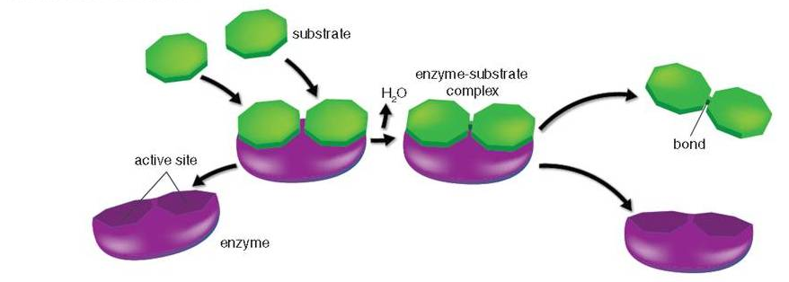
Types of reactions
Enzymes can bond substrates together OR break a substrate apart.

Slide 16
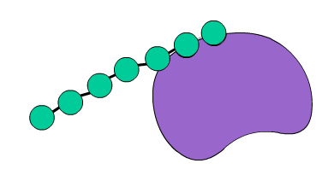
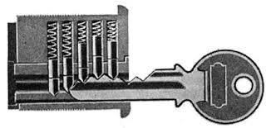
Lock & key
Enzymes and substrates fit very specifically
http://www.kscience.co.uk/animations/anim_2.htm

