Slide 1
All Parts of The Endoplasmic Reticulum (ER)
By: Sapphire Bowen-Kauth
Barksdale
19 September 2016
AP Biology ½ Period

Slide 2
What is ER in cells?

Slide 3
What is ER in cells?
Endoplasmic means “within the cytoplasm” and reticulum means “little net”
Extensive network of membranes that make up approximately half of the membrane in a cell
Consists of tubules and sacs, called cisternae, which is a reservoir for liquid
Membrane of the ER encloses a continuous compartment called ER lumen (cisternal space)

Slide 4
What is ER in cells?
Two Types of ER: Smooth ER (SER) and Rough ER (RER)
SER and RER look separate but are subcompartments of the same organelle
Smooth ER: surface lacks ribosomes, associated with smooth slippery fats, and found evenly distributed through cytoplasm
Rough ER: ribosomes attached to its external surface and also to cytoplasmic side of nuclear envelope’s outer membrane, which is continuous to rough ER.

Slide 5
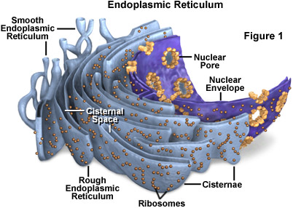
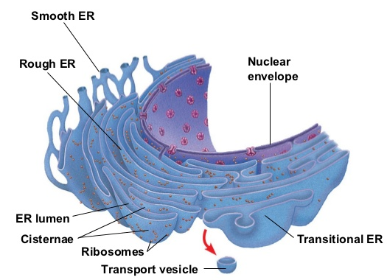
What is ER in cells?
Distinguishing between Rough ER and smooth ER from physical characteristics:
through an electron micrograph you can view transport vesicles that spring off from a region of the rough ER called transitional ER and travel to the Golgi apparatus and other destinations

Slide 6
Functions of Smooth ER

Slide 7
Functions of Smooth ER: Metabolic Processes
Main themes to think about when studying SER:
Synthesis of lipids
Metabolism of Carbohydrates
Detoxification of Drugs and Poisons

Slide 8
Functions of Smooth ER: Synthesis of Lipids
Enzymes of SER are important to synthesis of lipids including oils, phospholipids, steroids:
Steroids made by SER in animal cells are sex hormones of vertebrates and other steroid hormones are secreted by adrenal glands

Slide 9
Detoxification of Drugs and Poisons
Detoxification- adding hydroxyl groups to drugs, making them more soluble and easier to flush from the body
Phenobarbital and other barbiturates are drugs metabolized by SER in liver cells- induce the increase of smooth ER, increasing the rate of detoxification= higher doses are needed to produce effect (in this case sedation)
Can increase the tolerance to other drugs besides phenobarbital
Notes:
smooth ER enables glycogen that is stored as granules on the external surface of smooth ER to be broken down

Slide 10
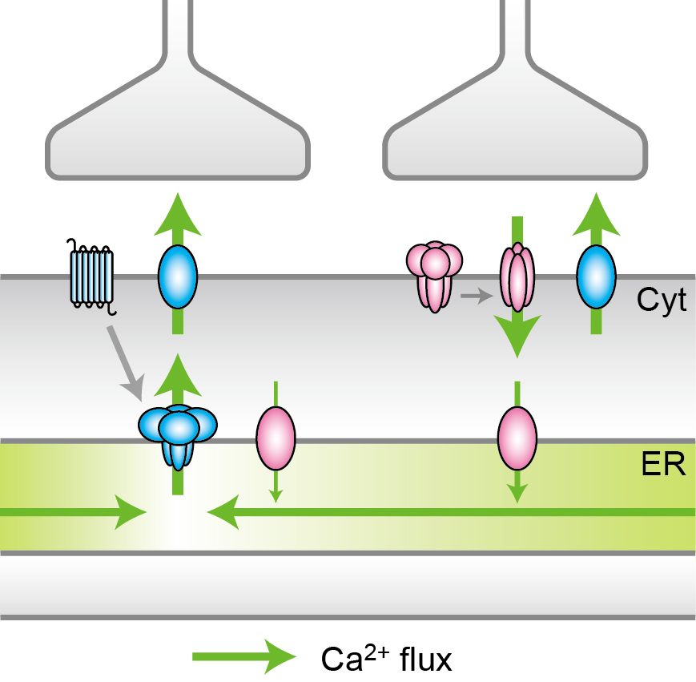
Functions of Smooth ER: Calcium Ions
Stores calcium ions- in muscle cells, specialized smooth ER pumps calcium ions from cytosol (where organelles and particles are suspended) into ER lumen
Calcium ions released by smooth ER can also trigger different responses
Imbalance of calcium ions
Notes:
When a muscle cell has a nerve impulse sent to it, calcium goes across cell membrane into the cytosol and trigger contraction of the muscle cell
Revealing the basics of calcium ion regulation mechanisms not only improves our understanding of cellular function but also the possibility for the clarification of disease mechanisms,” says Lecturer Okubo. He continues, “For example, it is suggested that the disruption of intracellular calcium homeostasis including in the ER is involved in neurodegenerative diseases.
For diagram: Ca2+ flux in response to two kinds of synaptic inputs (Left) A synaptic input induces the local depletion of Ca2+, which is followed by diffusion from the surrounding region. (Right) Another synaptic input induces the uptake of Ca2+ from the cytoplasm (Cyt) to ER via Ca2+ pump, followed by the accumulation and the maintenance of Ca2+ within ER.

Slide 11
Functions of Rough ER

Slide 12
Functions of Rough ER
Main themes to think about when studying RER:
Synthesize
Modify
Transport

Slide 13
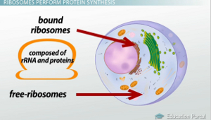
Functions of Rough ER: Protein Synthesis
Free ribosomes vs. bound ribosomes
Free ribosomes are suspended in the cytosol
Bound ribosomes are attached to the outside of the ER or nuclear envelope
Notes:
membrane bound ribosomes and are firmly attached to the outer cytosolic side of the ER.
Bound ribosomes function as making proteins with the purpose of insertion into membranes, packaging within certain organelles such as lysosomes, or for export (secretion).
If the protein is to be used with the cell, the ribosome remains in the cytosol

Slide 14
Functions of Rough ER: Secretory Proteins
Ribosomes attached to RER secrete specialized proteins
Pancreas cells secrete protein insulin in bloodstream
Protein threads itself into ER lumen (glycoproteins)
Folds into original confirmation (reconstruct primary proteins to make them into tertiary structures)
Metal groups added to ER lumen- hemoglobin
Notes:
when protein develops from a bound ribosome it is threaded into the ER lumen through a pore formed by a protein complex in membrane As it enters the protein complex, it folds into original confirmation that proteins are folded to produce the highly important biochemical architecture which will provide ‘lock and key’ and other recognition and linking sites- most of these proteins are glycoproteins ( have carbs covalently bonded to them, glycosylation occurs in the rough ER, most often it takes place in the Golgi apparatus.) - attach to the protein in the ER by molecules built into ER membrane
It is in the rough ER for example that four polypeptide chains are brought together to form hemoglobin

Slide 15
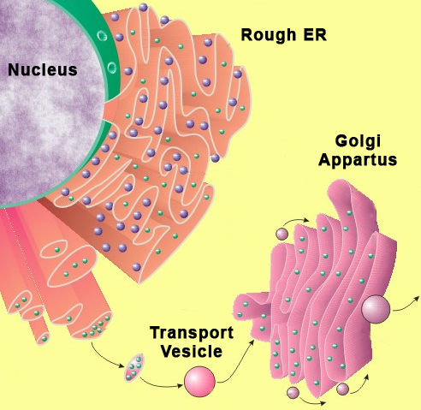
Functions of Rough ER: Secretory Proteins
Secretory proteins leave the ER wrapped in transitional vesicles (sacks made of the membrane)
Transport Vesicles: spring off from region of transitional vesicles

Slide 16
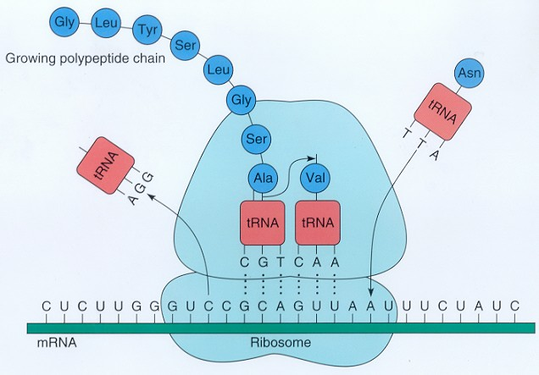
Functions of Rough ER: Translation
Ribosomes carrying RNA from the nucleus attach here and read RNA molecules to translate into protein

Slide 17
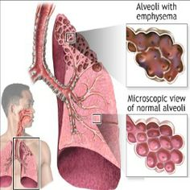
Protein Quality Control
If a protein is folded wrong it is rejected in ER lumen
A type of emphysema (a lung disease) is caused by the ER quality control
Notes:
(rejected protein either stored in lumen or sent to be recycled into amino acids)
section continually rejecting an incorrectly folded protein. The protein is wrongly folded as a result of receiving an altered genetic message. The required protein is never exported from the lumen of rough ER.

Slide 18
Interactions with other Organelles

Slide 19
Interactions with other Organelles
Proteins are produced for:
Plasma membrane
Golgi apparatus
Secretory vesicles
Plant vacuoles
Lysosomes
Endosomes
ER itself
Notes:
Some of the proteins are delivered into the lumen or space inside the ER whilst others are processed within the ER membrane itself.

Slide 20
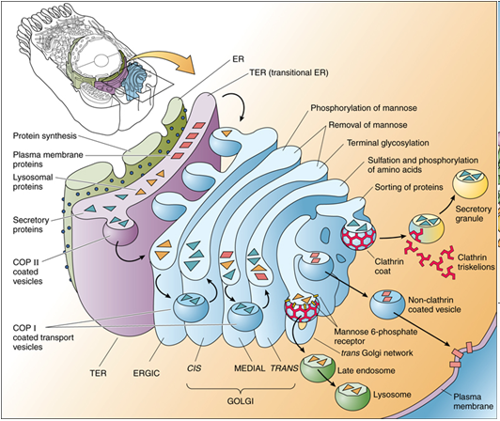
Interactions with other Organelles: ER and the Golgi Apparatus are Best Friends
Fats and proteins are packaged into vesicles and sent to the Golgi Apparatus by transport vesicles
The Golgi apparatus is also closely associated with the ER
Notes:
recent observations suggest that parts of the two organelles, i.e. the ER and the Golgi complex, are so close that some chemical products probably pass directly between them instead of being packaged into vesicles.

Slide 21
Relation of ER Structure to its Functions

Slide 22
Relation of ER Structure to its Functions
ER composites approximately half of the membrane in a cell!
Notes:
to have large surface area to carry out functions of storing enzymes, such extensive network of membranes.

Slide 23
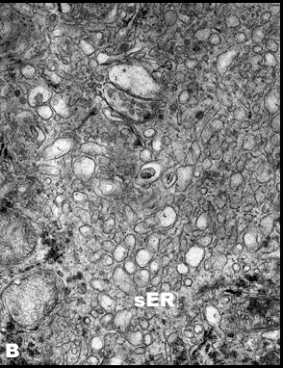
Relation of ER Structure to its Functions: Smooth ER
Cells that synthesize and secrete sex hormones in the ovaries and testes
Example: Adrenocortical Tumor
Can double in size in the matter of a few days to assist in detoxifying poisons collected in the liver
Notes:
Left and right above the kidneys-over production of hormones

Slide 24
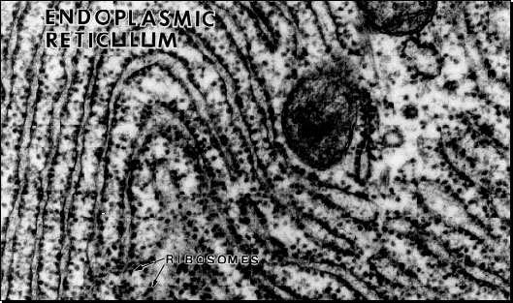
Relation of ER Structure to its Functions: Rough ER
Found throughout the cell but the density is higher near the nucleus and the Golgi apparatus.
Surrounds the nucleus
Notes:
Surrounds the nucleus- ribosomes with RNA TEMPLATES attach to rough ER, read the RNA CODE, packaged into vesicles and shipped to Golgi Apparatus
Cells specialising in the production of proteins will tend to have a larger amount of rough ER whilst cells producing lipids (fats) and steroid hormones will have a greater amount of smooth ER.

Slide 25
What Goes into ER and what is produced?

Slide 26
What Goes into ER and what is produced?
Polypeptides that are meant to be membrane proteins grow from ribosomes and are put into the ER membrane
Makes own membrane phospholipids
Enzymes in ER membrane assemble phospholipids into cytosol
ER membrane expands and is transferred in the form of transport vesicles to other regions of the endomembrane system
Notes:
Grows by adding by adding membrane proteins and phospholipids to its own membrane- amino acid produced from rna code, fatty acids and glycerol on smooth ER for hormone production and anchored their hydrophobically

Slide 27
Any Questions?

Slide 28
Works Cited
Campbell, N. A., & Reece, J. B. (2005). Preparing for the Biology AP Exam with
Biology, Seventh Edition (7th ed.). San Fransico, Ca.: Pearson/Benjamin
Cummings.
Endoplasmic Reticulum (Rough and Smooth). (n.d.). Retrieved from
http://bscb.org/learning-resources/softcell-e-learning/endoplasmic-reticulum-ro
ugh-and-smooth/
Inside A Cell. (n.d.). Retrieved September 14, 2016, from
http://learn.genetics.utah.edu/content/cells/insideacell/
Review of Protein Secretion. (n.d.). Retrieved from
https://courses.washington.edu/conj/cell/secretion.htm
Visualization of the Movement of Calcium Ions in Neurons. (2015, December 24).
Retrieved September 19, 2016, from http://www.u-tokyo.ac.jp/en/utokyo-research/research-news/visualization-of-the-movement-of-calcium-ions-in-neurons.html

