Slide 1
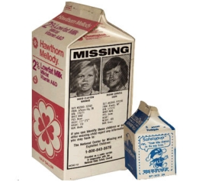
Bell ringer
Imagine a family whose new baby has gone missing. Fast forward 20 years. The family meets a young man who they are convinced is their long-lost child. How could you determine that they are in fact related?

Slide 2
Pre-TEST – What do you already know?
Define “evolution” in your own words.
Name the scientist whose studies have provided the foundation for modern evolutionary theory.
Give at least one evidence you know of that supports the theory of evolution.
Describe what makes species different from one another.
What does “survival of the fittest” mean to you?

Slide 3
THE THEORY OF EVOLUTION

Slide 4
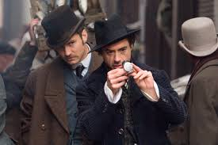
What is a “theory”
Everyday definition:
An explanation that attempts to make sense of an event/phenomenon
I have a theory, Watson.
What do you make of the watch, Holmes?

Slide 5
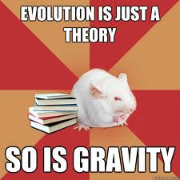
What Is a “theory”
Scientific definition:
A comprehensive explanation of some aspect of nature that is supported by a vast body of evidence.
Theory of Gravity
Atomic Theory
Cell Theory
Germ Theory
Theory of Evolution

Slide 6
In this unit…
Evolution will be discussed as fundamental principle of biology.
Any doubts you may have about the content of this unit should not prevent you from understanding what evidence the scientific community has gathered in support of this theory.

Slide 7
Evolution definition
The process of modern organisms descending from ancient organisms over time.

Slide 8
Observations and Inferences

Slide 9
Exit task
How does viewing Earth’s history as if it were 24 hours better inform you about when life on Earth came to be?

