Slide 1
FUNCTIONAL UNITS
AP BIOLOGY UNIT 8
ORGANISM FORM & FUNCTION

Slide 2
Absorption of Nutrients
The small intestine has a huge surface area
Due to the presence of villi and microvilli that are exposed to the intestinal lumen

Slide 3
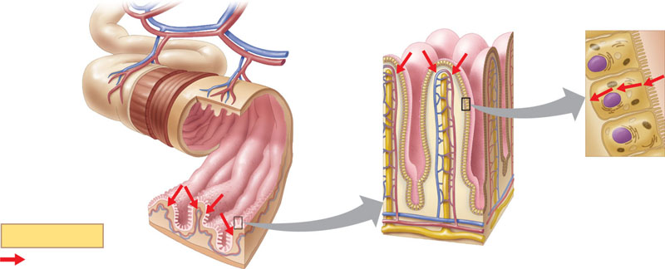
The enormous microvillar surface
Is an adaptation that greatly increases the rate of nutrient absorption
Microvilli (brush border)
Vein carrying blood to hepatic portal vessel
Figure 41.23
Blood capillaries
Epithelial cells
Muscle layers
Epithelial cells
Large circular folds
Villi
Lacteal
Key
Lymph vessel
Nutrient absorption
Intestinal wall
Villi

Slide 4
The core of each villus
Contains a network of blood vessels and a small vessel of the lymphatic system called a lacteal

Slide 5
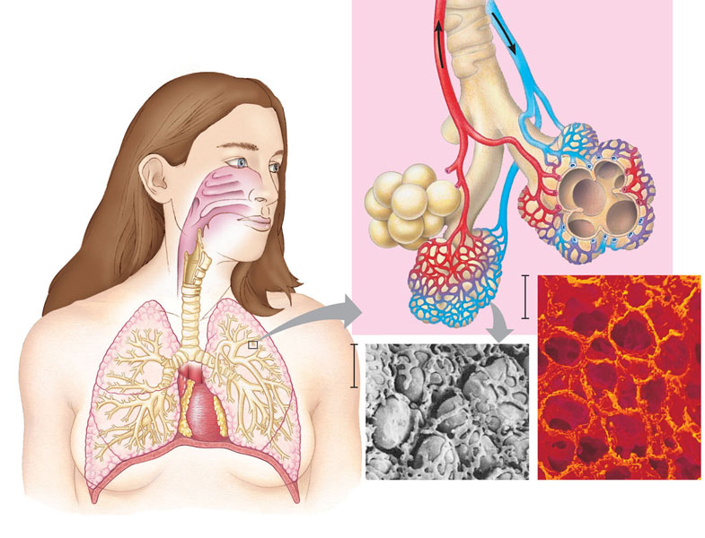
Mammalian Respiratory Systems: A Closer Look
A system of branching ducts
Conveys air to the lungs
Branch from the pulmonary vein (oxygen-rich blood)
Branch from the pulmonary artery (oxygen-poor blood)
Terminal bronchiole
Nasal cavity
Pharynx
Left lung
Larynx
Alveoli
Esophagus
50 µm
Trachea
Right lung
50 µm
Bronchus
Bronchiole
Diaphragm
SEM
Colorized SEM
Heart
Figure 42.23

Slide 6
Concept 44.4: Nephrons and associated blood vessels are the functional unit of the mammalian kidney
The mammalian excretory system centers on paired kidneys
Which are also the principal site of water balance and salt regulation

Slide 7
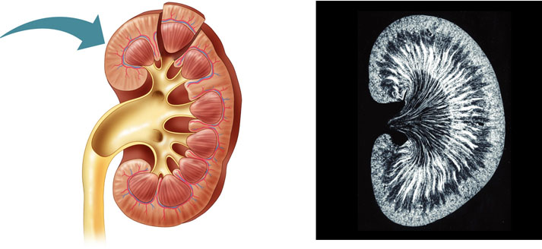
Structure and Function of the Nephron and Associated Structures
The mammalian kidney has two distinct regions
An outer renal cortex and an inner renal medulla
Renal
medulla
Renal
cortex
Renal
pelvis
Ureter
Section of kidney from a rat
Figure 44.13b
(b) Kidney structure

Slide 8
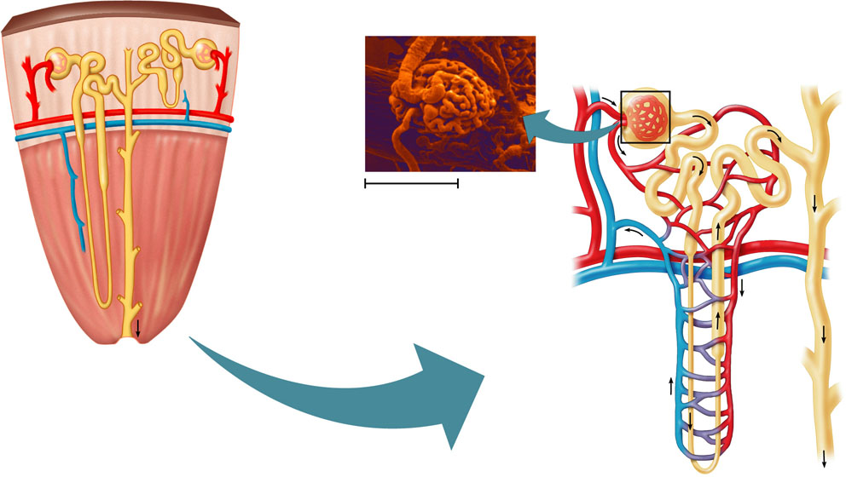
The nephron, the functional unit of the vertebrate kidney
Consists of a single long tubule and a ball of capillaries called the glomerulus
Juxta-
medullary
nephron
Cortical
nephron
Afferent
arteriole
from renal
artery
Glomerulus
Renal
cortex
Bowman’s capsule
Proximal tubule
Peritubular capillaries
Collecting
duct
SEM
20 µm
Renal
medulla
Efferent
arteriole from
glomerulus
Distal
tubule
To
renal
pelvis
Branch of
renal vein
Collecting
duct
Loop
of
Henle
Descending
limb
Ascending
limb
Figure 44.13c, d
Vasa recta
(c) Nephron
(d) Filtrate and
blood flow

Slide 9
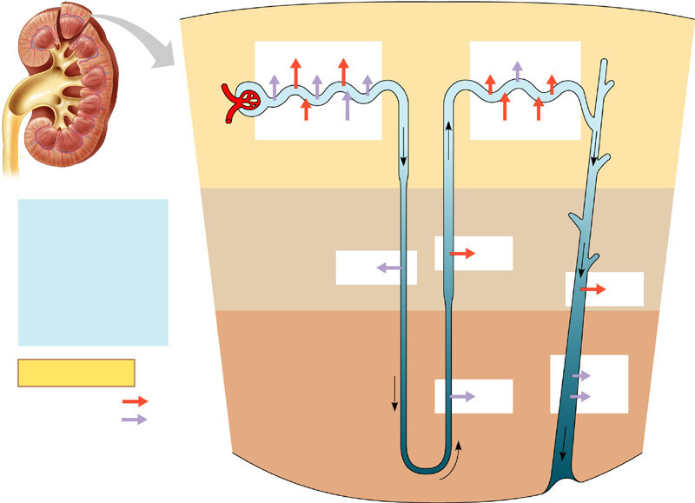
From Blood Filtrate to Urine: A Closer Look
Filtrate becomes urine
As it flows through the mammalian nephron and collecting duct
1
Proximal tubule
4
Distal tubule
NaCl
Nutrients
H₂O
HCO₃
H₂O
K⁺
NaCl
HCO₃
H⁺
NH₃
K⁺
H⁺
CORTEX
Filtrate
2
Descending limb
of loop of
Henle
3
Thick segment
of ascending
limb
H₂O
Salts (NaCl and others)
HCO₃–
H⁺
Urea
Glucose; amino acids
Some drugs
H₂O
NaCl
OUTER
MEDULLA
NaCl
3
Thin segment
of ascending
limb
5
Collecting
duct
Key
Urea
Active transport
NaCl
H₂O
Passive transport
INNER
MEDULLA
Figure 44.14

