Slide 1
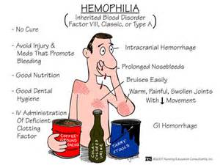
Hemophilia
Brandon Vilorio

Slide 2
Intro to Hemophilia
Hemophilia was discovered in 1828.
It does not seem to affect one
population more than another.
About 400 cases of hemophilia
arise each year.

Slide 3
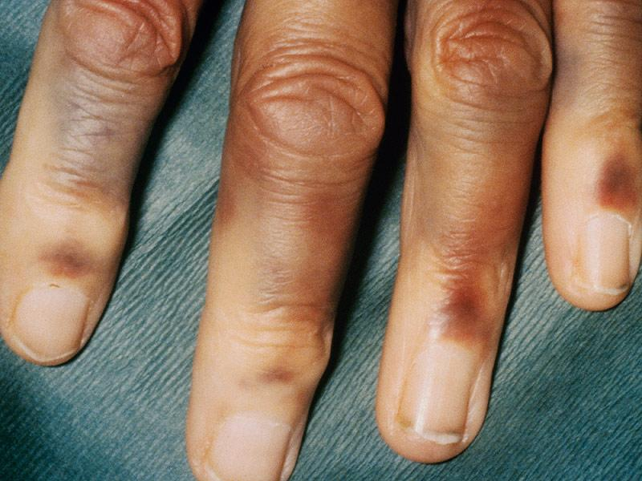
Description Of HemoPhilia
The Symptoms of Hemophilia are:
Bruising, Nosebleeds, Bleeding
Into joints with pain or swelling.
The main sign of hemophilia is
Excessive bleeding
The all-cause mortality is 21%.

Slide 4
Inheritance of Hemophilia
Hemophilia is a sex linked disorder where the F8 and F9 chromosomes mutate.
Hemophilia A is caused by a mutation in the gene for factor VIII, so there is deficiency of this clotting factor. Hemophilia B (also called Christmas disease) results from a deficiency of factor IX due to a mutation in the corresponding gene.

Slide 5
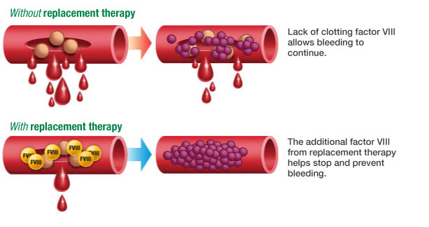
Treatment of hemophilia
There is no cure for hemophilia however there are many forms of treatment.
Replacement therapy: Certain blood products, called factor concentrates, may be given to your child. They replace the missing clotting factor the blood. Replacement clotting factor is given so that the blood will be able to clot and to stop any bleeding. Clotting factor can come from human blood or be artificial.
Demand therapy: receive clotting factor to stop a bleeding episode
Desmopressin: Medicine used to treat Hemophilia A which adds clotting factor to the blood.

Slide 6
Prevention
There is no simple way to prevent hemophilia.
Types of screenings are: CBC’s (Complete Blood Count), APTT Tests (Show how long it takes blood to clot.)

Slide 7
Sources
The history of hemophilia. (n.d.). Retrieved November 15, 2016, from http://www.hemophilia.ca/en/bleeding-disords/hemophilia-a-and-b/the-history-of-hemophilia/
Data & Statistics. (2016). Retrieved November 15, 2016, from http://www.cdc.gov/ncbddd/hemophilia/data.html
What is hemophilia? (n.d.). Retrieved November 15, 2016, from http://www.wfh.org/en/page.aspx?pid=646

