Slide 1
HUMAN IMPACTS on ECOSYSTEMS

Slide 2
The Greenhouse Effect
Earth’s atmosphere traps heat from sun’s rays naturally.
Allows for life-sustaining temperatures

Slide 3
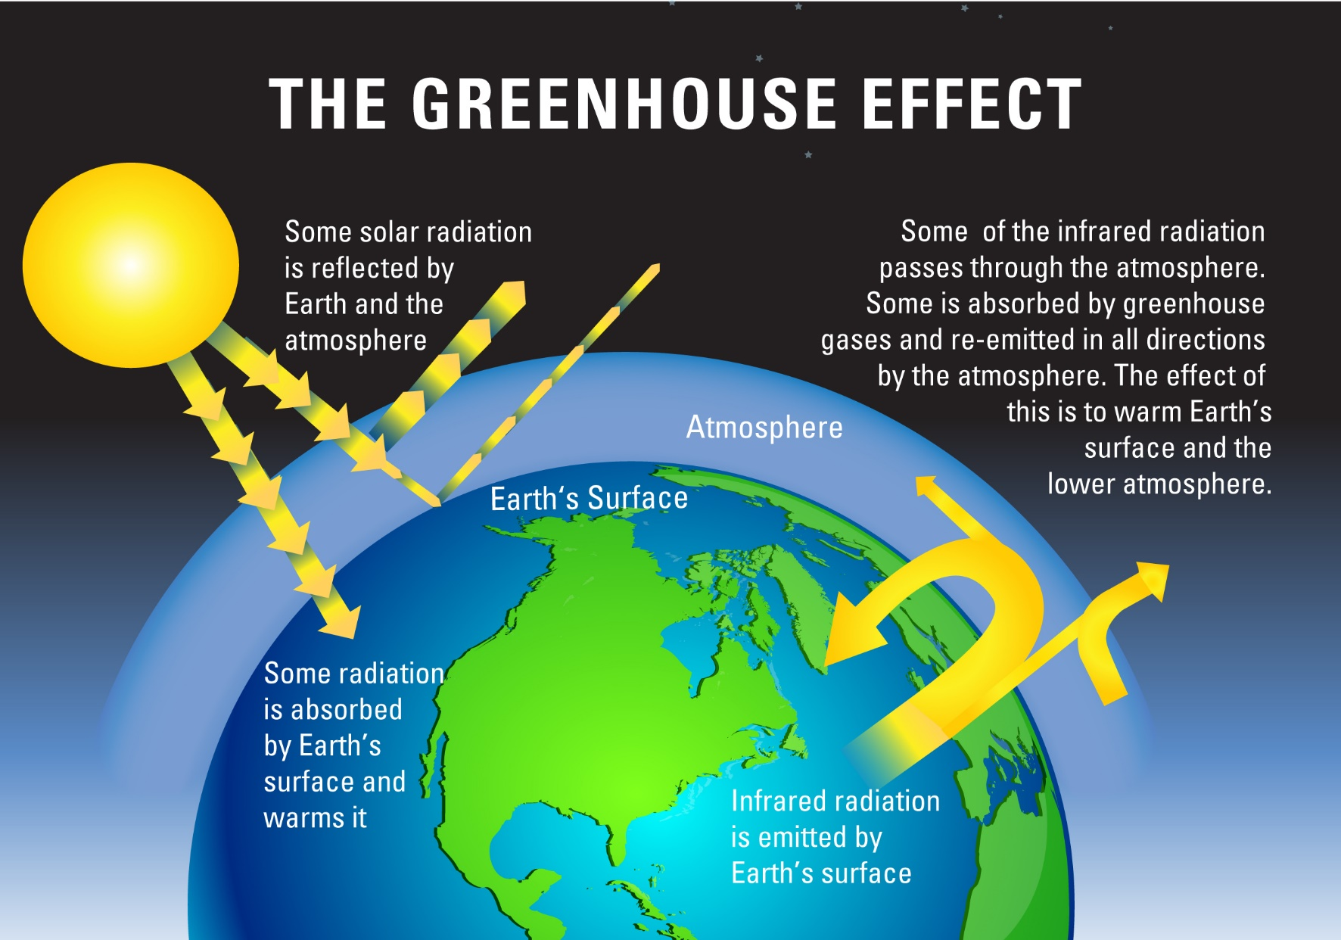

Slide 4
The Greenhouse Effect
The burning of fossil fuels increases carbon dioxide in the atmosphere, trapping more heat.
Ice melts, sea levels rise, oceans warm
Global climate affected, not just global warming

Slide 5
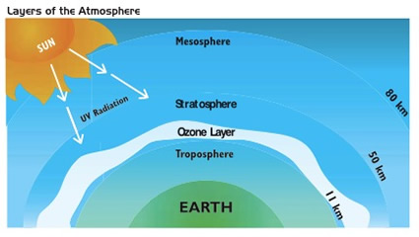
Ozone Depletion
The ozone layer of the atmosphere protects Earth from harmful radiation (i.e. UV light)

Slide 7
Ozone Depletion
The release of pollutants (i.e. CFCs) into the air from industry breaks down ozone molecules
Creates “ozone holes”
Biosphere exposed to radiation

Slide 8
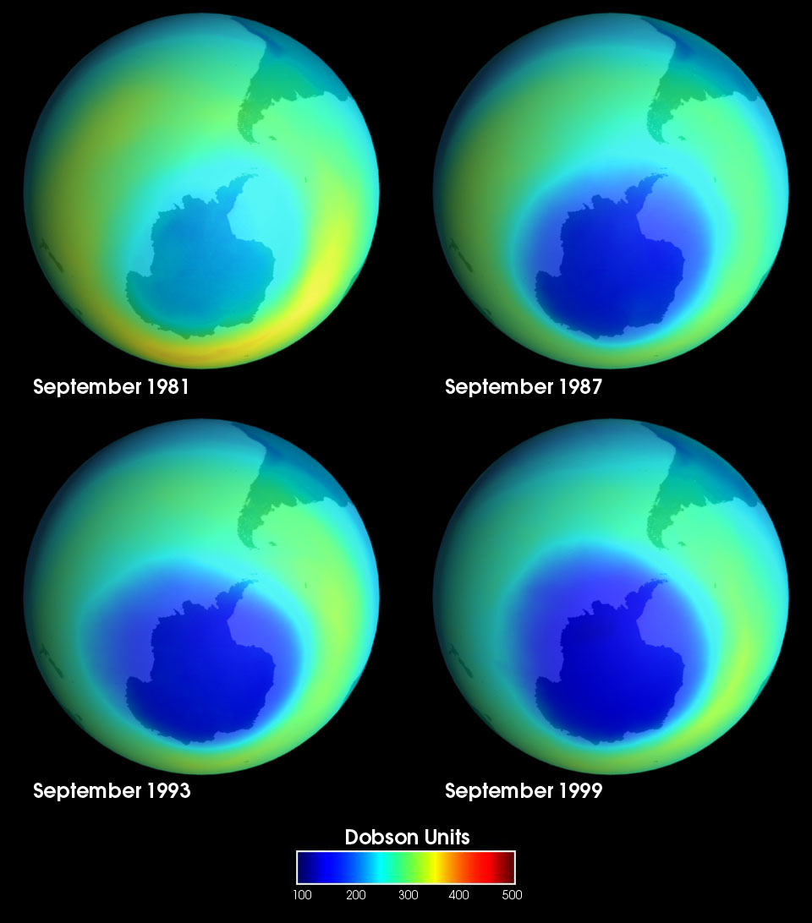

Slide 9
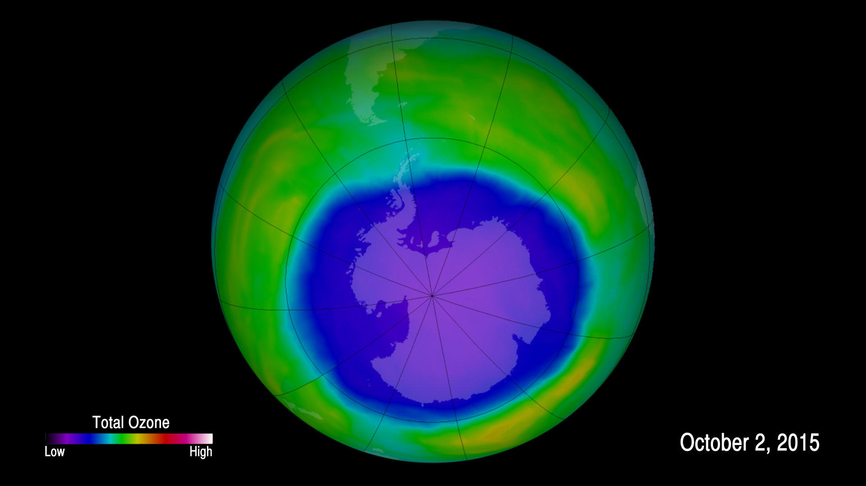

Slide 10
Acid Rain
Pollutants in the air can also combine with water in the atmosphere to create sulfuric and nitric acid
Precipitation then has a low pH
Harmful to plants, soil, aquatic life

Slide 11
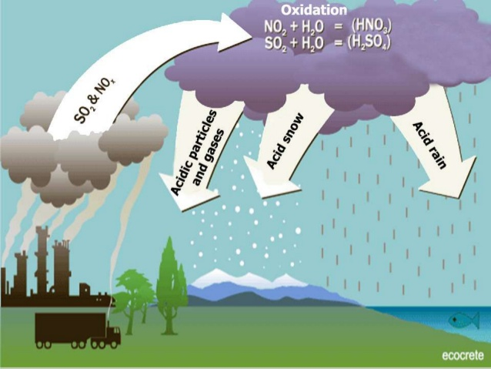

Slide 12
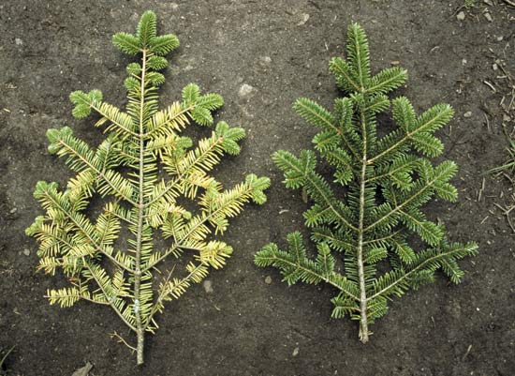

Slide 13
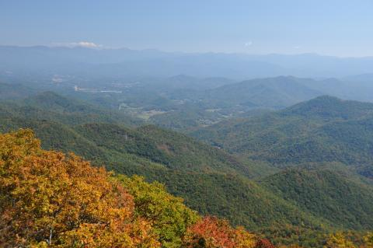
Great Smoky Mountains
Some of the worst air quality in the nation
Air pollution trapped in the valleys away from wind

Slide 14
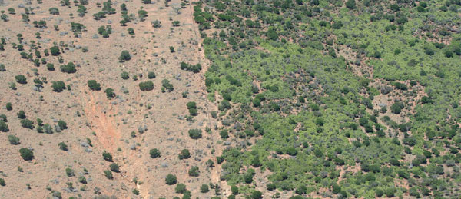
Desertification
Overgrazing and development of grasslands next to deserts turns the land into desert.
Agriculture output decreases, loss of biodiversity

Slide 15
Deforestation
Cutting down forests to develop the land for agriculture.
Slash-and-burn in tropical rainforests = CO2 emissions
Soil erosion, loss of nutrients in soil, flooding, weather changes, loss of biodiversity

Slide 16
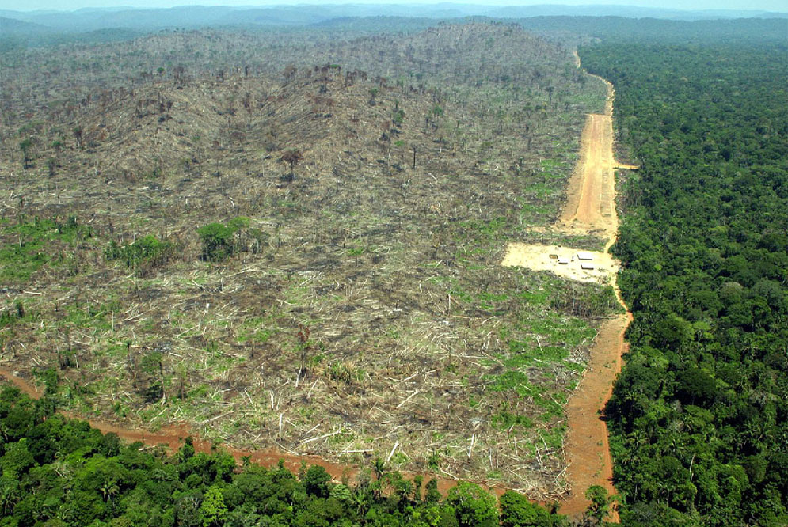

Slide 17
NC Beach Erosion
The wearing/washing away of beach or dune sediments by wave action.
Natural phenomenon
Occurs gradually

Slide 18
NC Beach Erosion
Human interference and global warming increase the effects.
Development too close to beaches, increased storm severity and other climate changes

Slide 19
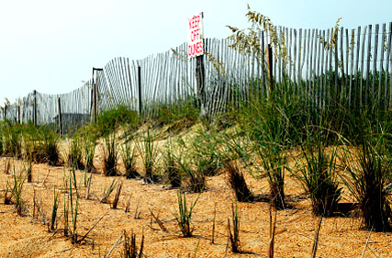

Slide 20
Algal Blooms
Fertilizer contains nutrients such as phosphates and nitrates
Essential for plant growth
Over use of fertilizer or poor irrigation systems causes run-off

Slide 21
Algal Blooms
Algae population increases
Respiration depletes oxygen
Dead algae feed bacteria
Increased bacteria = more O2 depletion
Lack of O2 in water kills aquatic life

Slide 22
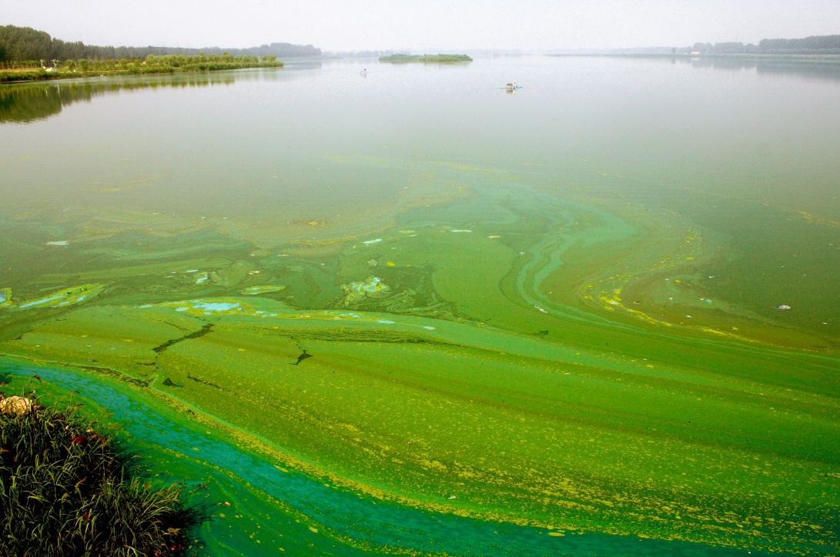
Algal Blooms
The process of nutrient enrichment and subsequent increase in biomass in lakes is eutrophication

Slide 23
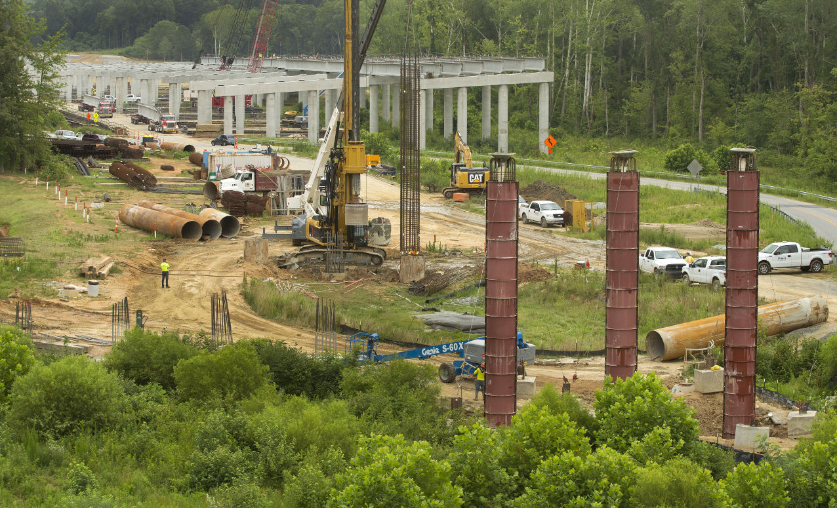
Urban Development
Development of Piedmont Triad is leading to increased run off and loss of habitat

Slide 24
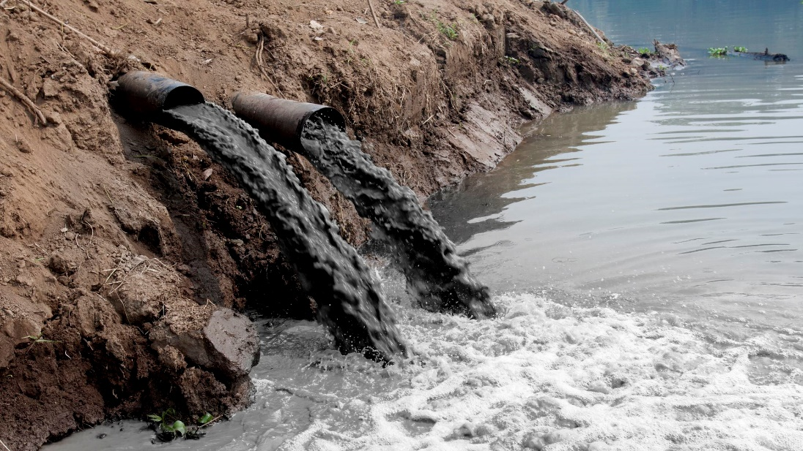
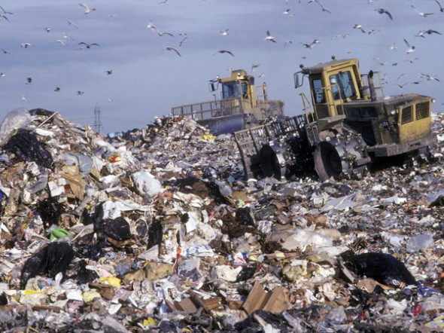
Water & Soil Pollution
Waste that is improperly disposed of usually ends up in water sources or accumulates in the soil

Slide 25
Water & Soil Pollution
Pesticides and other chemicals, solid garbage, industrial waste, etc.

Slide 26
Water & Soil Pollution
Toxins can build up in food chains and harm wildlife and humans through bioaccumulation
Waste lagoons on hog farms can overflow polluting surrounding habitats

Slide 27
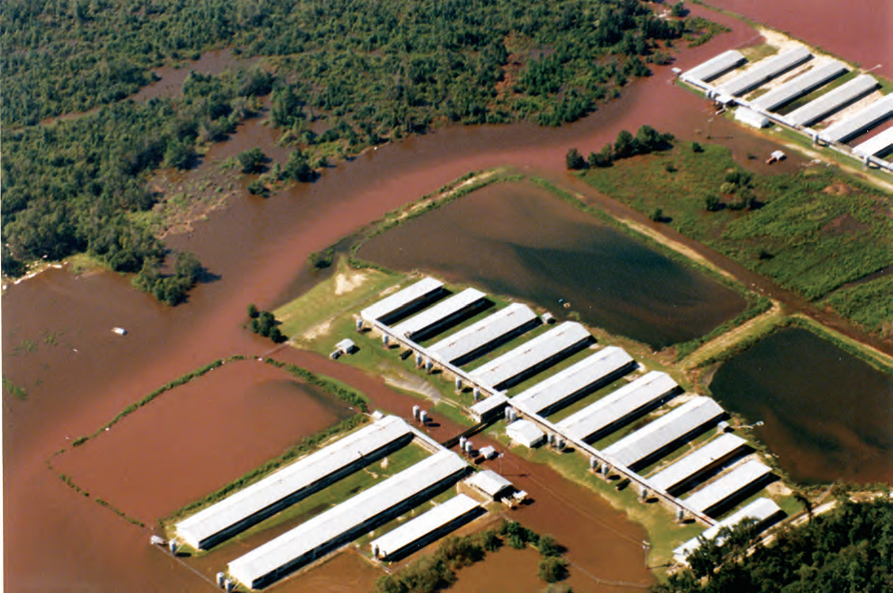

Slide 28
Invasive Species
Sometimes new species are introduced by humans to new ecosystems.
Kudzu was first introduced as an ornamental shade plant, then rebranded as a way for farmers to prevent soil erosion.

Slide 29
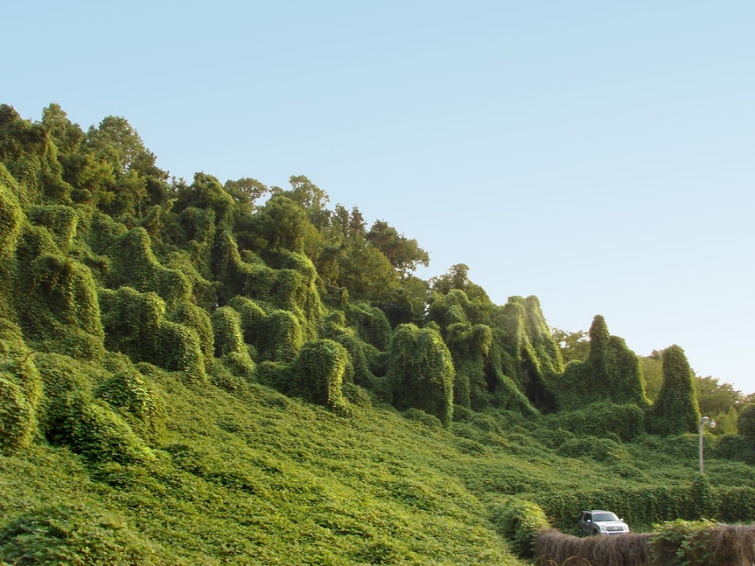
Invasive Species
Kudzu is extremely aggressive – kills native plants through heavy shading.

