Slide 1
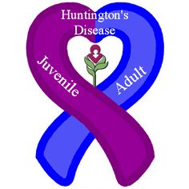
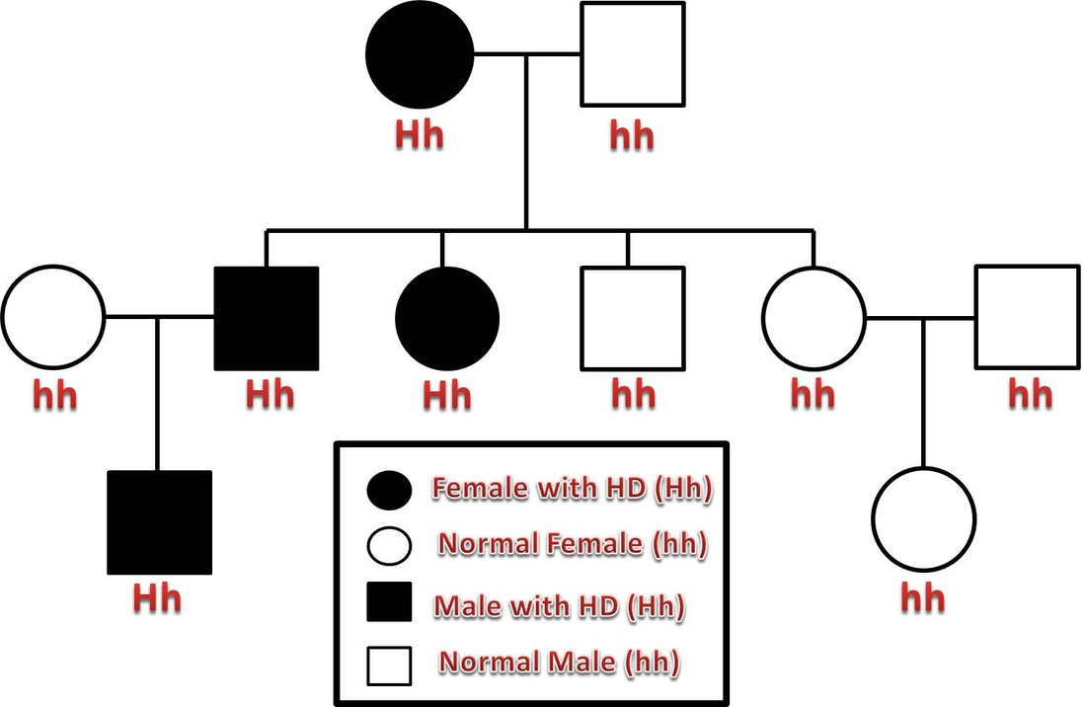
Huntington’s Disease
Brett McCraw

Slide 2
Discovery
Huntington’s was first recognized as an inherited disease in 1872 by the 22 year old George Huntington.
It became known as Huntington’s Chorea (quick movements in Greek)
Scientists discovered the specific gene in 1993

Slide 3
Frequency
Huntington’s usually appears in a victim in their 30s or 40s
It is most common in people of European ancestry and very uncommon to Asian and African people
Affects both genders
In North America, 7 out of 100,000 people are affected per year

Slide 4
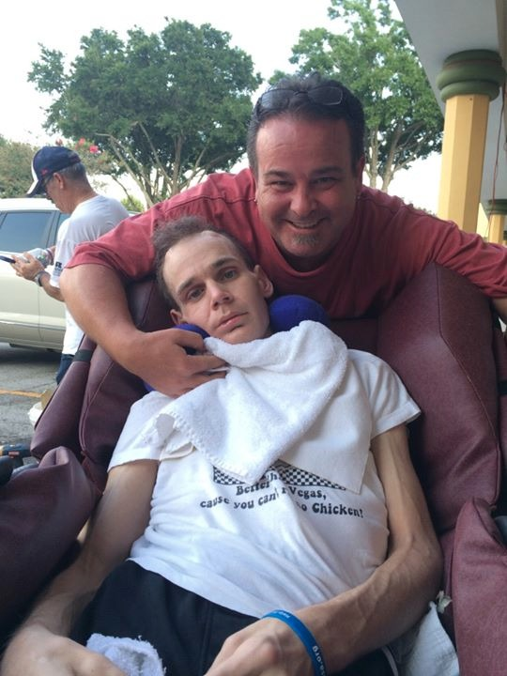
What is Huntington’s
Huntington’s disease is a progressive brain disorder that causes uncontrolled movements, emotional problems, and loss of cognition due to the degeneration of brain cells.

Slide 5
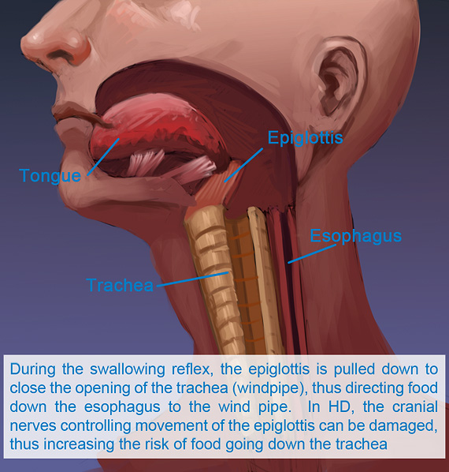
Signs
Muscle rigidity or contracture
Difficulty organizing, focusing, or prioritizing
Irritability
Lack of awareness of behavior
Fatigue or loss of energy

Slide 6
Symptoms
Movement
Involuntary jerking or writhing
Slow or abnormal eye movements
Impaired gait, posture, or balance
Difficulty speaking and swallowing
Cognitive
Lack of flexibility in tasks
Lack of impulse control
Slow in finding words
Difficulty learning
Psychiatric
DEPRESSION>Suicidal thoughts
Withdrawal
Insomnia
OCD, Mania, Bipolar disorder

Slide 7
Prognosis
Huntington’s is incurable
Time of death ranges from 10 to 30 years after symptoms first occur, but depends on the level of medication being received to slow symptoms and environmental factors.
Cause of death is usually heart failure, pneumonia, or complication with symptoms such as the inability to swallow.

Slide 8
Inheritance
The mutated Huntington’s gene is a dominant gene on the autosomal chromosome number 4. This means that you only need one mutated allele to be affected.
HTT gene- instructions for making a protein called huntingtin. It contains a DNA segment called CAG trinucleotide repeat. A normal amount of repeats is 10 to 35 times.
The altered HTT gene increases the size of CAG trinucleotide repeats, which is called anticipation (40 to 50 repeats). This makes Huntington’s a duplication mutation type.
If a parent with one defective Huntington’s gene has children, the child has a 50% chance of inheritance. If they have two, then it is inevitable that the child will have Huntington’s.

Slide 9
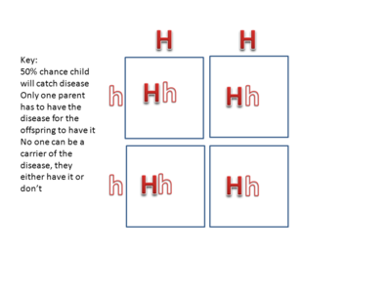

Slide 10
Treatment
No treatments alter the course of Huntington’s, but they can lessen the symptoms.
Tetrabenazine- suppresses involuntary jerking and writhing
Antidepressants
Mood-Stabilizing drugs- helps prevent bipolar outbursts
Speech therapy- helps with clear speech or other ways of communication
Physical therapy- can enhance strength, flexibility, balance, and coordination
NO CURE

Slide 11
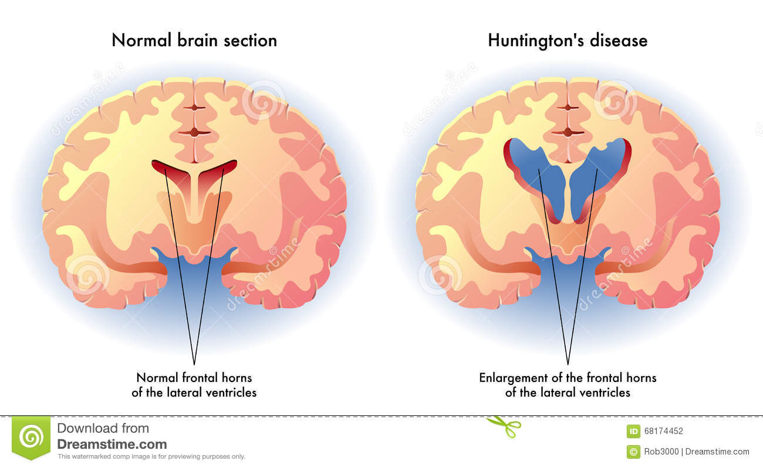
Prevention
Genetic testing or Family planning give options to prevent having offspring with Huntington’s
Vitro fertilization- the embryos are tested in a lab and negative ones are placed back in uterus
Donor sperm/egg
Predictive testing- personal and prenatal
Brain imaging and function (MRI)
There is no way to prevent yourself from getting Huntington’s if you have it in your genetic code, but there are ways to prevent you from passing the terrible disease down to your children.

Slide 12
Citations
Huntington's New South Wales. (n.d.). Retrieved November 14, 2016, from http://www.huntingtonsnsw.org.au/information/hd-facts/history
Huntington's disease. (n.d.). Retrieved November 14, 2016, from http://www.mayoclinic.org/diseases-conditions/huntingtons-disease/basics/symptoms/CON-20030685
Huntington disease | Genetic and Rare Diseases Information Center(GARD) – an NCATS Program. (n.d.). Retrieved November 14, 2016, from https://rarediseases.info.nih.gov/diseases/6677/huntington-disease/cases/53692

